Slide 1
Year 9 OED - Campfires
Used in conjunction with student worksheet
All students must complete this work booklet prior to undertaking campfire building.

Slide 2
The Problem
Fire Danger – Mute sound
Identify: What were errors that led to these situations?

Slide 3
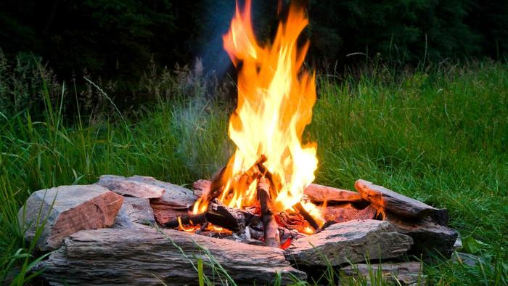

The Purpose
Discuss: What are the uses for fire when camping or hiking?
Light
Warmth
Location
Cooking
Water purification
Protection
Fires used solely for cooking should only be small. Why do you think this is so?

Slide 4
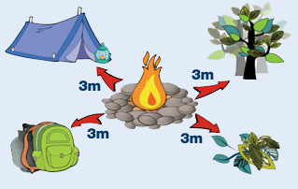
The Process
Selection of fire site:
Clearance of the site must be to bare, level earth.
There must be clearance above, with no overhanging branches. You must be able to see the sky.
There must be 3 metres clearance to tents, trees etc...
Surround fire pit with stones or similar non-flammable barrier.
Prepare one 5 litre bucket of water per fire which is to be kept within 3 meters of the fire.

Slide 5
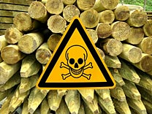
Wood
Collected wood is to be kept in an organised pile a minimum of 3 meters away from the fire.
Standing dead wood is the driest. Wood from a ridge is drier than gullies.
Always keep some wood under cover if possible.
If wood is damp, strip off the outer layers.
In non-wooden areas, utilize grasses, bushes or animal dung
Never use green treated pine logs as these release poisonous gas when burning.
Never use uncontrollable fuels like large bunches of leaves.

Slide 6
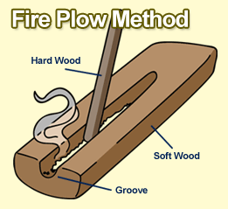

Fire Starters
What are 5 methods of fire starting?
cigarette lighter
magnifying glass
friction
flint and steel
Why do you think a fire should be lit on the upwind side of the fire?

Slide 7
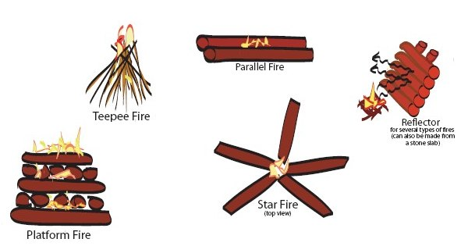

Fire Structures
The fire needs oxygen in order to burn efficiently.
Therefore, the structure must be built to allow for a consistent flow of air.
What might be the purpose of a reflector?

Slide 8
Never Fail Campfire Building
Draw and annotate three types of wood required to build a campfire.

Slide 9
The Place
The orange tree is OFFLIMITS unless your teacher gives you direct permission to have one.
No one is to climb onto the mulch pile or the trees.
Do not stand on the access road.
Leaving the marked area is only to occur under the direct instruction of your teacher.

Slide 10

The Prevention
Everyone is to wear shoes, socks and long pants.
All long hair is required to have it tied back away from the face.
Everyone is to ensure that clothing is not hanging loose.
EVERYONE IS RESPONSIBLE FOR BEING AWARE OF THEIR OWN SAFETY AND THE SAFETY OF OTHERS. NO EXCUSES.
Turia Pitt
Was competing in an ultramarathon when she was caught in a bushfire along with many others.
She suffered burns to 65% of her body.
An inquiry by the Australian Government criticised the organisers of the race for negligence and incompetence.

Slide 11

The Protocol
Camp Master – One person per group is to be solely responsible for handling the campfire. This person will rotate every lesson. They are never to leave the fire from lighting to putting out.
Their job is the construction, lighting, adding of fuel, and putting out of the fire.
Gophers – All other members of the group are responsible for the manual labour including:
  Clearing the campsite
  Collecting fuel
  Arranging buckets of water
  Cooking their own food

Slide 12
The Putting Out
It is optimal that the fire be allowed to burn out so only enough fuel should be added to fit the time required. No fuel should be added to the campfire in the final ten minutes of class time/camp time.
A normal fire will need multiple buckets of water before it is completely out and safe to leave unattended.
Using a long, thick stick, the fire should be carefully spread around inside the fire-pit circle.
After this the first bucket of water should be poured over the fire.
CAUTION: When the first bucket of water is poured on the fire it is possible that a lot of very hot steam could rise up. As such, the water should be poured slowly, from upwind and with the face and head not directly above.
After adding the first bucket of water, use the large stick to mix the coals with the water. Use the stick to carefully break any large pieces of coal to observe if there is still evident heat energy inside. Upon inspection, the decision needs to be made whether to add another bucket of water.
Once the fire is considered to be out, the teacher must be summoned to confirm that it has been dealt with appropriately. Once the teacher confirms that the fire has ceased to be burning, the students may leave the fire pit.

Slide 13

The Picking Up
All fuel stores should be tidied up neatly out of the way.
Buckets should be completely emptied of water and stacked.
Aluminium foil, wrappers, cooking sticks should be picked up and disposed of in an appropriate method via a rubbish bag.

