Slide 1
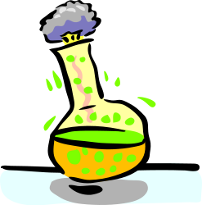
Year 8: Chemical vs. Physical Changes

Slide 2
Have you ever wondered . . .
Where sugar goes when it is dissolves in water?
Why you feel hot after exercise?
Why iron rusts but
aluminium doesn’t?

Slide 3
Pre-Quiz
Pg 2 Student Booklet (5 minutes)

Slide 4
What are the 3 states of matter?
What is a change of state in science?
  Moving from WA to NSW.
  A solid, liquid or gas.
  A substance changing from a solid to a liquid.
  The atom hydrogen.
2. What is contraction?
3. How come, when your mum cooks a meal, the smell carries throughout the house?

Slide 5

4. What is produced when a nail rusts?
  Oxygen and Carbon Dioxide
  Iron and water
  Brownification
  Iron Oxide
5. Why does ice float?
  It has less density than water.
  It gets so cold that it tries to stay closer to the warm sun.
  It’s so cold that it pushes the warmth away forcing it upwards.
6. What is a chemical reaction?

Slide 6
What is Physical Change?

Slide 7
Physical Change
If no new substance has been formed during a change, then it must have been Physical Change.
Because no new substance has been formed, then the change is very likely to be reversible.
Demonstration: (Bunsen burner, ice cube)

Slide 8
The 3 Main States of Matter:
Solid
Liquid
Gas
Twig Video

Slide 9
Draw what water (H2O) would look like in each state, below label what we call them.

Slide 10
Identifying Physical Change:

Slide 11
1. Change of Shape or Form
  A force is applied to break, bend, stretch, crush and twist objects.
  There is no new substance formed.
  Draw an example using a tin can:
Before | After

Slide 12

2. Expansion and Contraction
Demonstration: (Thermometer, Bunsen burner, Water)
  Occurs when the temperature either increases or decreases.
  There is no new substance formed.
  Solids, liquids and gasses expand when they are heated up and take up more space.
  Solids, liquids and gasses contract when they are cooled and take up less space.

Slide 13
Questions: Use the table below to give an example of expansion and contraction of air (a gas) USING PARTICLES.
    Which one will be higher from the ground? _______________________
    Which balloon would have hotter air? _______________________
Hot air balloon with contracted air | Hot air balloon with expanded air.

Slide 14
Changing between States
If a state of matter increases a lot in temperature it will change it’s state.
If a state of matter decreases a lot in temperature it will change it’s state.

Slide 15

Melting and Freezing
Melting – Solid to a liquid
Freezing/Solidification – Liquid to a solid
Draw a picture using particles to show a liquid freezing and forming a solid.

Slide 16
Evaporation and Condensation
Evaporation – Liquid to a gas
Condensation – Gas to a liquid
Draw a picture using particles to show a liquid evaporating from a hot kettle.
Before Evaporation | During Evaporation

Slide 17
Sublimation and Deposition
Sublimation – Solid to a gas
Deposition – Gas to a solid
Demonstration: Dry ice

Slide 18
Mixing and Separation
Mixing – When two states of matter are together but remain individual.
Separation – When two states of matter are removed from being together.

Slide 19
M&M Demonstration
Dissolving is when a solid is mixed with a liquid forming a solution. The solid often disappears as it spreads evenly throughout the solution.
A good example of this in everyday life is salt water. If we were to boil the water away, there would be salt left behind.
It’s important to remember that the solute and solvent are not forming a new substance. They are just mixed together, just like the M&Ms.
Solute – is the solid.
Solvent – is the liquid.

Slide 20
Identifying Chemical Change

Slide 21
Identifying Chemical Change Practicum
Reaction Number | Reaction | Observation
1 | HCl + Blue Litmus
2 | HCl + Magnesium
3 | HCl + Silver Nitrate
4 | HCl + Sodium Hydroxide

Slide 22
Types of New Substances

Slide 23
Seeing a new solid (Precipitate)
A permanent change in colour
Burning a match or toast.
Metal rusting.
Smelling gas/Seeing bubbles
Rotten Eggs – Hydrogen Sulphide
Soft Drink – Carbon Dioxide
Two liquids form a solid.
Example: Kidney Stone
Heat or Light produced
Exothermic – Gives off energy in the form of heat or light.
Endothermic – Absorbs heat energy.

Slide 24
Explaining Physical changes using the Particle Theory
Complete the CLOZE Worksheet in your booklet

Slide 25
End of Identifying Chemical Change

Slide 26
Density
#1-3

Slide 27
What is density?
Density is a comparison of how much matter there is in a certain amount of space.
http://www.youtube.com/watch?v=tfgm2k-dHiI

Slide 28
Which one is more dense?
Demonstration: People in a square
How about this: Which square is more dense?

Slide 29
Which one is more dense?
Now which one is more dense?

Slide 30
Mass & Volume
Mass = how much matter is in a substance, it is the same wherever you are – measured using a balance beam or electronic balance.
Weight is how hard gravity is pulling on that object.
Volume is the amount of space a substance takes up.

Slide 31
What is density?
Density = mass
volume
Units for density: g .
cm³
Why are these the units for density?
Density measures how many grams of matter are in a cubic centimeter of material
ALWAYS REMEMBER UNITS!

Slide 32
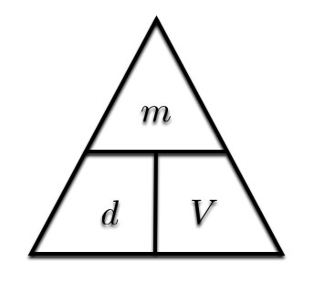
Mass, Density and Volume Formula

Slide 33
Let’s try a density problem together
Frank has a paper clip. It has a mass of 9g and a volume of 3cm³. What is its density?
Frank also has an eraser. It has a mass of 3g, and a volume of 1cm³. What is its density?

Slide 34
Work on these problems with your neighbor.
Jack has a rock. The rock has a mass of 6g and a volume of 3cm³. What is the density of the rock?
Jill has a gel pen. The gel pen has a mass of 8g and a volume of 2cm³. What is the density of the rock?

Slide 35
Now, try these on your own.
Al’Licia has a watch. It has a mass of 4g and a volume of 2cm³. What is the density of the watch?
Mia has a wallet. It has a mass of 15g and a volume of 5cm³. What is the density of the wallet?

Slide 36
Liquid Layers
If you pour together liquids that don’t mix and have different densities, they will form liquid layers.
The liquid with the highest density will be on the bottom.
The liquid with the lowest density will be on the top.

Slide 37
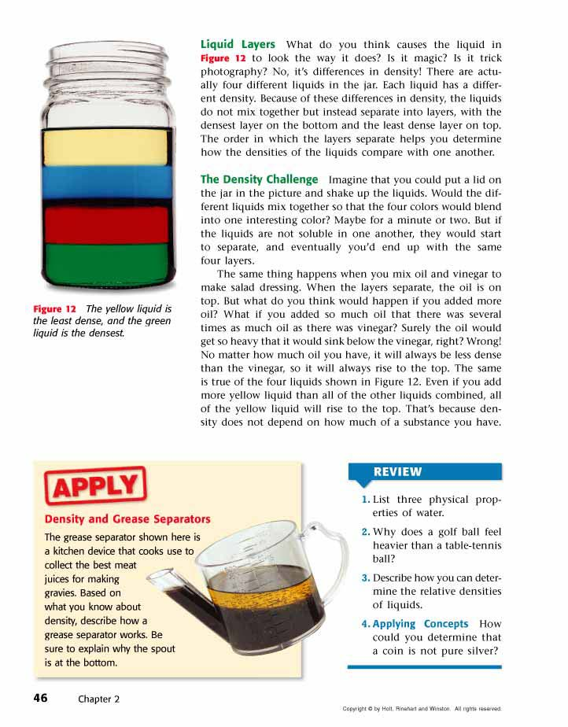
Liquid Layers
Check out this picture from your book. Which layer has the highest density?
Which layer has the lowest density?
Imagine that the liquids have the following densities:
  10g/cm³. 3g/cm³.
  6g/cm³. 5g/cm³.
Which number would go with which layer?

Slide 38
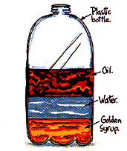
Liquid Layers – Try with your neighbor
Which liquid has the highest density?
Which liquid has the lowest density?
Which liquid has the middle density?

Slide 39
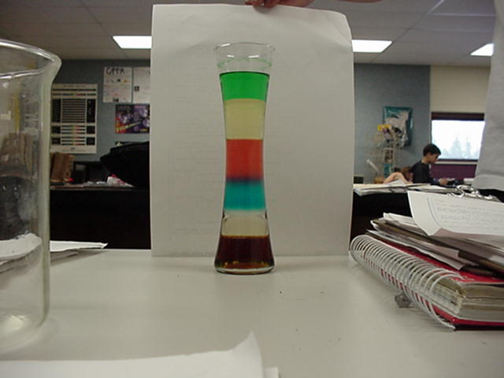
Liquid Layers – Try on your own!
Imagine that the liquids on the right have the following densities:
  15g/cm³ 10g/cm³
  3g/cm³ 9g/cm³
  7g/cm³ 12g/cm³
Match the colors to the correct densities.
3g/cm³
7g/cm³
9g/cm³
10g/cm³
12g/cm³
15g/cm³

Slide 40
Review
What is the formula for density?
What happens if you pour together liquids that have different densities?
Will the liquid on the top have the highest or lowest density?
Will the liquid on the bottom have the highest or lowest density?

Slide 41
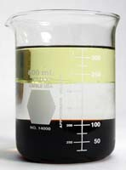
LIQUIDS
The more dissolved solids in a solution, the more dense (such as ocean water)
Cold water in lakes tend to sink (this creates a constant mixing of water, nutrients, and other substances)
      Kinetic energy again!!
Denser layers to less dense layers…..
Notes:
Straw solute

Slide 42
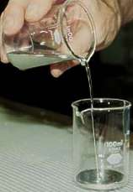
What would happen????
Mercury density = 13600kg/m³
Lead density = 11340kg/m³
Notes:
Sinking vial - make it float

Slide 43
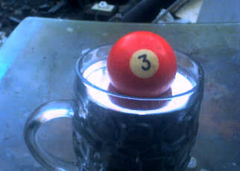
Lead floats on liquid mercury!

Slide 44
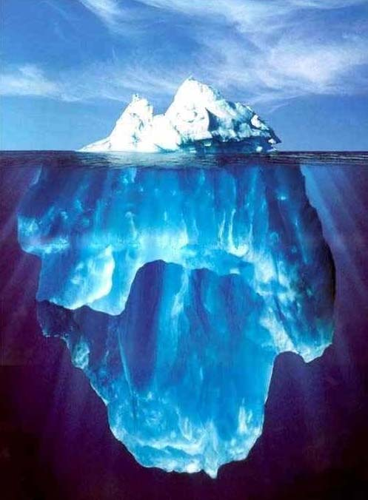
Solids
Ice vs. water…..

Slide 45
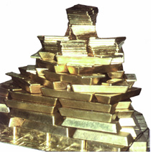
SOLIDS
Ice is less dense than water (which is why lakes and ponds have a thin layer of ice covering in winter, with water underneath)
Various rocks, woods, metals have a characteristic density specific to that substance
Wouldn’t you like to have a bunch of THIS dense material?
Notes:
Beans/ping pong ball; Big jug of water in a pool

Slide 46
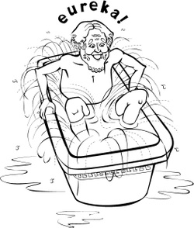

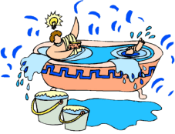
Archimedes and the Kings Crown
http://3quarksdaily.blogs.com/3quarksdaily/images/2007/07/18/archimedes.jpg
Notes:
250 b.c., the Greek mathematician Archimedes - story

Slide 47
Super Scientist Question of the Day
Jake has a book, a ruler, and a balance.
How can Jake find the density of the book with the tools he has?

