Slide 1
Volcanic eruptions
Pompeii: The Last Day (BBC)
Notes:
Youtube Video: Pompeii the Last Day (BBC) 37:41 Start - https://youtu.be/PlZ-SGfp6Os?t=37m41s

Slide 2
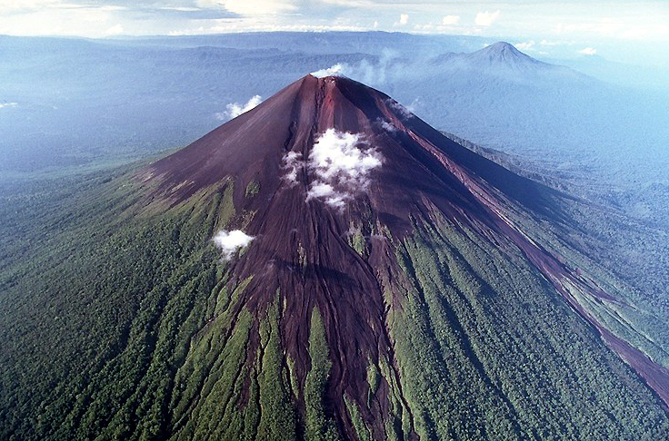
Volcanic eruptions
Volcanoes emit:
Gas
water vapour
hydrogen sulphide
Ash
fine rock particles that rise to 50 – 80
km in the air at speeds of 200 km/h
Lava
molten rock
Scoria
Lumps of solid volcanic rock
Pyroclastic flow - This is when the cloud of ash, rock and gas at 500°C rushes down the volcano like an avalanche at over 100 KPH.
This heat is what killed the people of Pompeii almost instantly.

Slide 3
Where they form
Mostly near the edge of tectonic plates.

Slide 4
Where they form
Mostly near the edge of tectonic plates.
Volcanoes form:
Where there are weak spots in the Earth’s crust
Where magma has accumulated below the weak spots.
This magma is occasionally pushed upwards under great pressure into the volcano.

Slide 5
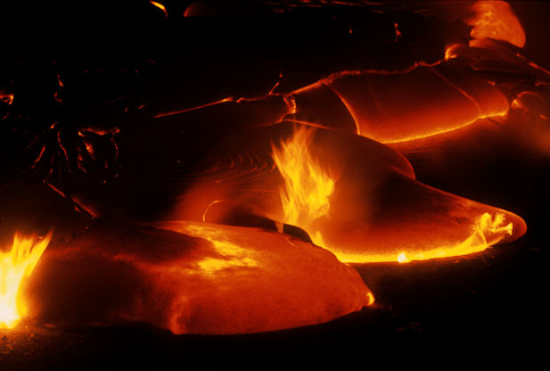
Heat of rock
Interesting Points:
The magma reaches the surface, and is now known as lava.
It erupts white hot at a temperature of over 1200°C.
The lava changes colour as it cools:
From white → yellow → orange → red → black

Slide 6
Unique Volcano’s
Hotspots

Slide 7
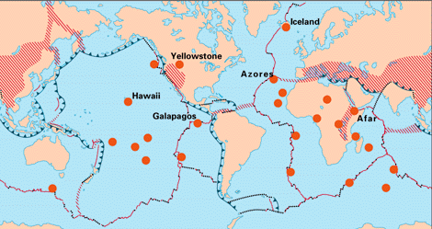
Hotspot Volcanos
Volcanos that form away from the edges of tectonic plates.
Question? What might cause a volcano to form away from tectonic plates?
Notes:
What is a Volcanic Hotspot: https://www.youtube.com/watch?v=AhSaE0omw9o

Slide 8
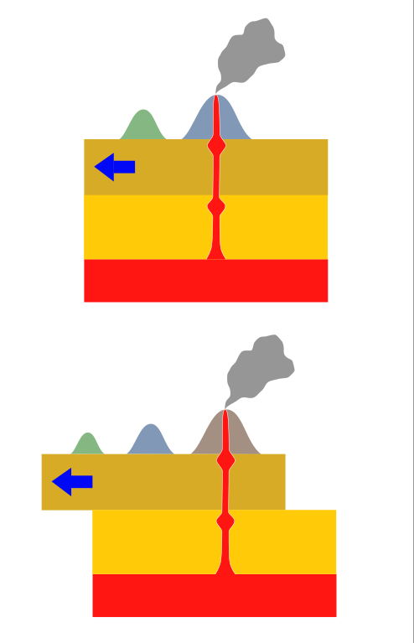
Hotspot Volcanos
Caused in isolated places where a high heat column forces it’s way through cracks in the earths crust.
The plate moves, but the hotspot stays in the same place.
This forms island chains in the ocean. (ie. Hawaii)
Video: What is a Volcanic Hotspot?
Notes:
What is a Volcanic Hotspot: https://www.youtube.com/watch?v=AhSaE0omw9o

Slide 9
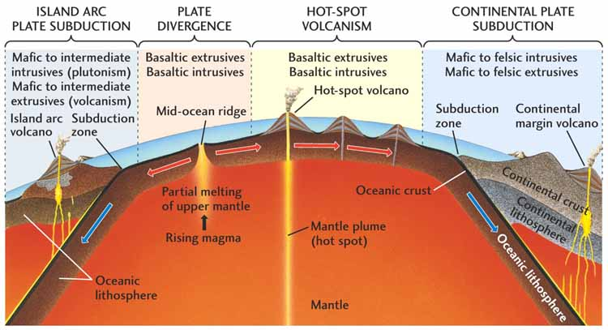

Slide 10
Explosion Effects

Slide 11
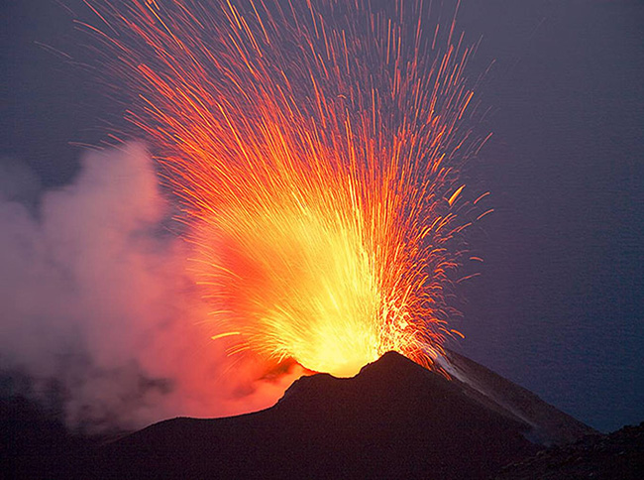
Large Explosions
Have a more viscous magma (flowing very slowly)
Contain a lot of water and gas
“The thicker magma doesn’t allow gas bubbles to escape so they keep building up until there is so much pressure they explode upward taking the magma with them.”

Slide 12
Scoria - is usually thrown out like volcanic bombs
Ash clouds - are released, rising at over 200 km/h for 50-80km
Pyroclastic flows - can occur (ash, rock and gas at 500 degrees Celsius flow down the mountain at over 100 km/h.

Slide 13
End

Slide 14
Ring of Fire
Notes:
Youtube Video: Ring of Fire – Abbreviated Frank Gregorio -https://www.youtube.com/watch?v=uw7Uq137YJQ

