Slide 1
Ultimate Frisbee
Year 9OED

Slide 2
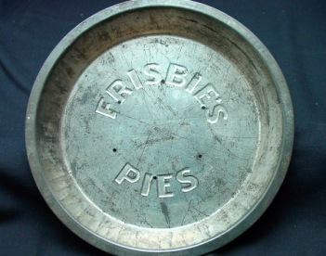
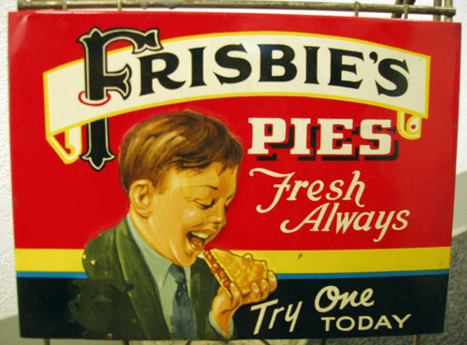
History of Disc
The flying disc was ‘invented’ by Yale University (USA) undergraduates.
The Yale campus was in close proximity to the Connecticut Frisbie Pie Company who sold their popular pies in metal tins; which when thrown would fly for a short distance.

Slide 3
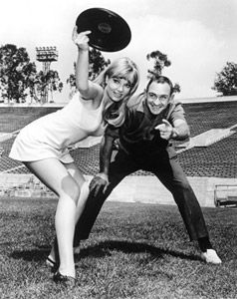
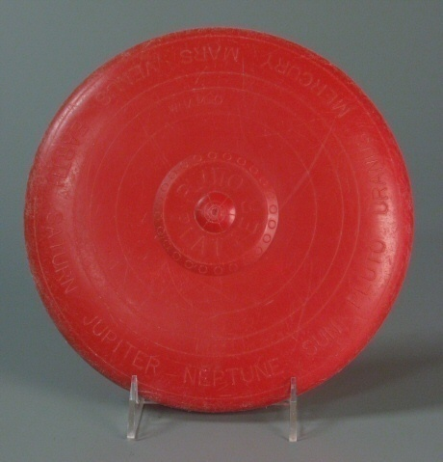
The first plastic disc was developed by Fred Morrison in 1948 which led to a mass produced disc from the ‘Wham-O’ Toy Company known as the “Pluto Platter”.
A year after the Frisbie Pie company closed in 1958, Wham-O registered the name “Frisbee” to market their flying discs.

Slide 4
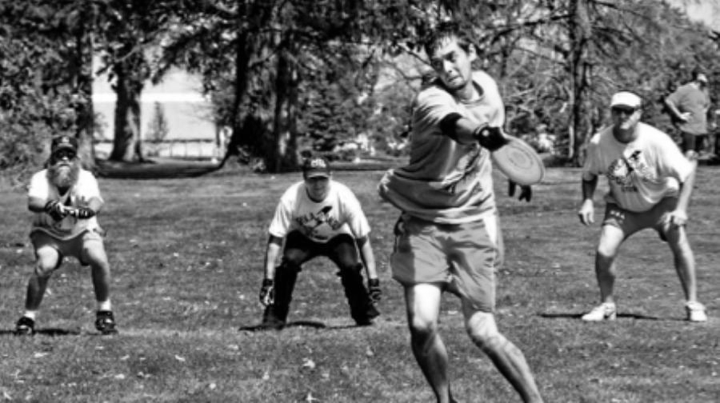
History of the Game
The first flying disc game was in 1954 called ‘Guts’.
The game basically consists of two teams who throw a Frisbee at each other.
You will get to have one lesson trying out this game.

Slide 5
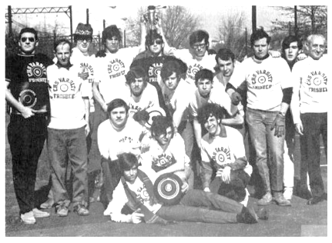
In 1968, Joel Silver introduced the idea of Ultimate Frisbee to the Columbia High School in New Jersey.
The game was first played between groups of students, then inter-school, then at the college level and finally in 1975, the first organised tournament which was held at Yale University.
In 1983 the First World Ultimate Championship was held in Sweden.

Slide 6
Student Tasks
Explore the rules for ‘Guts’.
Go to the Weebly link and read the article - http://www.wfdf.org/sports/guts
Go to Weebly and watch - https://www.youtube.com/watch?v=vjGeThnzvgE
Explore the rules for ‘Ultimate Frisbee’.
Go to Weebly link and read the article - http://www.usaultimate.org/assets/1/Page/USAU_Resource_Guide_P4-Ult_in_10_Simple_Rules_08-09-10.pdf
Go to Weebly and watch - https://www.youtube.com/watch?v=UnNUEvs2Ev0

Slide 7
Kahoot Formative Assessment
https://play.kahoot.it/#/k/797dca4e-634f-4a12-bf51-83d772389d2b

