Slide 1
The effect of exercise on the body

Slide 2
This week…
You will be completing an investigation on:
the effect of exercise on the heart rate
Today you will design your investigation
Tomorrow you will carry out your investigation
Review results and determine if the hypothesis is correct

Slide 3
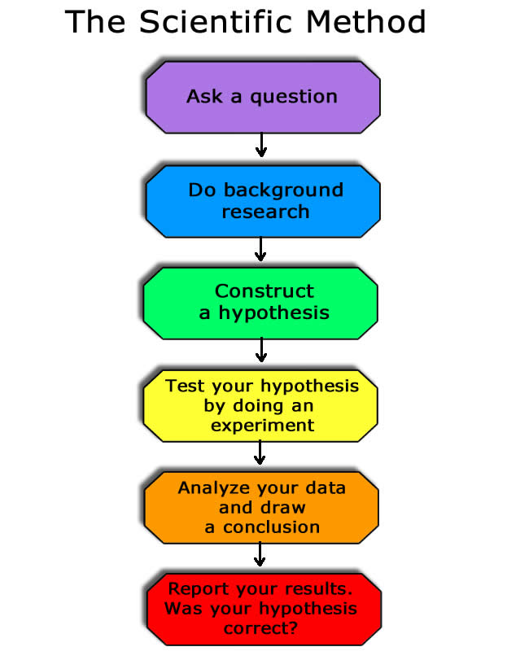

Slide 4
Todays task
Planning your investigation:
we will determine if exercise has an effect on our heart rate by preforming an exercise and observing the effects on heart rate

Slide 5
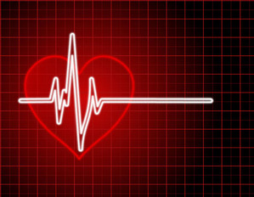
What is a pulse?
Your heart rate
The surge of blood that is pushed through the arteries when the heart beats
The pulse rate is how many times one can feel a pulse every minute
The pulse rate is a vital sign that can tell a lot about a victim's medical condition

Slide 6
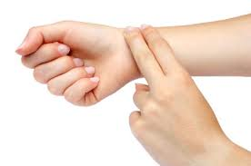
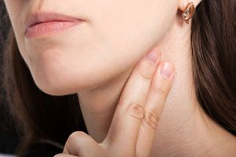
Where is it?
Common places to feel a pulse include:
wrist
neck
temple
behind the knees
on top of the foot

Slide 7
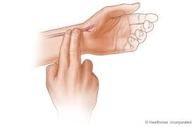
Pulse
To feel the pulse in the wrist:
place your index and middle finger over the underside of your opposite wrist, below the base of the thumb
press firmly with flat fingers until you feel the pulse
Can you find it?
What is your heart rate?

Slide 8
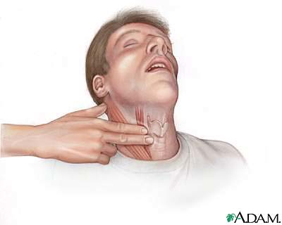
Pulse
To feel the pulse on the neck:
place your index and middle finger just to the side of your Adam's apple, in the soft hollow area
press firmly until a pulse is felt
Can you find it?
Why would you not want to use
your thumb to check your pulse?

Slide 9
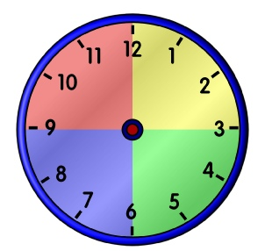
Pulse
You can get an approximate pulse by counting for 30 seconds and multiplying by 2
The bad thing about approximations is that they become less and less accurate as you count for shorter and shorter times
In this investigation check your pulse for a whole 60 seconds

Slide 10
What can your pulse tell you?
A fast resting pulse can mean that you are dehydrated or have an infection
A slow resting pulse can mean that your heart is very strong and healthy
How quickly your heart rate returns to normal after exercise gives information about your fitness

Slide 11
Groups
In groups of 3-4
Complete planning worksheet
We will review the planning worksheets towards the end of the lesson

Slide 12
Title: the effect of exercise on heart rate
Aim:
To determine if exercise for a period of time has an effect on an individuals heart rate
Prediction:
Hypothesis:

Slide 13
Variables
Independent variable:
Dependent variable:
Control variable:

Slide 14
Materials
Stop watch

Slide 15
Method
You can choose to:
Jog up and down stairs
Do push ups
Do sit ups
Do star jumps
Jog on the spot
Time spent exercising: 30 sec, 60 sec, 90 sec, 120 sec
How many times will your repeat each trial?

