Slide 1
Investigations
All Natural – False Advertising
Notes:
A short message from the “False Advertising Industry” - https://www.youtube.com/watch?v=AV_Y_bvYmws

Slide 2
Scientific Method

Slide 3
Why we investigate
The goal of conducting a scientific investigation is to:
understand the natural world better
discover solutions to help humanity and the environment.

Slide 4
Before you start …
Prior to starting your own scientific experiment, it is vital that you RESEARCH what is currently known about the topic.
You should make summary notes on the things you learn to help you in your investigation.
Your teacher will provide
you with information to get
you started.

Slide 5
1. Hypothesis
A proposed explanation of why something happens. Often comes from a simple observation.
It needs to be specific.
Includes the dependent and independent terms.
Fits the template “If _________, then ________.”

Slide 6
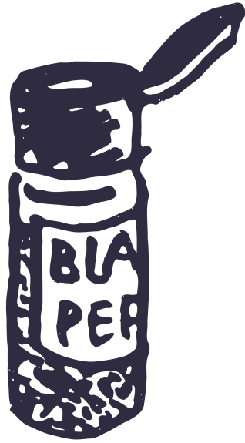
Hypothesis example Part 1:
Observation:
You are sitting at the dinner table and you watch your parents add salt and pepper to their steak.
Your dad loves pepper and so adds a lot more than your mum. Suddenly, your father lets out a huge sneeze and moments later your mum lets out a small sneeze.
Maybe your dad is sick and your mum is coming down too? Maybe there is a cat in the house that they are allergic to? Or maybe, you think, the pepper is the culprit.

Slide 7
Hypothesis example Part 2:
Writing the Hypothesis:
You sit down at your desk and start to write. After a couple of tries you perfect it.
The more stuff you have on your steak the more you sneeze.
The more pepper you put on your steak the louder you sneeze.
The more pepper that goes up your nose the louder you sneeze.

Slide 8
2. Variables
All the factors that will affect the result in some way.
Independent variable – the variable that the scientist is changing.
Independent = I am manipulating
Dependent variable – the variable that the scientist is measuring.
Controlled variables – all the other factors that are being controlled in the experiment.

Slide 9
Variable Example
Independent variable – the variable that the scientist is changing.
The amount of pepper being put up the nose.
Dependent variable – the variable that the scientist is measuring.
The loudness of the sneeze
Controlled variables – all the other factors that are being controlled in the experiment.
The same type of pepper. The nostril that it is being placed in. The amount that the pepper is ground up…

Slide 10
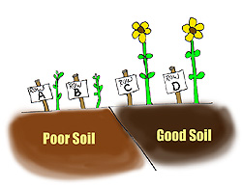
MEMORY TIP!
D – Dependent Variable
R - Responding Variable
Y – Graphed on ‘Y’ axis
M – Manipulated Variable
I – Independent Variable
X – Graphed on the ‘X’ axis
OR
I Can Do Maths Counting Kittens
Independent – Controlled
Dependent – Measured
Controlled – Kept same

Slide 11
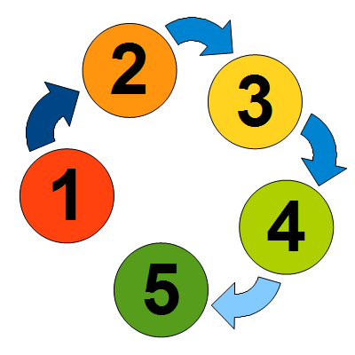
3. Method
How a scientist describes in detail
How they performed the experiment.
The equipment used
The quantities used
How they regulated their controlled variables.
Safety factors
Relevant diagrams

Slide 12
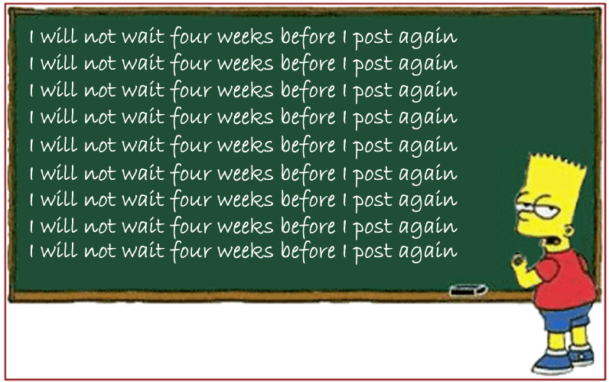
Producing a Reliable method
Repetition – The more times you repeat an entire experiment, the more RELIABLE.
Sample Size – The more subjects tested or used, the more RELIABLE.

Slide 13
Reliable vs Valid
Reliable – same result every time.
Ie. A reliable car starts every time.
To make a test more reliable you do a lot of repetitions of the experiment.
Valid – actually measures what you are wanting to measure
Ie. You use scales to measure your weight, not a thermometer.
To make a test more valid, you make sure the method of testing is correct for the task.

Slide 14
How could you make your test more valid if you initially used the scales below?

Slide 15
4. Results
Are the observations/data from your experiment which you should write down.
Should be what you actually see, NOT what you were hoping to see.
Observation/data is organised into:
Table
Graph

Slide 16
Tables

Slide 17
Table Organisation
Independent variable – goes on the left side
Dependent variable - goes on the right side
Average – this is the data that goes on the graph. The average is calculate by the equation $\frac{Sum of tests}{number of tests}$ which for the test at 25° is $\frac{50+56+56}{3}=54$
Title
Independent Variable Title (Units) | Dependent Variable Title (Units)
 | Test 1 | Test 2 | Test 3 | Average

Slide 18
Table Example
Note: Data below is atrociously unlikely and used for illustration only. You should never put that much pepper up your nose.
The relationship between grams of pepper in nose and sneeze volume
Amount of pepper (grams) | Sneeze Volume (dB)
 | Test 1 | Test 2 | Test 3 | Average
25 | 50 | 56 | 56 | 54
50 | 76 | 77 | 77 | 76.6
75 | 82 | 81 | 80 | 83
100 | 95 | 90 | 95 | 93.3

Slide 19
This is an example of a very good table. What are some things they could improve though?

Slide 20
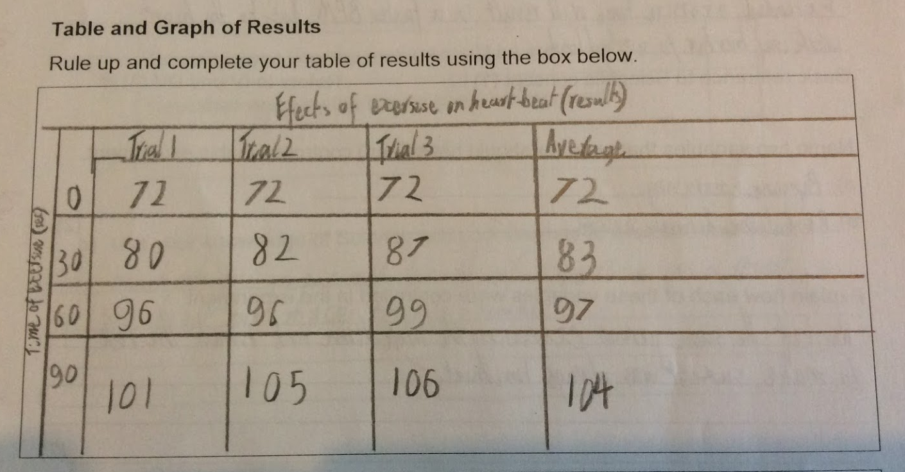
What are the errors in this table?

Slide 21
Graphs

Slide 22
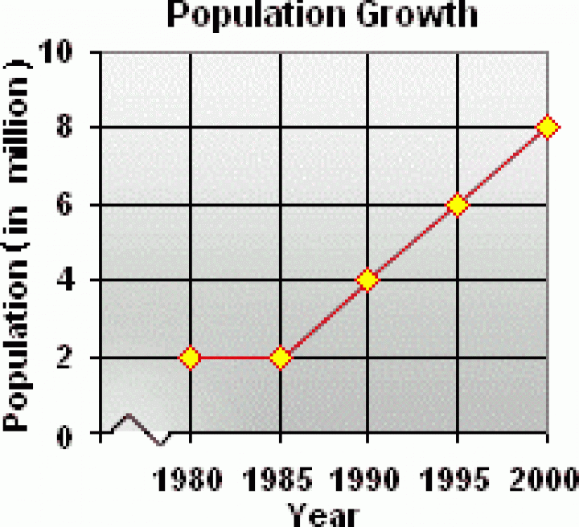
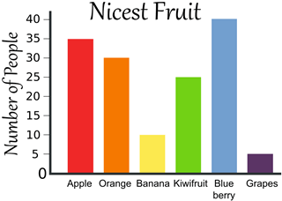
How do we know when to use a line or a bar graph?
Vs

Slide 23
b. Graph Organisation
Note location of variables.
Note how the axis numbers are EVENLY spaced out.
Dots exactly where the data points meet.
Connect the dots with a straight line.
Y axis
X axis

Slide 24
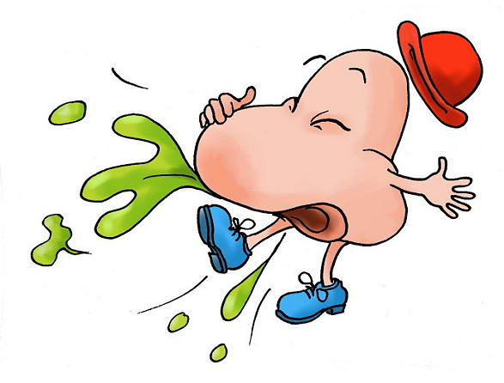
Graph Example

Slide 25
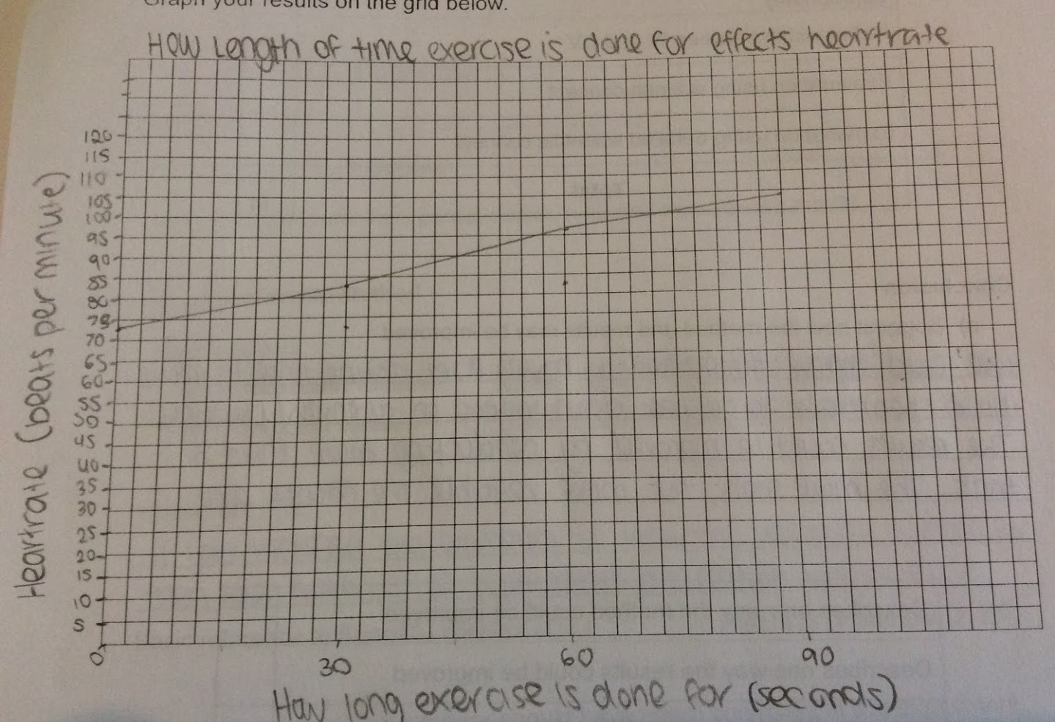
This is an example of a very good graph. What are some things they could improve though?

Slide 26
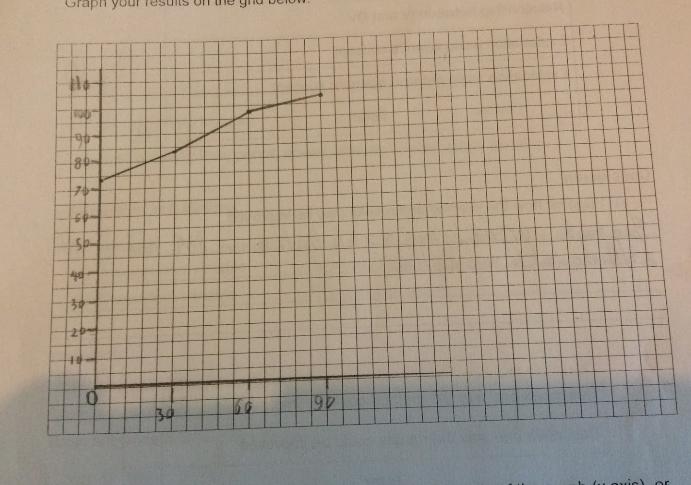
What are the errors in this table?

Slide 27
5. Discussion
Where we discuss the relationship between the data and the hypothesis.
Use words to describe the results
Describe the trend
Explain why that trend happened and refer back to our hypothesis
Relate the trend to the scientific concepts that we researched at the start.

Slide 28
6. Conclusion
Here we analyse the investigation and identify strengths and weaknesses.
We then consider how we can test again but with more refinement.
A new hypothesis
Suggestions

Slide 29
Fair Go - Ribena
Video can be a bit glitchy but it is the only original that I can find.
Notes:
Daily Motion – Fair Go: Ribena – a matter of juice

