Slide 1
Philosophy – Introduction
Resources: www.logicallyfallacious.com

Slide 2
Why is truth important?
Because ideas have consequences- propositional truth is more lasting than physical actions
Because if you are a Christian or non-Christian, you will encounter people who argue about truth
(If you find philosophy boring, sorry)
Socrates
Plato
Aristotle
Alexander the Great
Notes:
Ideas have consequences. Many will have heard of either Socrates, Plato or Aristotle, three Greek philosophers. Socrates most famous student was Plato, whose most famous student was Aristotle. Aristotle’s most famous student was a young man by the name of Alexander the great. Because of the ideas of Socrates, refined and developed by Plato then Aristotle, Alexander the great set out to conquer the known world and impose his hellenism (a system of thought/culture), and did it in such an emphatic way that even to today, he is referred to as a demon and his name is used to scare children in the middle east. Communism arose from the ideas and philosophy of Karl Marx and Hitler was greatly influenced by Nihilism (a philosophy we will get to later).
Sayings of people usually last longer than their actions.

Slide 3
Philosophers throughout the centuries have been concerned with one main question:
What is true/real and how can we know?
Notes:
This question has been answered in many ways: to be addressed on a later slide.

Slide 4
What is something you are certain is true?
How do you know it is true?
Notes:
Students to discuss. Extra emphasis on the how.
Try to convince them they can’t know anything-they can’t trust their senses etc.

Slide 5
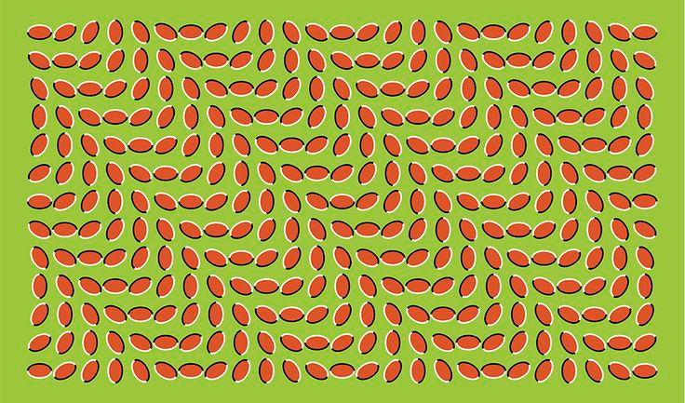
Can you trust your senses?
Notes:
Try to convince students they can’t-a good example is a pen half in a glass of water appears bent, but we know it isn’t (Your eyes are lying to you)
Or the optical illusion-your eyes are still lying to you.

Slide 6
The pursuit of truth
Throughout the last 3000 years, the pursuit of truth has taken different forms:
Truth can be discovered
There is truth but it can’t be discovered
There is no such thing as truth
Truth is what is true for you
Notes:
This is a very simplistic summary of philosophy in history.

Slide 7
What is Philosophy?

Slide 8
What is Philosophy
the study of ideas/set of ideas about knowledge, truth, the nature and meaning of life, etc.
Structure of a philosophical argument
Proposition | You make a declarative statement | Mr Schepemaker is a mortal.
Premise 1 | Since . . . (Evidence 1) | All men are mortal
Premise 2 (etc) | Since . . . (Evidence 2) | Mr Schepemaker is a man
Conclusion | Therefore . . . | Mr Schepemaker is a mortal.

Slide 9
7 Common Fallacies in Logic
Notes:
https://www.youtube.com/watch?v=plB51zfAIOQ

Slide 10
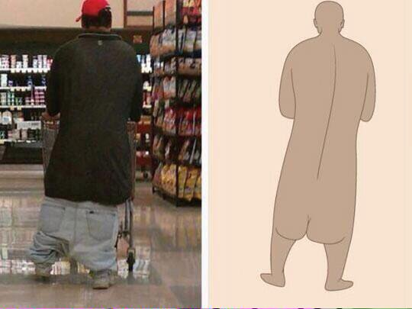
Fallacious Logic?

Slide 11
Hasty Generalisation
A universal conclusion is made based on a small sample size.
Example 1: I’m from Michigan
Example 2: My father smoked four packs of cigarettes a day since age fourteen and lived until sixty-nine. Therefore smoking can’t be that bad.

Slide 12
Appeal to Authority
Using an authority as evidence for your argument when the authority is not really an authority on the fact relevant to the argument.
Example 1: Old Spice
(Note: You can have good appeals to authority)

Slide 13
Slippery Slope
When a relatively insignificant event is suggested to lead to a more significant event and so on, until some ultimate, significant event is reached.
Example 1: “Get Rid of Cable”
Example 2: We cannot unlock our child from the closet because if we do, they will want to roam the house. If we let them roam the house, they will want to roam the neighbourhood. If they roam the neighbourhood, they will get picked up by a stranger who will sell them as a slave in some other country.
Notes:
https://www.youtube.com/watch?v=NZ80SVOHKoo

Slide 14
False Cause (Post hoc ergo propter hoc)
Ascribing a cause where none exists in situations where natural fluctuations exist while failing to account for these natural fluctuations.
Scenario 1: Big Bang Theory
Scenario 2: I prayed that my team would win the game. My team won the game. Therefore, prayer works!
Notes:
https://www.youtube.com/watch?v=vRJUvFG8gbE

Slide 15
False Dilemma
When only two choices are presented yet more choices exist. Often characterised by the words “either this or that”
Scenario 1: Food Fallacy
Either feed me pancakes or I will starve.

Slide 16
Circular Reasoning
A type of reasoning where the proposition is supported by the premise, which is supported by the proposition.
Scenario 1: Brawndo (stop at 1:10)
Question: What are electrolytes?
Answer: They are used to make Brawndo!
Question: Why do they use them to make Brawndo?
Answer: Because Brawndo has electrolytes!

Slide 17
Strawman Fallacy
Substituting a person’s actual position or argument with a distorted or exaggerated version of the argument.
Scenario 1: Thankyou for Smoking
So you like chocolate and you think it’s the best.
Yes I do, I would only order chocolate.
Well, I need more than chocolate and I need more than vanilla. I need the freedom to choose. I call that liberty.

Slide 18
Key Points
An understanding of philosophy can prevent us from being mislead.
It requires you to challenge and critically assess your beliefs, and the beliefs of others.
While your beliefs might be true, it is possible that the evidence that supports it is false.

Slide 19
Kahoot Quiz: Logical Fallacies

