Slide 1
Mr Schepemaker
An Introduction

Slide 2
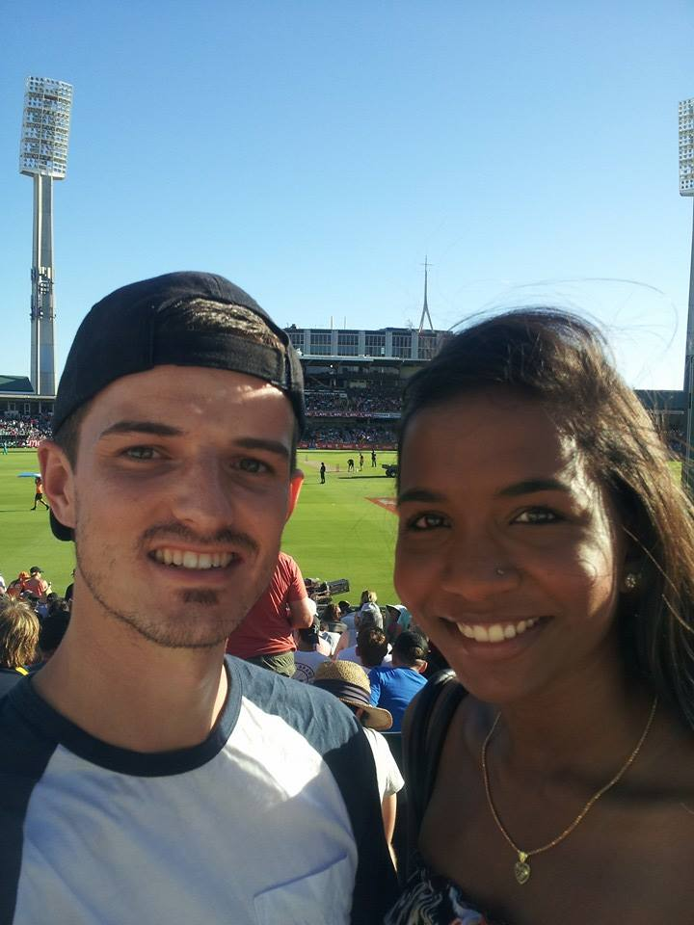
About me
Born in the USA on 2nd July, 1985
3rd child in a family with 14 kids
Married
1 child
Live in Caversham

Slide 3
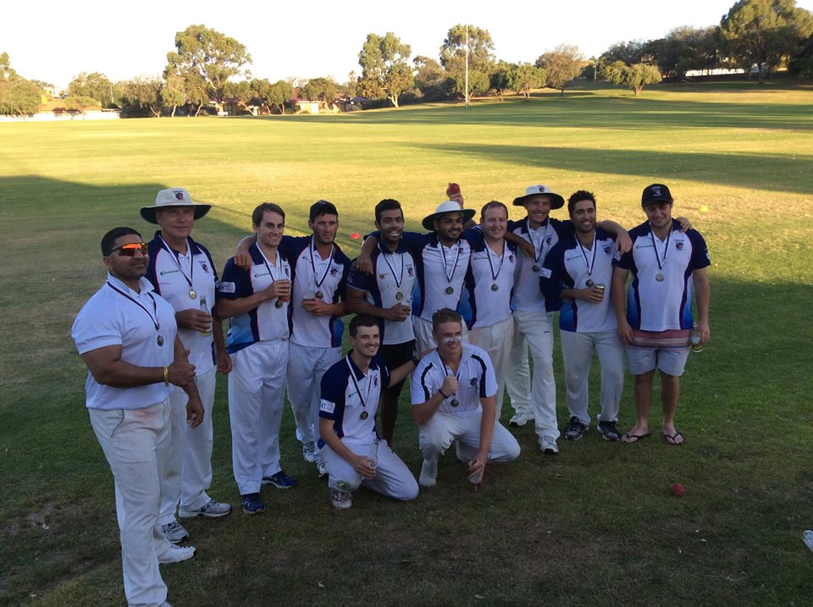
What I do for fun
Play Cricket
Handyman
Play computer games (Mainly DOTA2)
Staying (kinda) fit
Being with my family
Fishing

Slide 4
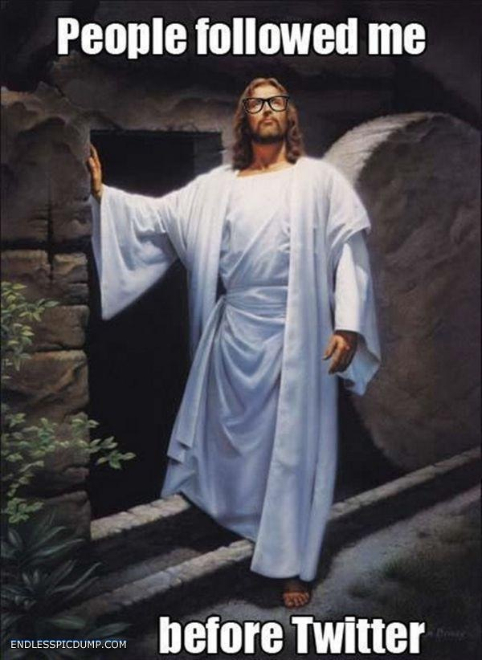
What defines me
I believe the teachings of Jesus Christ.

Slide 5
Classroom Expectations

Slide 6
At the start of the lesson

Slide 7
Line up outside the class in two neat lines
Uniform is to be in good order
Enter the classroom only on invitation
Stand behind your desk respectfully and place your equipment on it.
I will greet you and you will return the greeting.
I will invite you to sit.
You will take out your workbook and note the outcomes that will be covered in your book in proper note taking fashion.

Slide 8
During the lesson

Slide 9
Stay in your seat unless given permission to get up.
Listen to me and don’t talk when I am giving instruction.
Especially pay attention for my cue to start.
If you have question or want to say something relevant, raise your hand. If I would like to hear what you have to say I will ask you to speak.
Don’t touch other people’s property ever unless they give clear permission.
Don’t throw, run, distract, murder, bungee jump etc.

Slide 10
At the end of the lesson

Slide 11
Make note of homework in your student organiser.
Expect the possibility of me checking that you have done so.
When asked by the teacher, stand up and pack up your equipment.
Ensure your chair is pushed in properly and any rubbish around your work area is picked up.
Exit the classroom in an orderly fashion upon your teachers request.

Slide 12
Other

Slide 13
You may not leave class to get a drink or fill up a water bottle.
If you need a drink, then you are expected to bring a filled water bottle to class.
Under limited instances will you be allowed to exit the class to use the toilet.
If allowed then proper notations will have to be made in your diary.
You are expected to bring all relevant equipment to your class
Pencil/pen/eraser/ruler
Textbook/device

Slide 14
Intervention

Slide 15
Swan Christian College Intervention Process:
Warning > Detention > Phone call Home > Referral to HOD
‘Sri Lankan’ Process (Not Used)
Teacher beats you with a cane > Principal beats you with a cane > Your parents beat you with a cane when you come home.

