Slide 1
Modernism

Slide 2
Shrinking Vessel
Scene:
It is the year 2034 and humanity is faced with extinction. All those who used to be human are now zombified with a taste for the flesh of living humans. Those few humans that remain have taken refuge in a small ship. Unfortunately, they have been discovered and must use their greatest weapon to defeat their enemy or their greatest weapon will be eaten.
Challenge:
You will be required to fit all members of the class into a set area within a time limit. Those that remain outside are devoured in a most gruesome manner.
Notes:
This game introduces modernism by having the students use the power of the human mind to solve humanities problems.

Slide 3
Modernism – Design in a nutshell
Our worldview affects everything that we do
Notes:
Youtube video: Modernism – Design in a nutshell

Slide 4
Basic Concept
Reading Introduction: pgs. 44 – 45
Science can solve most problems and it can be used to understand all reality.
Intellectually – People can be sure of what is true.
Scientifically – Knowledge will continue to grow.
Socially – Technology will conquer illness and bring prosperity

Slide 5
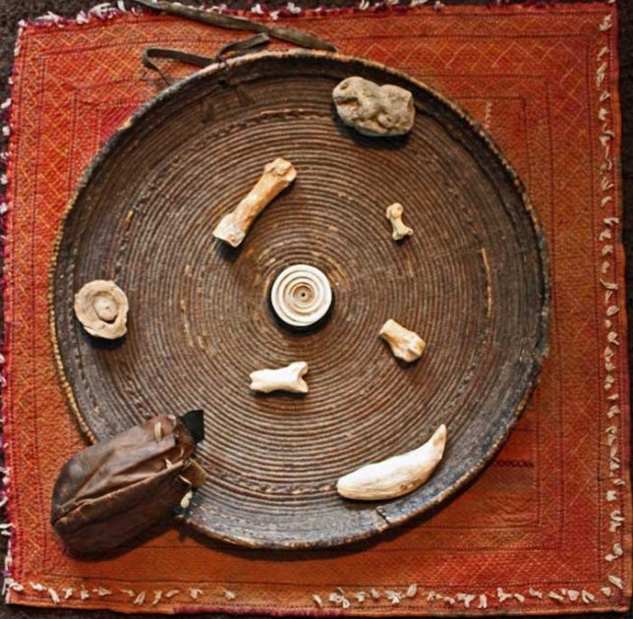
Pre-Modernism & Modernism
God
Human
Earth
Historical → | Pre-Modern | Modern | Post-Modern
Philosophical ↓
Date: | 400 – 1500's | 1500's – 1900's | 1900's - Present
Metaphysical | Super-natural | Naturalism | Anti-realist
Epistemology | Mysticism & Faith | Reason& Senses | Skepticism
Human Nature | Inherently sinful | Tabula Rasa –Individual is a blank slate | Group determinism
Ethics | Duty& Sacrifice | Pursuit of Happiness | Flawed humanity in conflict
Politics | Hierarchical Authoritarian | Liberty& Equality | Socialism – highly politicized (Marxism)
Looked at later
Notes:
Source: https://www.youtube.com/watch?v=ewzzXSD3FBg
Dr Stephen Hicks
Recommended to watch both the pre-modern and modern clips to help with expounding the content.

Slide 6
Task
In groups of four, consider the following modernism statements and describe WHY they appear to be at odds with pre-modernism. You have 120 seconds to read and write down your response below it. Then rotate the page, read the previous comment and then comment again.
Deism: “Part of demonstrating God’s power in nature was showing what a perfect machine it all was; but if the machine runs perfectly on its own, where is the need for God? | Miracles: “seemed a bit superstitious, a bit too supernatural”
Reliability of Scripture: “The New Testament documents began to be described a ‘myth’.” | Social Inequality: “It was no accident that the French revolution was against the church [because of their clerical powers] as well as the aristocracy”
Notes:
Print document on A3 paper for groups which contains the quote and a place to respond. (Modernism Group Task DOC)

Slide 7
Impact of Modernism
Reading: pgs. 50 – 52
Modernism - Journal Questions
What would be a good slogan to sum up the underlying beliefs of modernism?
Use 5 words that best describe the modernism world view.
Why might modernism be described as being naively optimistic?

