Slide 1
Chemistry: Ions

Slide 2
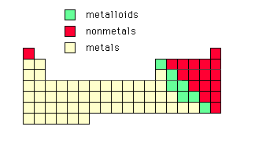
Ions
Ionic bonding occurs between metals and non metals

Slide 3
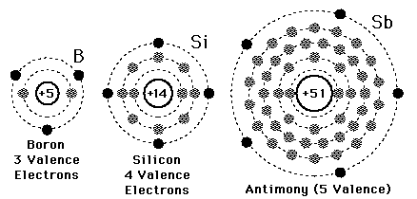
Ions
Atoms are normally neutral (i.e. same number of protons and electrons)
Ion - If an electron is added or taken, the atom becomes charged
If an electron is added it becomes more negative (-)
If an electron is taken away it becomes more positive (+).
Valence Electrons – The outer shell electrons that are either added to or taken from.

Slide 4
Why do Ions form?

Slide 5
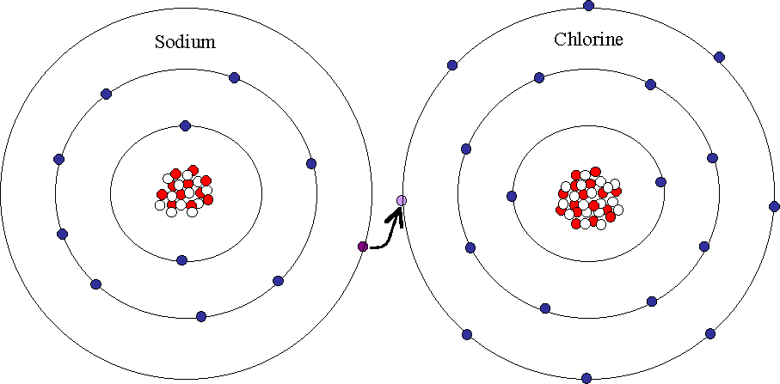
8 is Great
Every atom wants a FULL outer shell, because this makes it stable

Slide 7
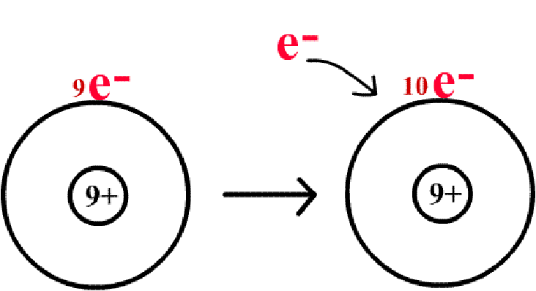
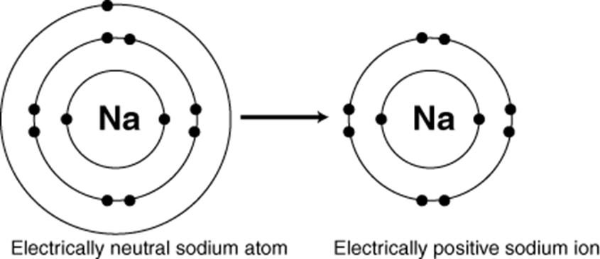
Gaining charge
When the electrons are either taken or received . . . The atom becomes either positively or negatively charged.

Slide 8
Using the Periodic Table to Identify Charges

Slide 9
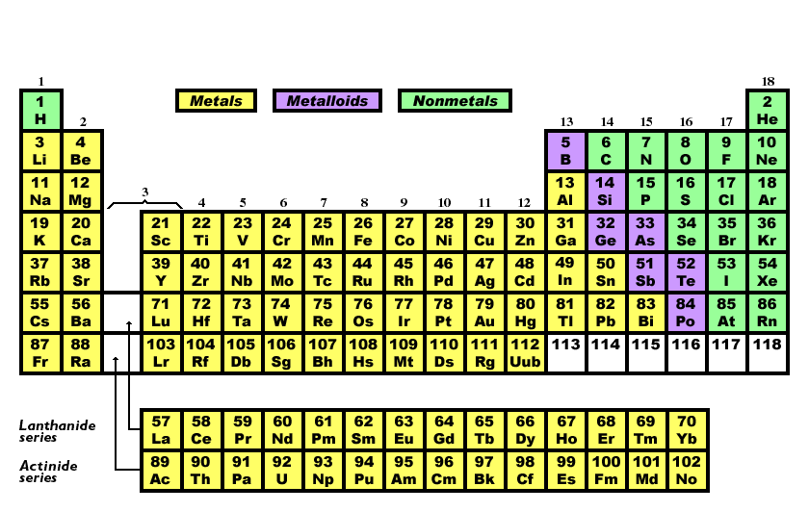
Look at Group 1!
All group 1 elements have 1 valence electron.
Is it easier for them to lose 1 electron,
or try to gain 7 electrons?
LOSE 1 ELECTRON!
+1 ion

Slide 10
Look at Group 2!
All group 2 elements have 2 valence electron.
Is it easier for them to lose 2 electrons,
or try to gain 6 electrons?
LOSE 2 ELECTRONS!
+2 ion

Slide 11
Look at Group 3!
All group 3 elements have 3 valence electron.
Is it easier for them to lose 3 electrons, or try to gain 5 electrons?
LOSE 3 ELECTRONS!
+3 ion

Slide 12
Look at Group 4!
All group 4 elements have 4 valence electron.
Due to the more complex nature of group 4 elements, we will not be using them.

Slide 13
Look at Group 5!
All group 5 elements have 5 valence electron.
Is it easier for them to lose 5 electrons, or try to gain 3 electrons?
GAIN 3 ELECTRONS!
-3 ion

Slide 14
Look at Group 6!
All group 6 elements have 6 valence electrons.
Is it easier for them to lose 6 electrons, or try to gain 2 electrons?
GAIN 2 ELECTRONS!
-2 ion

Slide 15
Look at Group 7!
All group 7 elements have 7 valence electrons.
Is it easier for them to lose 7 electrons, or try to gain 1 electron?
GAIN 1 ELECTRON!
-1 ion

Slide 16
Look at Group 8!
All group 8 elements have 8 valence electrons.
8 is GREAT!!! No Ions formed!!!

Slide 17
Summary

Slide 18
Why do Ions bond?

Slide 19
Opposites Attract
Atoms that are positively charged will be attracted to atoms that are negatively charged.
They will be attracted to atoms that will make their overall charge 0.
Ie. A 3+ atom will be attracted to a 3- atom

Slide 20
Cations

Slide 21
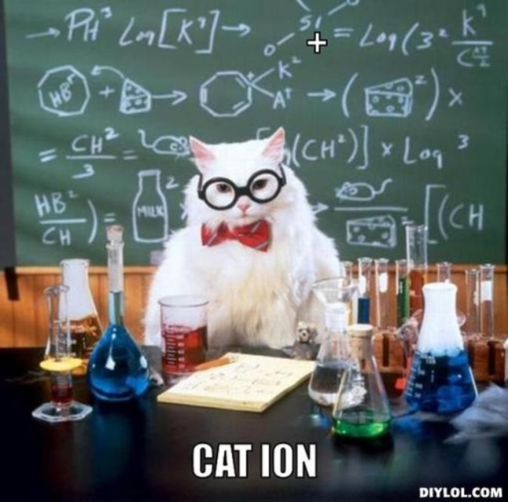
Cations
Are formed when an atom loses an electron
This makes that atom more POSITIVE
This happens if its outside shell is mostly empty

Slide 22
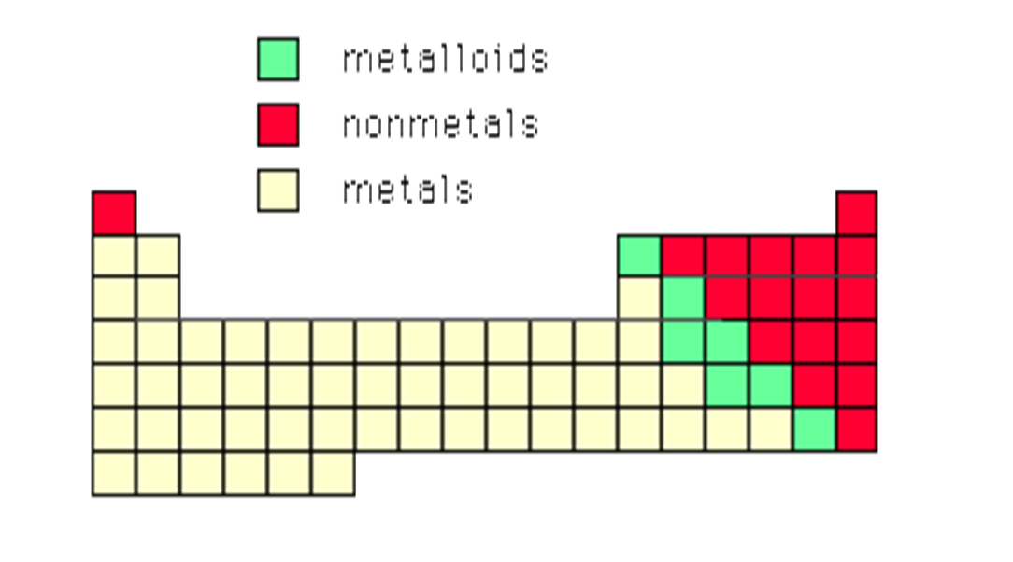
Cations
Most cations are from metal elements.
Metal elements only hold weakly onto their electrons e.g. Copper –Cu²⁺, Li⁺

Slide 23
Anions

Slide 24
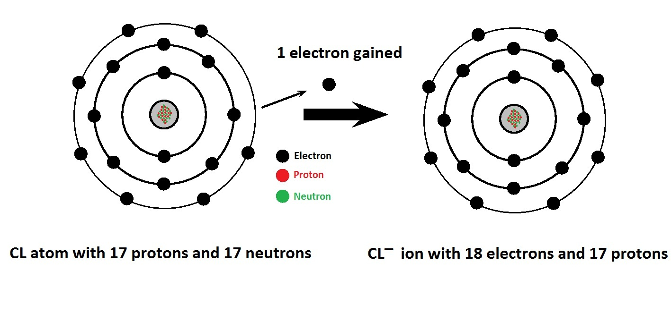
Anions
Are produced when an atom gains electrons
This makes that atom more NEGATIVE
This happens if the outermost shell is almost full
It gains electrons to fill its outer shell, making it stable

Slide 25
Anions
All anions come from non-metals
These hold onto electrons tightly e.g. Chloride- Cl⁻, Oxide- O²⁻

Slide 26
Ions can exist as Monatomic ions or Polyatomic ions
Monatomic – mono means one
Calcium ion – Ca ²⁺ . . . Has one calcium
Polyatomic – poly means many
Nitrate ion – NO₃¹⁻ has . . . 1 nitrogen and 3 oxygen

Slide 27
How to Write Ionic Formula

Slide 28
Writing Ionic compound formula
Atoms are happiest when all charges are 0, so there must be an equal number of positive protons and negative electrons.
E.g. For Sodium (1+) and Chloride (1-), only 1 of each is needed to make it even (NaCl)
For Magnesium (2+) Chloride (1-), two chlorides are needed for every magnesium (MgCl₂)

Slide 29
Using Swap and Drop

Slide 30
Why use Swap and Drop? Cause its easier!
Remember that atoms all want a charge of 0.
While we know the charges individual ions have . . . we don’t know how many atoms each molecule/lattice will need to make it 0 charge.
Option 1
Ba ²⁺ and N ³⁻
?
Charge
Barium
Nitrogen
Ba ²⁺
N ³⁻
Ba ²⁺
N ³⁻
Ba ²⁺
N ³⁻
Ba ²⁺
N ³⁻
Ba ²⁺
N ³⁻
Ba ²⁺
N ³⁻
Ba ²⁺
N ³⁻

Slide 31
Option 2: Swap & Drop Method
Aluminum Ion
Al
Oxygen Ion
O
-
+
3
2
Step 1: Drop the signs.

Slide 32
Swap & Drop Method
Aluminum Ion
Al
Oxygen Ion
O
3
2
Step 2: Swap Values.

Slide 33
Swap & Drop Method
Aluminum Ion
Al
Oxygen Ion
O
2
3
2
3
Step 3: Drop values to subscripts.

Slide 34
Swap & Drop Method
Aluminum Ion
Al
Oxygen Ion
O
2
3
Aluminum Oxide
Step 4: Combine into compound.

Slide 35
Monatomic Formula
Refer to Periodic Table to identify charges
Write the symbols and charges
Complete Swap and Drop
Example Sodium Chloride
Practice 1 Magnesium Oxide
Practice 2 Potassium Nitride
Practice 3 Calcium Sulfide

Slide 36
Polyatomic Formula
Refer to Ion Chart for chemical formula
Put brackets around the polyatomic ion but with the charge on the outside.
Complete Swap and Drop only using the charges.
Remember to keep the polyatomic ion in brackets.
Example
Practice 1 Copper(II) Sulphate
Practice 2 Silver Phosphate
Practice 3 Potassium Permanganate

Slide 37
How to name Ionic Compounds
Name Ionic Compounds
Write Ionic Formula

Slide 38
Naming Ionic compounds
Remember: When anions (-) and cations (+) come together, they make compounds which are crystal lattices
Steps
Name the cation first
Name the anion second
BUT . . . we change the last letters to ‘ide’)
Calcium + Chlorine = Calcium Chloride
Sodium + Oxygen = Sodium Oxide
Copper+ Oxygen = __________________________
Notes:
Youtube: Naming Ionic Compounds - www.youtube.com/watch?v=CkCzceecCrc

Slide 39
Naming Practice
Easy
Sodium + Fluorine = ___________________________
Potassium + Chlorine = ________________________
Magnesium + Oxygen = _______________________
Medium
Chlorine and Copper = _________________________
Oxygen and Aluminium = ______________________
Hard
Fe²⁺ + F⁻ = ____________________________
Ba²⁺ + S²⁻ = __________________________

Slide 40
Facts about Ions in a Solution

Slide 41
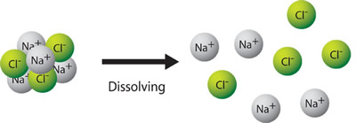
Ions in solution
Some ionic compounds dissolve in water (they are soluble)
When one dissolves in water, the water particles surround the cations and anions
This breaks the lattice apart so the ions are evenly spread out throughout the water

Slide 42
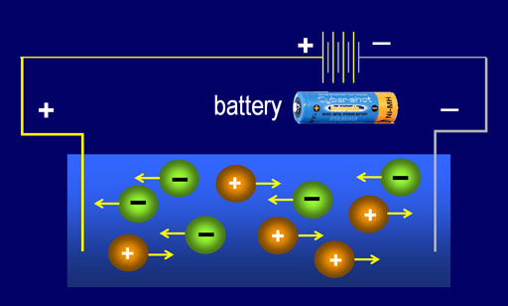
Ions in solution
If water is removed, the ions will stick together again (called re-crystalisation)
Because ions can move about in solution, they can conduct electricity
Cations move towards the negative electrode
Anions towards the positive
Only solutions with ions can conduct electricity

Slide 43
Facts about Ionic Compounds

Slide 44
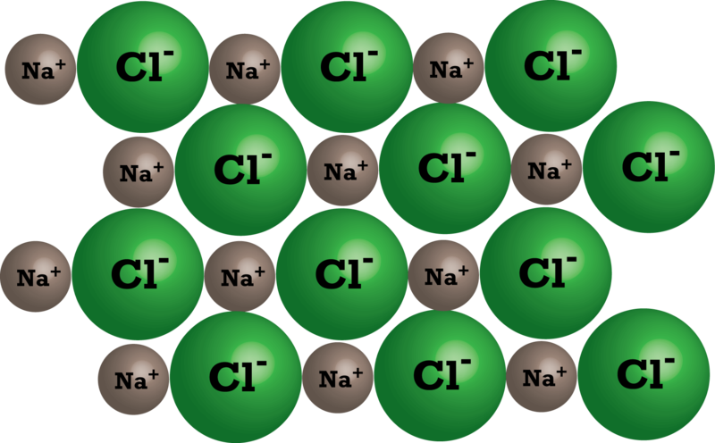
Ionic compounds
Cations and anions are attracted to each other (opposite charges attract)
Ionic bond – when a cation and anion bond
These are always crystal lattices

Slide 45
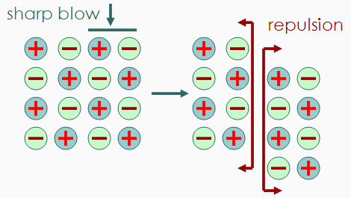
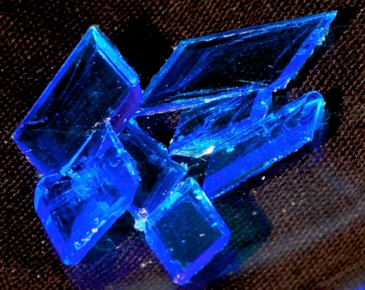
Ionic compounds
The bonds are very strong, so ionic compounds are usually:
Hard (it takes a lot of force to break their bonds)
Brittle (The bonds hold them in fixed positions so they shatter rather than bend)
Have high melting points (high temperatures are required to break the strong bonds)
E.g. copper sulphate

Slide 46
Quiz
Questions
Answers
What term describes an atom with a positive or negative charge?
What are Valence Electrons?
Why do atoms want to form ionic bonds?
What do we call atoms that form a positive charge?
What do we call atoms that form a negative charge?
T/F – Ionic bonds occur between metal and non metal atoms.
What does Polyatomic ion mean ???
_____________________
_____________________
_____________________
_____________________
_____________________
_____________________
_____________________

