Slide 1
Chemistry: Atoms and Reactions
Students need to have notebook and e-book

Slide 2
Review: Atoms
This handsome guy (Democritus) said that everything is made of atoms (See History of Atomic Model)
They are tiny building blocks of all matter
There are 118 known types of atoms, but only 91 are found naturally on earth

Slide 3
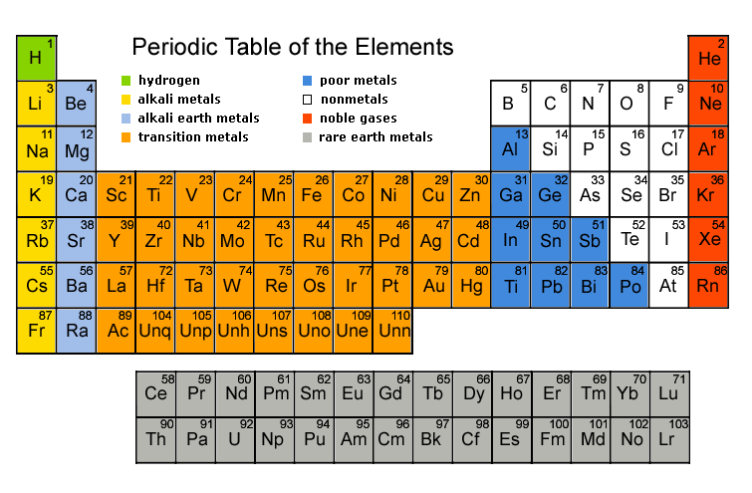
Scientists list atoms from smallest to largest in the periodic table
DO NOT COLOUR ON YOUR PERIODIC TABLE!
Pg. 2

Slide 4
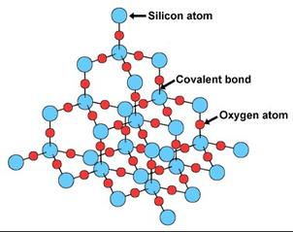
When Atoms Combine
When atoms stick together they form:
Molecules - clusters of atoms (e.g. water-H₂O)
OR
Crystal Lattices - Large grid-like structures (e.g. sand-SiO₂, where each grain is made a single lattice)
Pg. 3

Slide 5
The difference between Elements and Compounds

Slide 6
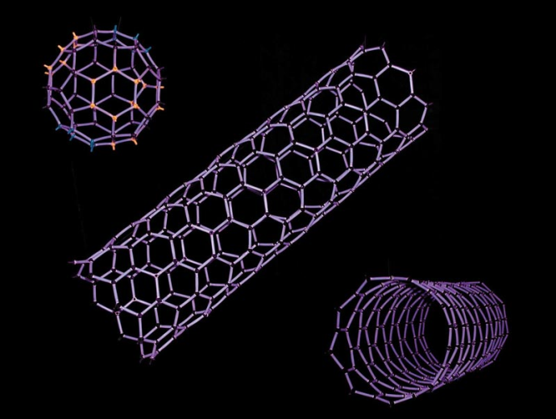
Elements
Are substances made up of just one type of atom
E.g. Diamond is only made of carbon, oxygen gas is made of only oxygen (O₂) , a buckyball is made of only carbon (C₆₀) and copper metal is made only of copper atoms
Note: Metallic elements always form crystal lattices

Slide 7
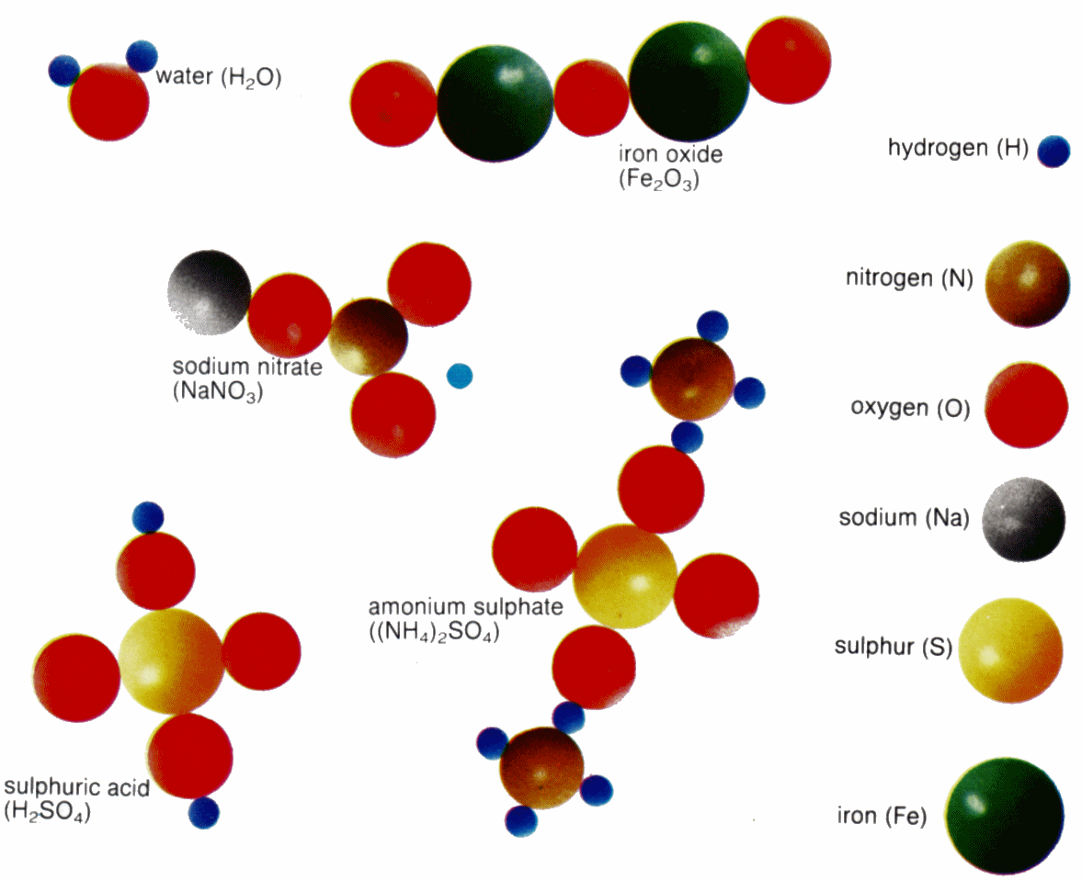
Compounds
Are substances with different types of atoms
E.g. sugar (carbon and hydrogen atoms), DNA, salt

Slide 8
Have a go! Element or compound?
Hydrogen
Water
Carbon dioxide
Iron
Sulphur dioxide
Chlorine gas
Table salt
Nitrogen
Element
Compound
Compound
Element
Compound
Element
Compound
Element
Pg. 4

Slide 9
What’s inside Atoms?
Have you ever seen an atom? www.youtube.com/watch?v=yqLlgIaz1L0

Slide 10
Faith in Science
Romans 1:20 (NLT) - For ever since the world was created, people have seen the earth and sky. Through everything God made, they can clearly see his invisible qualities--his eternal power and divine nature. So they have no excuse for not knowing God.
Faith in Science and Faith in God require people to trust in things that cannot always be seen.

Slide 11
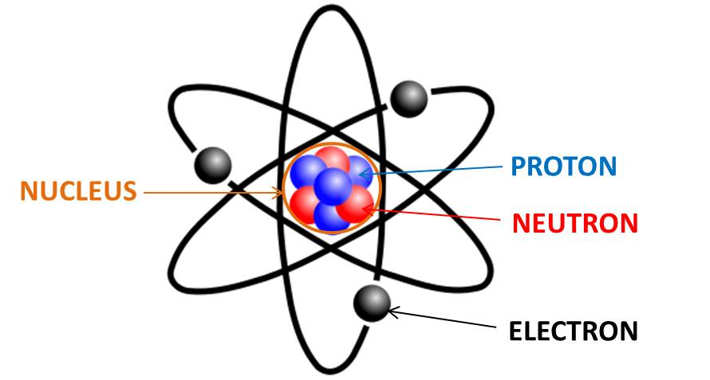
Inside atoms
Atoms are made of three subatomic particles; protons, neutrons and electrons
Protons (+) form a cluster with Neutrons (neutral) to form a nucleus
Electrons (-) move very fast around the nucleus in shells/clouds

Slide 12
A table on size and charge of subatomic particles:
Subatomic particle | Location | Comparing mass of (example) | Electric charge
Neutron | Nucleus | 1 | 0
Proton | Nucleus | 0.9986 | +1
Electrons | Electron cloud around nucleus | 0.0005 | -1
Note: If you could have a teaspoon full of only neutrons, it would weigh about 10 billion tons, or the weight of an average mountain!

Slide 13
Atomic Nucleus

Slide 14
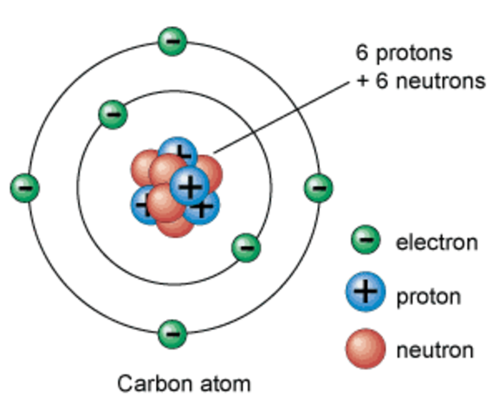
Atomic nuclei
It is the number of Protons in the nucleus that defines the type of atom (therefore, the type of element)
E.g. All hydrogen atoms have 1 proton in their nucleus, all lithium atoms have 3

Slide 15
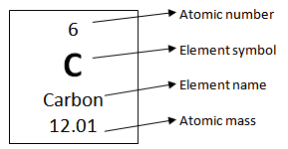
Atomic nuclei
Atomic number -The number of Protons in the nucleus of an atom.
Mass number - The number of protons + neutrons in a nucleus of an atom
It tells us the average mass of all the types of atoms of that element. (i.e. Carbon 12 vs Carbon 13)

Slide 16
Electrons

Slide 17
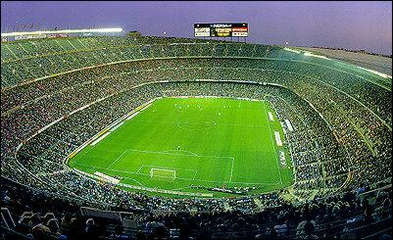
Electrons and the nucleus
The number of electrons are usually equal to the number of protons in an atom, making its overall charge neutral
Electrons are really far away from the nucleus, so most of an atom is empty space
Note: If a nucleus was the size of a golf ball, the electron clouds would be the size of a football stadium!

Slide 18
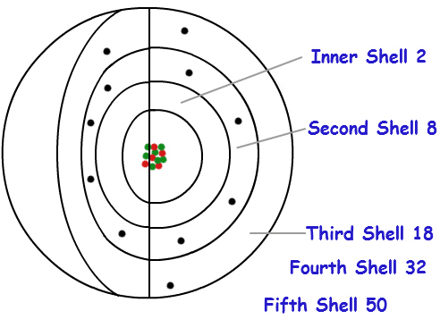
Why do atoms stay together?
The (-) electrons in an atom are attracted to the (+) protons in the nucleus
They don’t fall in because they are trapped in electron shells (like layers of an onion)
Pg. 5-8

Slide 19
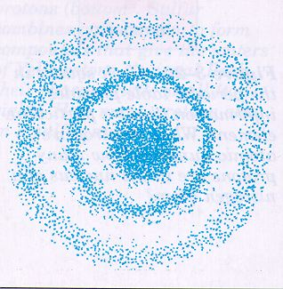
Electron shells
The shell closest to the nucleus has the lowest energy level and the energy level increases the further away the shell is.
The 1st = 2 elecrons max
The 2nd = 8 elecrons max
The 3rd =18 elecrons max
The 4th = 32 elecrons max
Once closest shell is full, the electrons then move to the next shell outwards until they are used up.
We will be using the rule of 2, 8, 8, 2
Pg. 9-11

Slide 20
Demo: Indirect Observation of Electron Shells

Slide 21
Notes:
Year 9 Pearson, Pg 12

Slide 22
What’s happening
When metals are heated in a flame, the flame becomes coloured due to the electrons being ‘excited’.
Fireworks make use of this for the colours they produce.
The heat causes the electrons to reach higher energy levels but they can’t maintain it so when they fall back into their original shell they emit a light.

Slide 23
If there is a small energy gap, then a low energy visible light (e.g. red/yellow) is emitted as the excited electrons fall back to their original state.
If there is a large energy gap, then a high energy visible light (e.g. green/blue) will be emitted as the electrons fall back into their original state.
Notes:
http://www.chemicalconnection.org.uk/chemistry/topics/view.php?topic=3&headingno=5

Slide 24
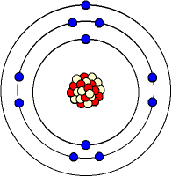
Writing Electron configuration
The number of atoms in each shell of an atom is known as the electron configuration
For example, Sodium has 11 electrons, so it has 2 in the first shell, 8 in the second and 1 in the 3rd.
Its electron configuration is 2, 8, 1
What element has the electron
configuration of:
2, 8, 4 - ______________
2, 2 - _______________

Slide 25
Practice Writing Atomic Information

Slide 26
Chlorine
Element Name:
P:
N:
E:
Shells:
e-config:
Diagram:
Carbon
Element Name:
P:
N:
E:
Shells:
e-config:
Diagram:

Slide 27
Fluorine
Element Name:
P:
N:
E:
Shells:
e-config:
Diagram:
Magnesium
Element Name:
P:
N:
E:
Shells:
e-config:
Diagram:

Slide 28
Element Name:
P:
N:
E:
Shells:
e-config:
Diagram:
Element Name:
P:
N:
E:
Shells:
e-config:
Diagram:
20
Ne
Pg. 15

Slide 29
Review Quiz
Questions
Answers
How many elements are there?
Define: “A cluster of atoms”
Sulphur Dioxide – Element or Compound?
State the 3 subatomic particles.
What does the atomic number tell us?
Define: the number of electrons in each shell of an atom is called?
_______________
_______________
_______________
_______________
_______________
_______________

