Slide 1
Acids, Bases & pH

Slide 2
Where do we find them?

Slide 3
Brainstorm

Slide 4
Comparing Acids and Bases

Slide 5
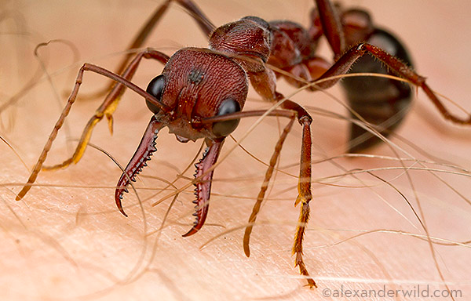
Found in…
Acid
Base
Orange juice
Stomach acid
Vinegar
Lollies
Batteries
Toothpaste
Soap
Shampoo
Cleaning agents
Baking powder
Animals:
Bull Ants – inject methanoic acid into their bits.
Wasps and Jellyfish – inject a base
Notes:
www.youtube.com/watch?v=Xeuyc55LqiY

Slide 6
Definitions:
Acid – a substance that releases hydrogen ions.
Hydrogen ion – (H ⁺)
Base – a substance that releases hydroxide ions
Hydroxide ion - (OH ⁻)
Alkali – A base that can be dissolved in water

Slide 7
Properties:
HCl – Hydrochloric Acid
NaOH – Sodium Hydroxide
Releases Hydrogen ions
Taste sour
Corrode metal
Neutralises a base
pH is 0-6
Turns blue litmus paper red
Releases Hydroxide ions
Taste bitter
Feel soapy/slippery
Neutralises an acid
pH is 8-14
Turns red litmus paper blue
Notes:
www.youtube.com/watch?v=Xeuyc55LqiY

Slide 8
3 Common Examples
Acid
Base
Hydrochloric Acid - HCl
Sulfuric Acid – H₂SO₄
Nitric Acid – HNO₃
Sodium hydroxide - NaOH
Calcium hydroxide CaOH
Ammonia NH₃
Notes:
www.youtube.com/watch?v=Xeuyc55LqiY

Slide 9
Properties Quiz (Acid or Base)
________________
________________
________________
________________
________________
________________
________________
________________
________________
________________
Corrodes metal
Tastes bitter
pH of 6
Turns red litmus paper to blue
Feels soapy
Releases hydrogen ions
Tastes sour
pH of 9
Neutralises a base
Releases (OH⁻)

Slide 10
How do we measure pH?
YouTube - Fuse School: What is the pH scale

Slide 11
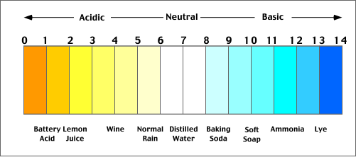
pH
pH - stands for “The power of Hydrogen”
See it as amount of hydrogen ions (H⁺) in a solution
Indicator – chemicals that change colour to show if a substance is acidic, basic or neutral.
It runs on a scale from 0 - 14

Slide 12
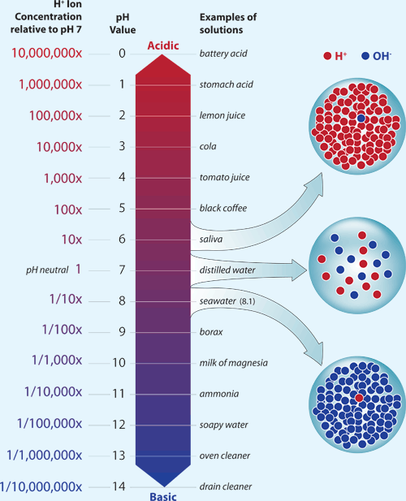
The more hydrogen ions, the more acidic.
The more hydroxide ions the more basic.

Slide 13
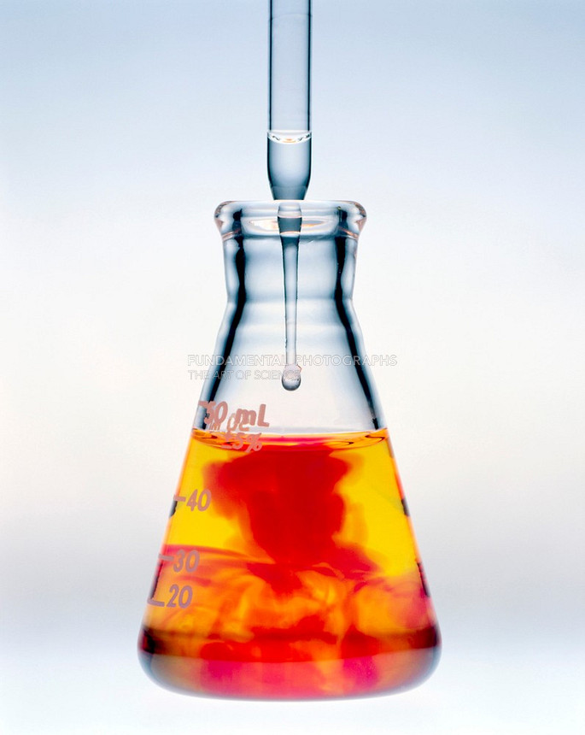
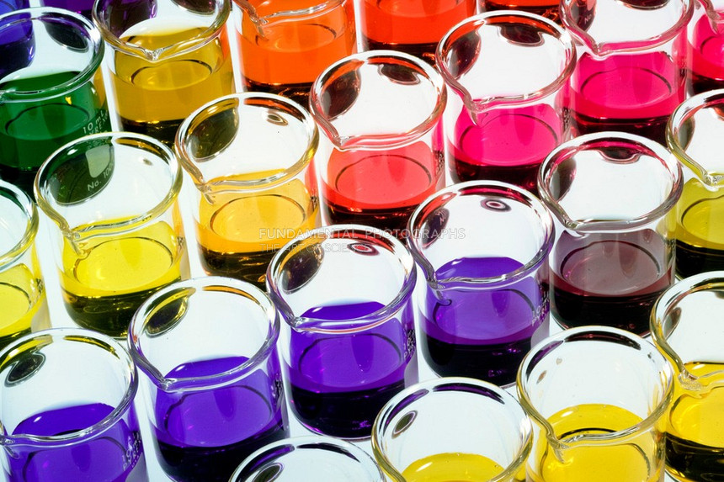
pH Indicators

Slide 14
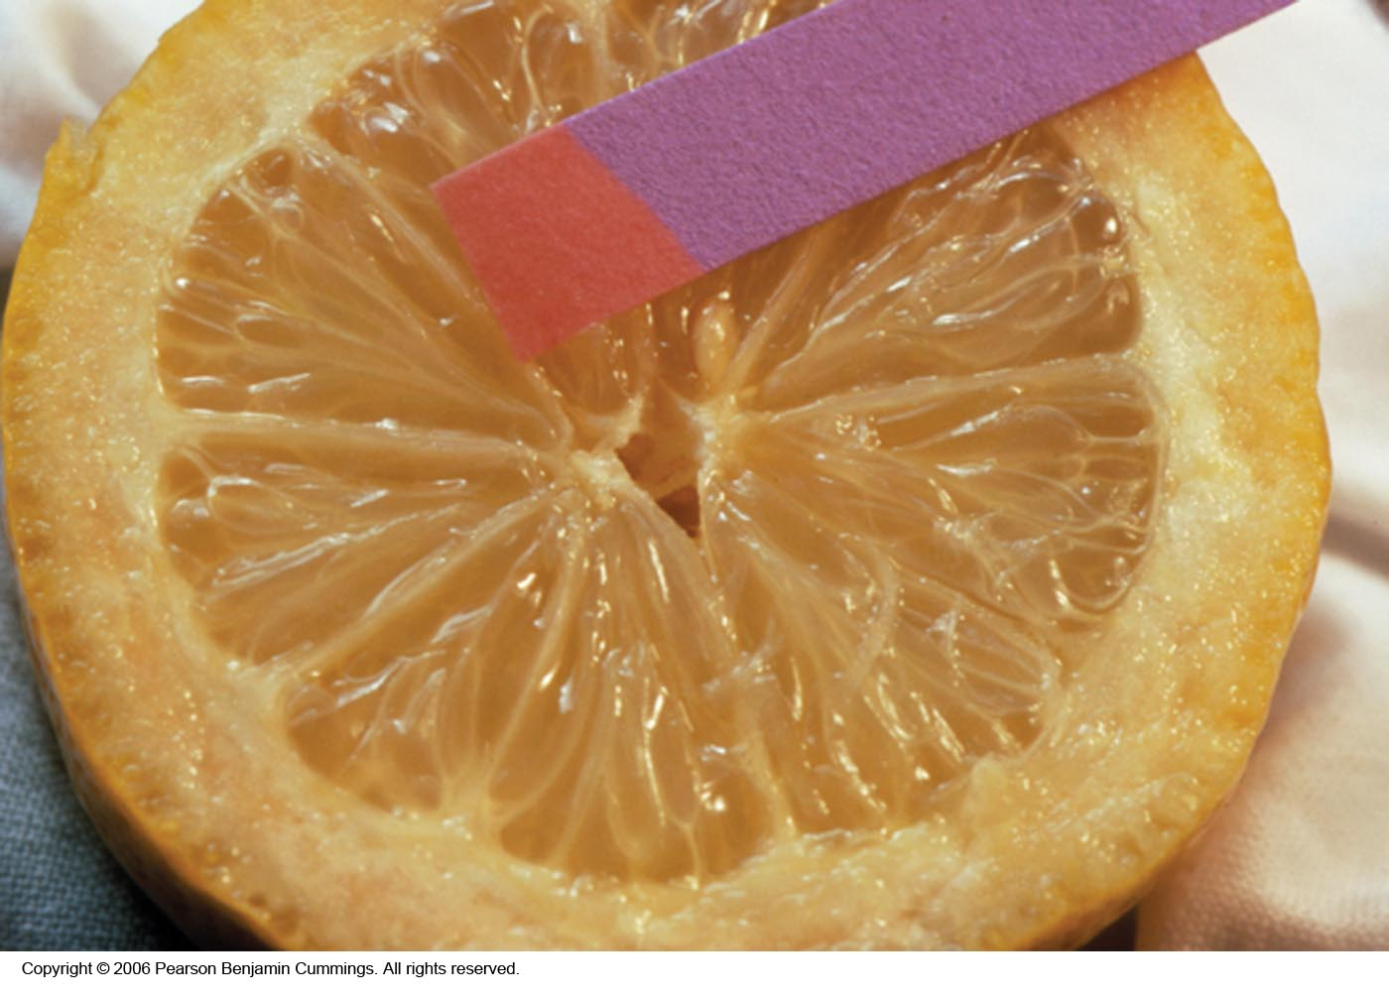
Litmus Paper
Copyright © 2007 Pearson Benjamin Cummings. All rights reserved.

Slide 15
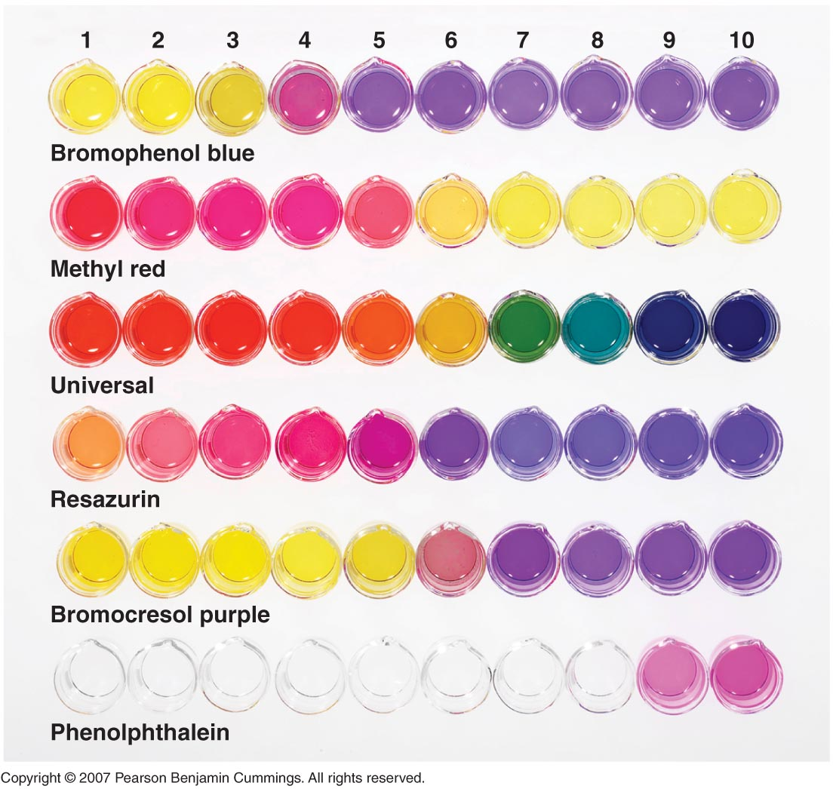
Range of different indicators
Copyright © 2007 Pearson Benjamin Cummings. All rights reserved.

Slide 16
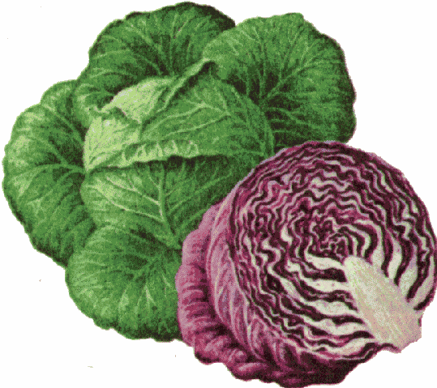
Edible Acid-Base Indicators
COLOR CHANGES AS A FUNCTION OF pH
INDICATOR pH 2 3 4 5 6 7 8 9 10 11 12
RED APPLE SKIN
BEETS
BLUEBERRIES
RED CABBAGE
CHERRIES
GRAPE JUICE
RED ONION
YELLOW ONION
PEACH SKIN
PEAR SKIN
PLUM SKIN
RADISH SKIN
RHUBARB SKIN
TOMATO
TURNIP SKIN
*
*YELLOW at pH 12 and above
Notes:
Source: Volume 62, Number 4, April 1985 pg 285 (Not sure of magazine title)

Slide 17
Complete Worksheet 1

Slide 18
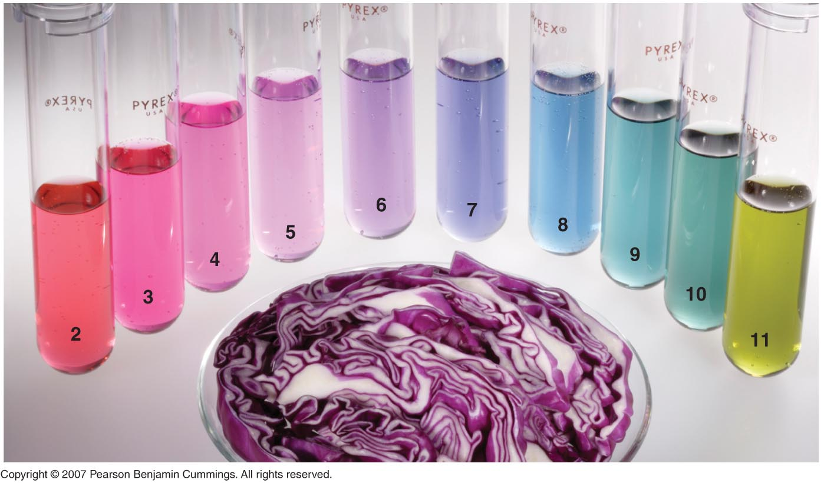
Red Cabbage Indicator
Copyright © 2007 Pearson Benjamin Cummings. All rights reserved.

Slide 19
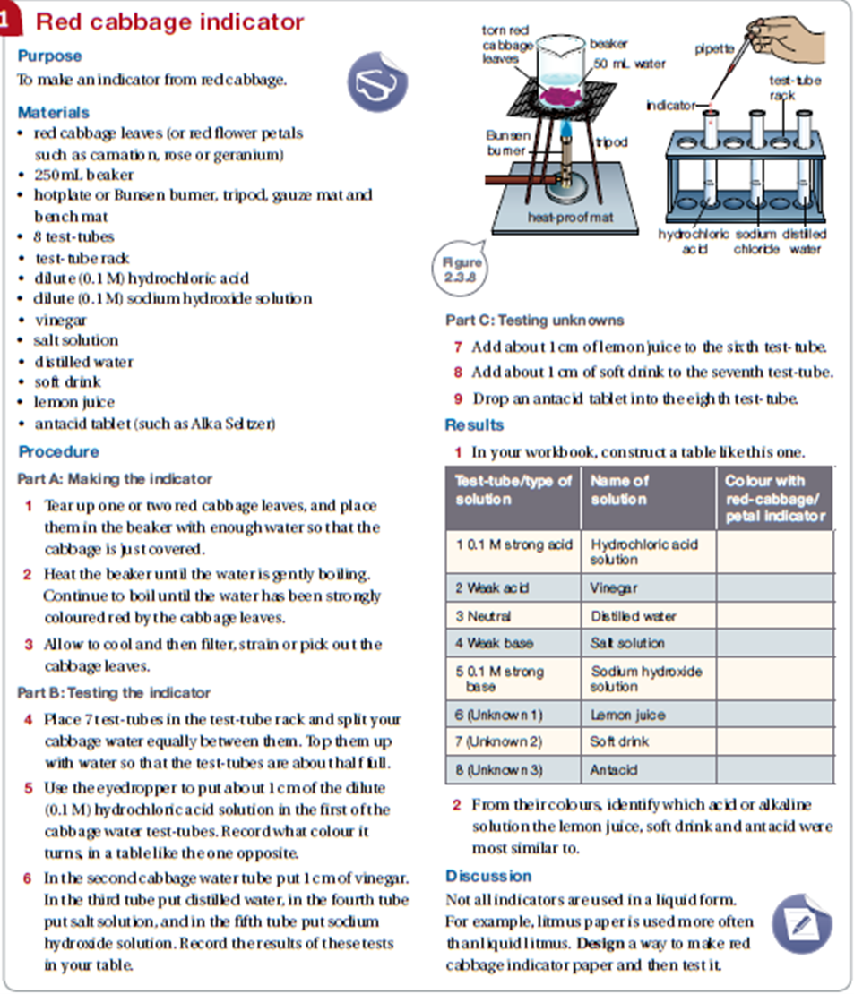

Slide 20
Why do we monitor pH?

Slide 21
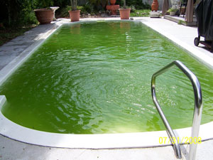
Swimming Pools
pH of pools should be between 7.4 – 7.6
This prevents bacteria and algae which can be dangerous.
The pH can change from:
People swimming in it.
New water added.
Sunlight breaking
down the chlorine.

Slide 22
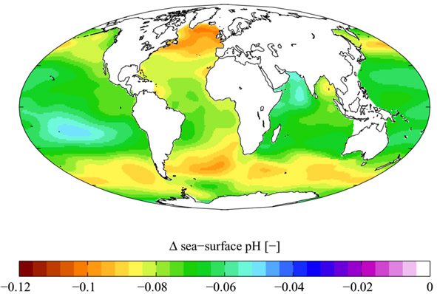
Ecosystems
Samples of rivers and oceans help environmental authorities identify pollution and water health.

Slide 23
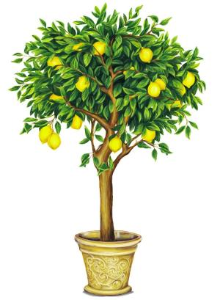
Soil
Nurseries and gardeners monitor the pH of the soil.
Different plants require different soil pH.
Lemon trees produce more fruit when planted in acidic soil.

Slide 24
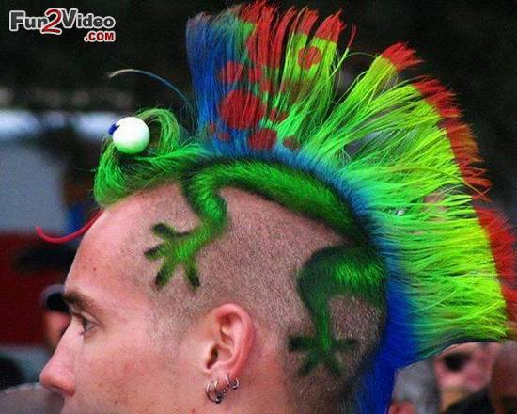
Hairdressers
Care has to be taken with the dyes and lotions.
The wrong pH can burn or irritate the hair.

Slide 25
Revision Quiz
Mr Schepemaker’s Year 9 – Acid and Bases

Slide 26
T/F – Acids and bases are rarely found in our homes.
What does an acid produce?
What does a base produce?
T/F – An alkali is a base that CAN be dissolved in water.
Acid or Base
Tastes bitter
Corrodes metal
Tastes sour
What is an indicator?
The more hydrogen ions the more …
Why do we monitor pH?
___________
___________
___________
___________
.
___________
___________
___________
_____________
_____________
_____________

Slide 27
End

Slide 28
Background Information

Slide 29
Water
In 1 cup of water there are about 8,000,000,000,000 molecules of H₂O.
Sometimes water molecules are so attracted to each other that they can remove one of the Hydrogen atoms.
In distilled water, there is a 1 in 10,000,000 chance that this will happen. pH = -log [1 x 10⁻⁷]
This equals 7

