Slide 1
Glue Prac
Note: Not limited to one explanation. Simply a number of theories.

Slide 2
Why does glue stick?
Terms:
Adhesive – how one object sticks to another object.
Cohesive – how one object sticks to itself.
There can be:
- Natural adhesives – such as honey
- Artificial adhesives – such as PVA glue

Slide 3
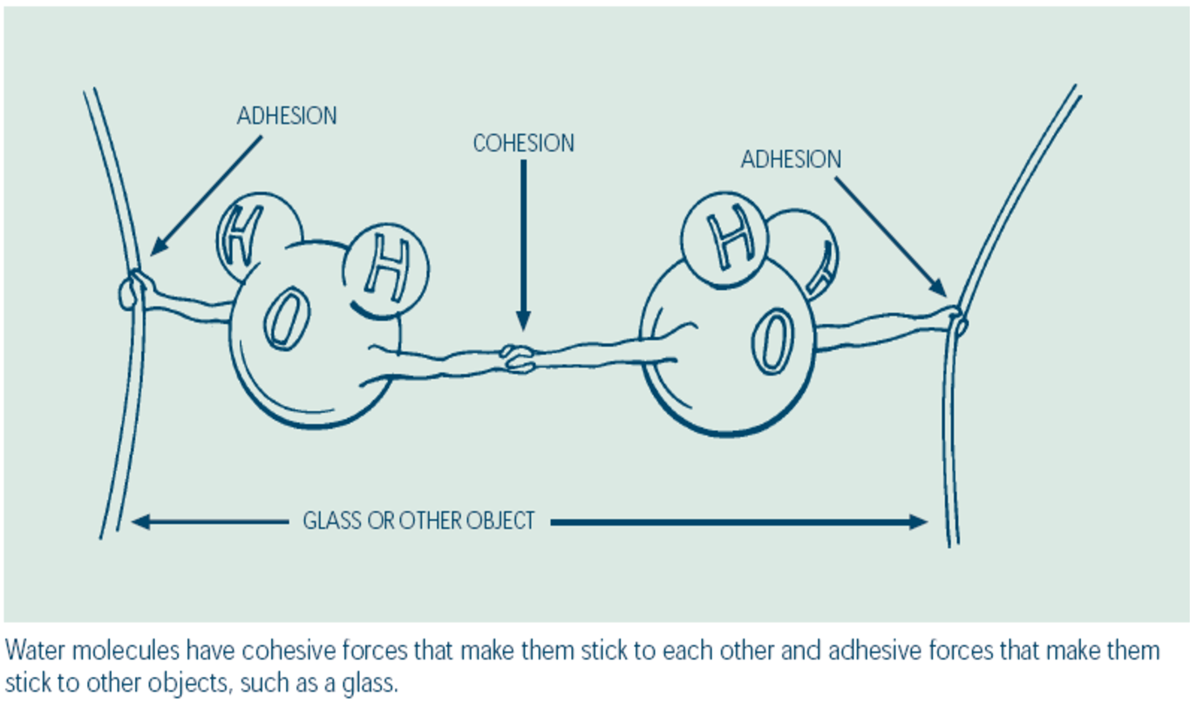
Adhesion vs Cohesion

Slide 4
Mechanical – pitted and rough surfaces allow the adhesive to physically grab on to the opposite surface. A common example is changing a bike tyre and roughing up the surface of the rubber to allow the adhesive to stick better.
Chemsorption – some adhesives actually bond to the other surface (chemical reaction).

Slide 5
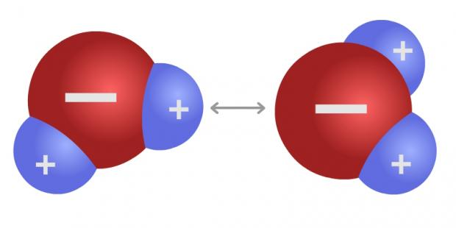
Adhesion works
Adsorption – electrostatic bonding (non chemical bond) (van der Waals theory)
Molecules create a magnet like effect because off the shape of the molecule. These opposites then attract to each other in a weak bond.
Recall the structure of an atom.

Slide 6
Cohesion
Mostly an electrostatic bond.
Consider this . . .
Why does iron not work so well as a glue even though it has an electrostatic bond?
Why does water not work so well as a glue even though it has an electrostatic bond?

Slide 7
Why Do?

Slide 8
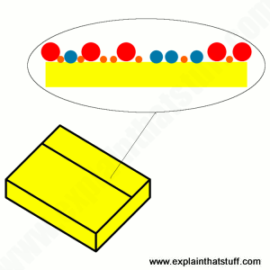
Sticky Notes Stick?
A look at the back of a sticky note shows microscopic glue bubbles. When you push a Post-it note onto a wall, some of these large sticky capsules cling to the surface allowing it to hold up the paper.
Every time you attach and peel of the note though, dust can attach to some of the capsules and they lose their stickiness.

Slide 9
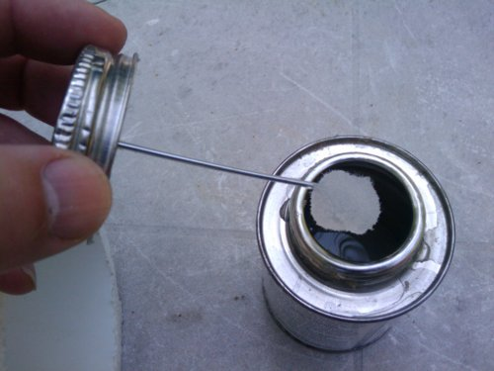
Why doesn’t glue stick to the tube?
Adhesives are designed to work after they leave the tube/can, not before.
Often they use a chemical called a solvent to prevent adhesion to the tube.
A solvent quickly evaporates into the air when used, hence the strong and dangerous smell and why the tube needs to be resealed after use.
Once the solvent is evaporated it leaves behind the adhesive to work.

Slide 10
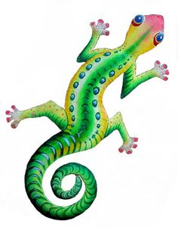
Why do gecko’s stick to glass?
Vote
The gecko has suction pads on it’s feet?
The gecko squeezes out some kind of adhesive?
Maybe there is a static charge like a balloon?
It’s actually Magic!

Slide 11
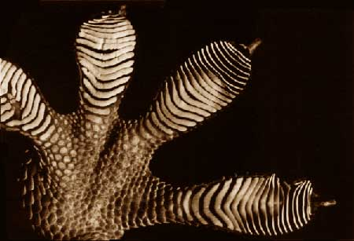
Gecko’s have millions of tiny hairs called ‘setae’ on each foot.
Each hair has a hundreds of millions of bristles brushing against the glass.
The carbon molecules in the hairs brush past the silicon dioxide molecule in the glass.
This creates tiny electrostatic charges that individually aren’t enough to hold up the gecko but with so many hundreds of billions of charges it is enough.

