Slide 1
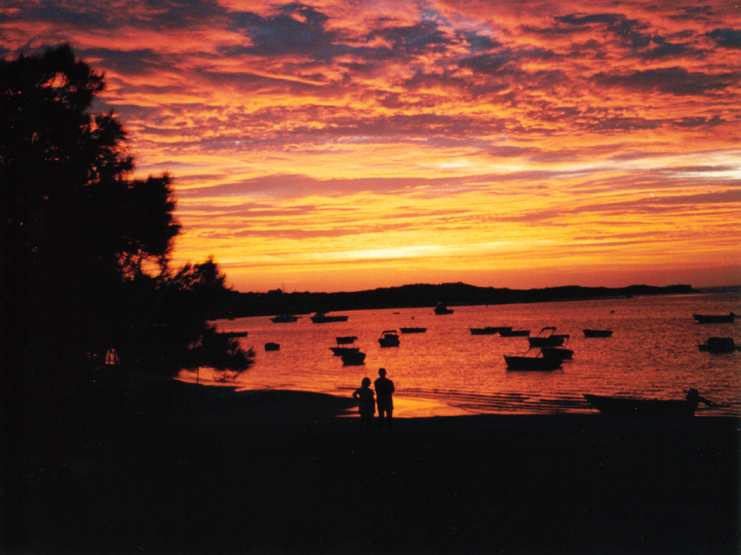
GLIMMERS OF GOD
Notes:
Intro – there are so many beautiful things to celebrate in this world – sunsets, love, the arts, an eagle in flight, a simple leaf etc… Some people believe that these come by chance, by a random mix of cells, atoms all grouping together with no particular order. However – in christian living we will explore/ask the question – could these beautiful things be.... Glimmers of God.
Cs Lewis Quote -

Slide 2
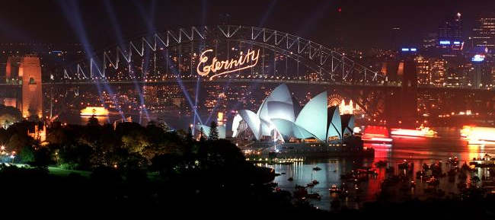
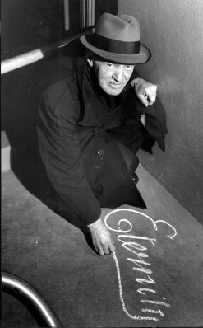
Arthur Stace
Stace described his life-changing experience at the Burton Street church in an interview with the Daily Telegraph in 1965, two years before his death:
John Ridley was a powerful preacher and he shouted, ‘I wish I could shout Eternity through the streets of Sydney.’ He repeated himself and kept shouting, ‘Eternity, Eternity’, and his words were ringing through my brain as I left the church. Suddenly I began crying and I felt a powerful call from the Lord to write ‘Eternity’. I had a piece of chalk in my pocket, and I bent down right there and wrote it. I’ve been writing it at least 50 times a day ever since, and that’s 30 years ago ... I think Eternity gets the message across, makes people stop and think.
- http://www.nma.gov.au/exhibitions/eternity/home
Notes:
Arthur Stace – Homeless man in Sydney – with gift of calligraphic writing – went around streets of sydney writing in chalk – the impact was enormous! So enormous that the word ETERNITY was lit up on sydney harbor bridge

Slide 3

Entropy
Everything in universe going from Order disorder
Notes:
St
Activity – hold bouncy ball up in air – let it go and let it bounce until it completely stops. Then ask Q – what happened to the ENERGY of the ball? Did it disappear? No – it went from potential energy to a bunch of different forms of energy – that’s what’s happening in our universe every single day – energy coming from sun dispersing into all these different forms – eventually even the sun is going to run out of energy – Q – WHERE DID THE ENERGY/ORDER COME FROM – feel free to read Gen chapter 1 – God brought ORDER INTO CHAOS. Remind students that you are not preaching – but these physics principles etc.. Simply beg the question – where did it come from?

Slide 4
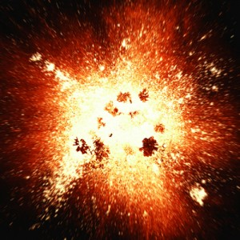
E = MC2
Notes:
Big Bang theory – Originally opposed by athiests because they thought that people were trying to prove the existence of a God by stating that such a large input of energy was needed to start the universe expanding and create matter (EINSTEINS theory E=MC’2 proves that there is almost infinite energy wrapped up in each atom of matter – if you can just split the atom – this means that a MASSIVE amount of energy was needed even for matter to simply exist – this also begs the question – WHERE DID THE ENERGY COME FROM “No such thing as a free lunch. The universe had to have come somewhere (John Polkinghorne - leading physicist). Only something Huge such as God could have put The energy into the system” Q – If God created us, who/what created God?

Slide 5
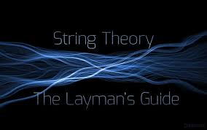


Particle physics interactions can occur at zero distance –
but Einstein's theory of gravity makes no sense at zero distance.
DIMENSIONS
(up to 10)
-string theory (higher
Level mathmatics)
‘maybe these higher
Dimensions could
Be ‘spiritual’?
String interactions don't occur at one point but
are spread out in a way that leads to more sensible quantum behavior.
Notes:
You can skip this slide if you want – but if you look at bottom rt hand corner – you can see the spiritual aspect of these dimensions – that even though us humans are bound by 4 dimensions (height, length, depth and time), a spiritual being – such as God – won’t necessarily be bound by these dimensions (eg – time) which helps explain the common Question as mentioned in last slide – Who created God – this helps people appreciated the notion that God can indeed have no beginning and no end – CRAZY head spinning stuff

Slide 6


WHAT ABOUT YOUR EXPERIENCES?
Epiphanies, David Hay research (spiritual experiences)
Notes:
Ask students to discuss in groups of 2/3 whether they’ve thought about any spiritual expierences they might’ve had – eg – stranger warned them about the slippery road at just the right time – good time to share any ways in which God may have been leading you in your pre-christian or christian days.

Slide 7


David Hay (‘Spirit of a Child’)
‘They’ve not yet met a child under
The age of 8 that doesn’t have a
Spiritual way of looking at the world’
Notes:
This is an interesting point from David Hay’s research (in their research they find that all children under the age of 8 have a spirtual awareness – begs the question – WHY DO YOU THINK ITS LESS FOR ADULTS?

Slide 8
Notes:
Life is a bit like where’s wally – there’s all sorts of mess etc. (we will talk about suffering next week) – however – if YOU HAVE EYES TO SEE IT, there are glimmers of God in this messy world – We as christians believe that he is at work in our lives – his holy spirit is always wanting to guide us towards him (but we have free will and we have the power to make a choice)

Slide 9
G O D I S N O W H E R E
Notes:
Two ways to read this statement
God is nowhere (chaos/athiest theory)
OR
GOD IS NOW HERE
(two people can look at the same set of circumstances – one can say – God is nowhere – and the other one can say God is NOW HERE.

Slide 10

Notes:
Bit of fun – two different images (prove the point above)

Slide 11

Notes:
Two diff images (eskimo and indian)

Slide 12
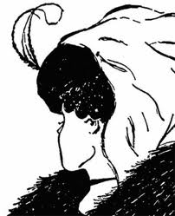
Notes:
Two diff images (young woman looking away, old woman looking down)

Slide 13
GODLOVESHURTINGPEOPLE
Notes:
Two diff ways to see this as well

Slide 14
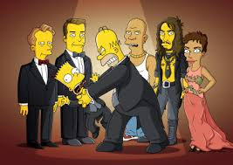

G O D I S N O W H E R E
Notes:
What opinion do you have of the christian God? Angry/disappointed? OR

Slide 15
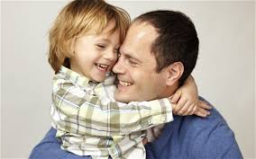

Notes:
A loving father
Psalm 30 (I think) – His anger lasts a moment but his lovingkindness lasts forever

