Slide 1
Experimental Errors
Funny

Slide 2
A good scientist chooses the correct equipment for the job to prevent errors in measurement.
Even with the correct equipment, mistakes can easily be made if care is not taken when measuring
There are three types of measuring errors

Slide 3
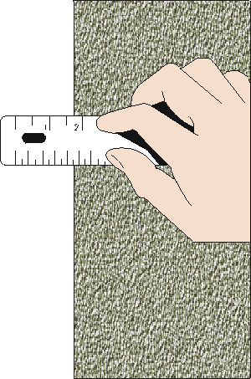
Reading Errors
When you guess what the actual measurement is because the measurement finishes between two marks.

Slide 4
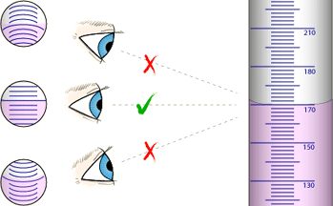
Parallax errors
When the eye is not placed directly opposite the scale when the reading is being taken.

Slide 5
Zero error
When an instrument (like a scale) has:
Not been set at zero prior to measuring.
The weight of a measuring container has not been considered.

