Slide 1
Exothermic and Endothermic Reactions Oxidation Reactions

Slide 2
Exothermic vs Endothermic

Slide 3
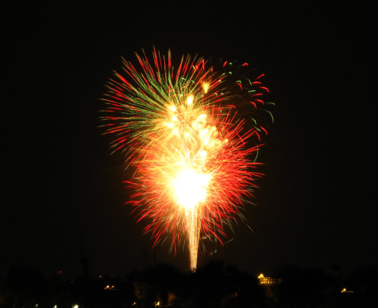
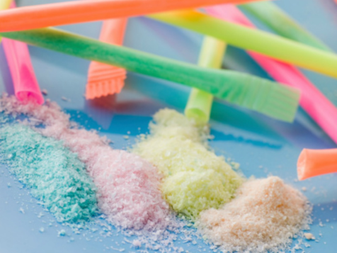
Exothermic
Endothermic
A chemical reaction that gives off energy.
The reactants have more energy than is needed to form the products so they release it.
I.e. gives off heat
A chemical reaction that absorbs energy.
The reactants need more energy to become products so they absorb that energy from around them.
I.e. absorbs heat

Slide 4
Endothermic Reaction
Collect:
½ teaspoon of citric acid (C₆H₈O₇)
¼ teaspoon baking soda (NaHCO₃)
3 teaspoons of icing sugar (C₁₂H₂₂O₁₁)
Clean mixing container
Teaspoon
Do this:
Add all ingredients to the small mixing container.
Use the back of the teaspoon to crush any lumps as you mix together.
Keep it dry until ready to eat!

Slide 5
Oxidation Reactions

Slide 6
Combustion

Slide 7
Combustion
Combustion is an exothermic reaction.
Combustion occurs whenever something reacts with oxygen gas (O₂)
No oxygen = no combustion

Slide 8
Burning Steel Wool Example
4Fe(s) + 3O₂(g)→ 2Fe₂O₃(s)
YouTube Video: www.youtube.com/watch?v=B6MX5uyXrb4

Slide 9
Complete vs Incomplete Combustion

Slide 10
Incomplete
Complete
Combustion that occurs when oxygen is limited.
Produces carbon (soot/smoke) and CO
Combustion that occurs when there is plenty of oxygen.
Produces CO₂ and Water
Carbon Monoxide | Carbon Dioxide
Doesn’t occur naturally in the atmosphere | Occurs naturally in the atmosphere
Result of oxygen starved combustion in improperly ventilated fuel-burned equipment | Natural by product of human and animal respiration, fermentation, chemical reactions, and combustion fossil fuels/woods
Generated by any gasoline engine WITHOUT a catalytic converter | Generated by any gasoline engine WITH a catalytic converter
Common type of fatal poisoning | Poisoning is rare
Flammable gas | Non-flammable gas

Slide 11
Demo: Bunsen burners are a common example of combustion.
Complete
methane + oxygen → carbon dioxide + water + energy CH_{4(g)} + 2O_{2(g)} → CO_{2(g)} + 2H₂O_{(l)}
Incomplete
methane + oxygen → carbon monoxide + water.
2CH4(g) + 3O2(g) → 2CO(g) + 4H2O(l)

Slide 12
Other examples
Aerobic Respiration
C₆H₁₂O₆ + 6O₂ → 6CO₂ + 6H₂O + ATP ENERGY
Burning Magnesium
2Mg + O₂ → 2MgO

Slide 13
Corrosion

Slide 14
Corrosion: The chemical reaction that uses oxygen and breaks down metals to form other compounds.
Iron/Steel → Rust
Copper → Verdigris
Silver → Tarnish
Aluminium → Anodising

