Slide 1
Continental Drift

Slide 2
How did the world begin?

Slide 3
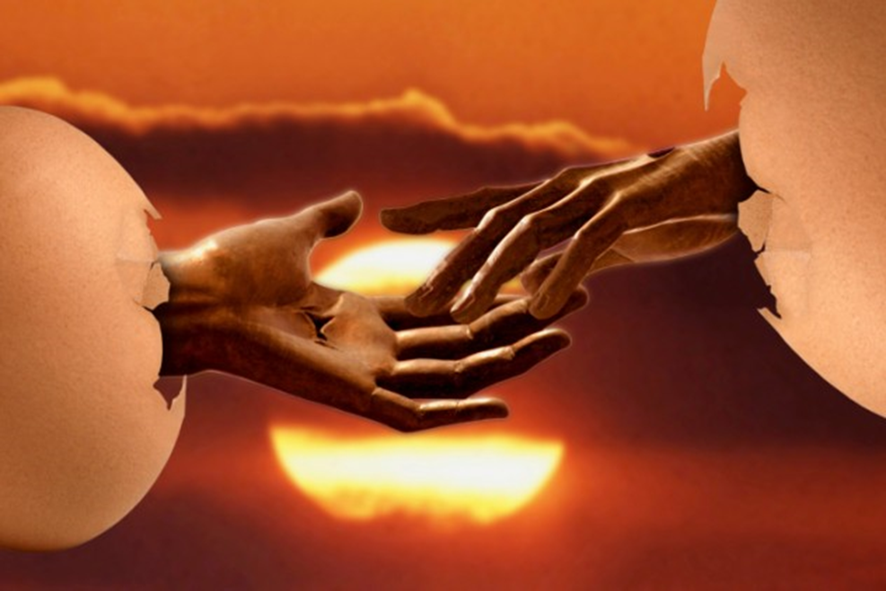
China’s Cosmic Egg
The first living being was P’an Ku, who grew for 18,000 years inside a cosmic egg. When he hatched, the shell above him became the sky while the piece below became the earth. The opposites in nature were separated as well—male and female, wet and dry, light and dark, yin and yang, etc.
After all this effort, P’an Ku literally fell to pieces and his features became the natural world. His limbs turned into mountains, his blood to rivers, his breath the wind, his voice the thunder, his hair the grass, his sweat the rain, and so on. His left eye became the sun and his right became the moon. Some people say that the parasites on P’an Ku’s body became mankind

Slide 4
India: Create, Preserve, Destroy, Repeat
Brahma began from nothingness. By thought alone, he created the waters, into which he deposited his semen. This grew into a golden egg, out of which he was born. By thought again, he split the egg in two, and the halves became heaven and earth. Brahma grew lonely, so he split himself in two to form male and female.
In one variation of the story, Brahma repeatedly splits himself in two until all living things are created from his body.
In another, the first man and woman mate in different animal forms until life forms are born.
Together, Brahma (the Creator), Vishnu (the Preserver), and Shiva (the Destroyer) make up the Supreme One. Each universe Brahma creates is eventually destroyed by Shiva, after which there is nothing but a vast ocean on which Vishnu floats, resting on a great snake.

Slide 5
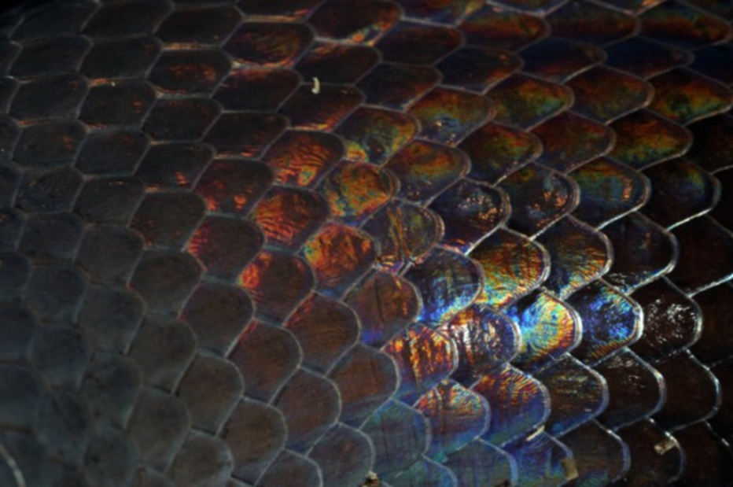
The Aborigines’ Rainbow Serpent
Aboriginal creation stories begin with the Dreaming, when the world was bare and cold. The Rainbow Serpent slept underground with all the animal tribes in her belly. When the time was right, she emerged and spewed forth the animals, along with the features of the natural world.
The Rainbow Serpent was the maker of laws, which all creatures must obey. In some variations of the myth, she swallowed wrongdoers and spat out their bones to form rocks and hills. In others, she rewarded those who obeyed the law by giving them human form and turned the lawbreakers into stone.

Slide 6
Christian: Genesis 1
vs 1-3
In the beginning God created the heavens and the earth. Now the earth was formless and empty, darkness was over the surface of the deep, and the Spirit of God was hovering over the waters.
And God said, “Let there be light,” and there was light. God saw that the light was good, and he separated the light from the darkness. God called the light “day,” and the darkness he called “night.” And there was evening, and there was morning—the first day.

Slide 7
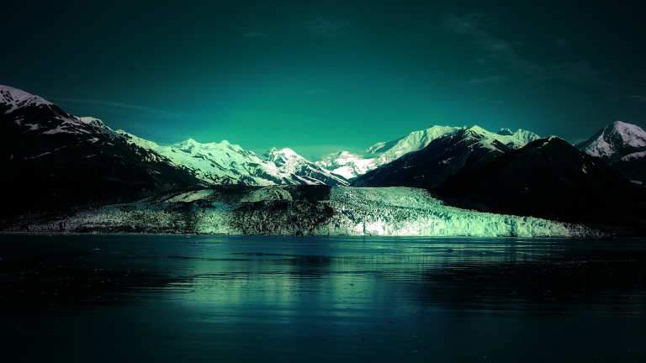
Vs. 9-10
And God said, “Let the water under the sky be gathered to one place, and let dry ground appear.” And it was so. ¹⁰ God called the dry ground “land,” and the gathered waters he called “seas.” And God saw that it was good.

Slide 8
Amazing Geological Features

Slide 9
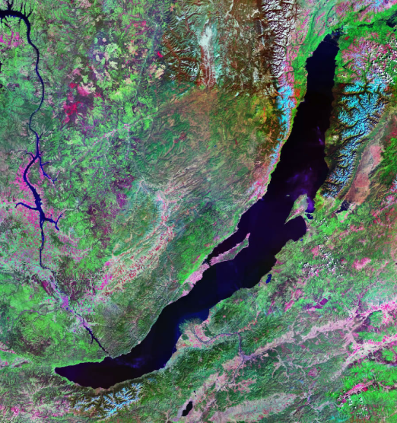
Lake Baikal - Russia
Contains 20% of
the earth’s liquid
freshwater
Is the deepest
lake in the world
(1,642m)

Slide 10
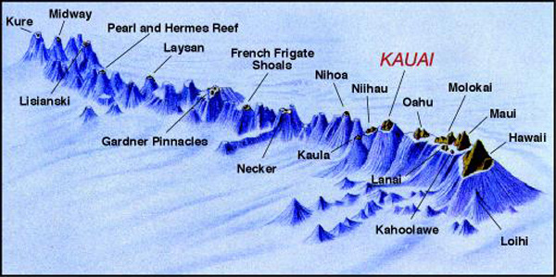
Mauna Kea
It is the highest mountain in the world from base to peak (10,010m-more than twice the height of Mount Everest!)
It is a dormant volcano

Slide 11
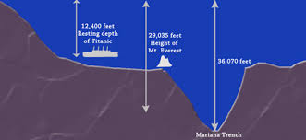
Mariana trench
Lowest natural point on earth (10,911m below sea level)
Cameron’s Long Way Down: Mariana Trench
Notes:
Video: http://video.nationalgeographic.com.au/video/news/deep-sea-challenge/cameron-how-deep

Slide 12
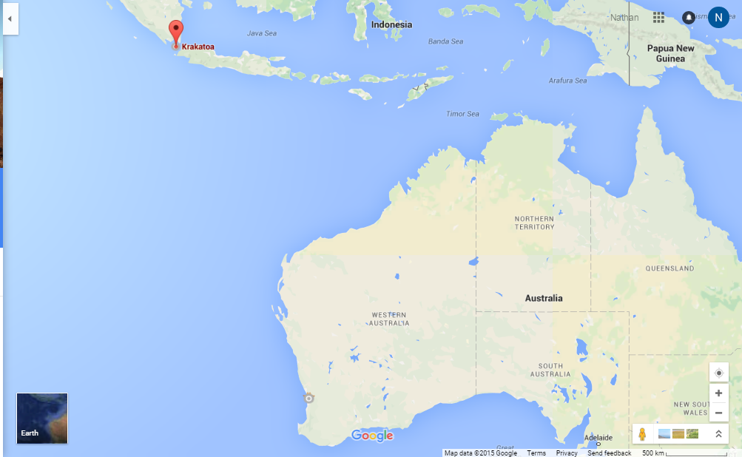
Krakatoa: Loudest noise on earth
Volcano exploded with the force of 13,000 atomic bombs
The sound was heard over 4,500km away
Notes:
Video: Discovery - http://www.discovery.com/tv-shows/other-shows/videos/krakatoa-volcano-of-destruction-loudest-explosion-ever/

Slide 13
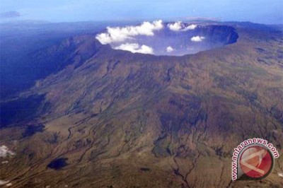
Mount Tambora – 1815 ‘The year without summer’
Global temperatures were an average of five degrees cooler (It was snowing in summer)
Crops failed worldwide
There was the invention of the bicycle as horses became too expensive to feed.
Notes:
Regency House Party part 26 (Start 7:40): https://youtu.be/t6uJjGKsj0U?t=7m40s

Slide 14
History of Discovery
Ice Age: Continental Drift
Notes:
Ice Age: Continental Drift – Ice Age 4: Scrat Continental Crack-up

Slide 15
Big Questions
How could we force Australia and New Zealand together to form one country?
What would happen to:
The climate
If we pushed Australia closer to New Zealand
If we pushed New Zealand closer to Australia
The animals and vegetation
If we pushed Australia closer to New Zealand
If we pushed New Zealand closer to Australia
Notes:
Slide added because of Strategic Questioning PD 2015: Kylie Bice – www.growingupgreatness.com

Slide 16
Student Activity: Pangaea Desks
Students to try and assemble desks back into proper order based on
Fossil Record
Jigsaw fitting together
Teacher to have pre-set printed off paper and taped to desk

Slide 17
Theory of Continental Drift
1. Around 1912, Alfred Wegener proposed that the continents were once connected to each other in a supercontinent called Pangea but were separated over time from each other by continental drift.
2. He based his ideas on two observations:
i) The continents fit together kind of like a jigsaw.
ii) Fossils from the same species were found on continents a long way apart.

Slide 18
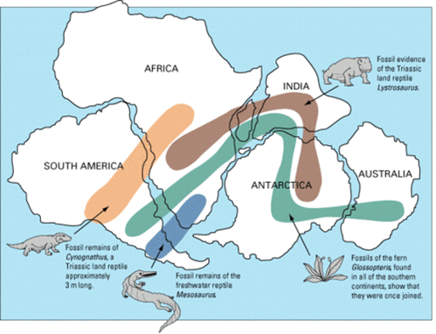
3. His theory was not accepted by other scientists because there was no know mechanism by which the continents could move, or to measure their movement.

Slide 19
Seafloor Spreading

Slide 20
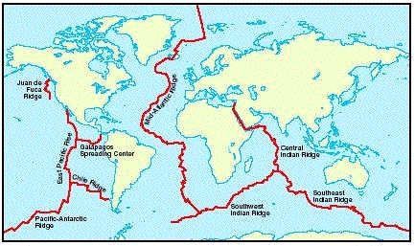
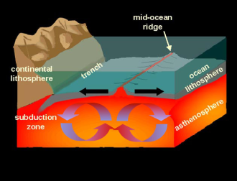
Seafloor spreading
1. In 1872 scientists first discovered a ridge in the Atlantic, which was later found to run the entire length of the Atlantic Ocean.
2. Further studies showed it continued into other oceans and that the ridge had cracks in the centre.

Slide 21
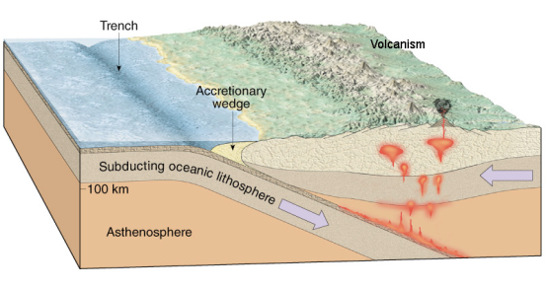
3. Harry Hess, an American geologist who discovered many flat-topped mountains under the Pacific ocean in WW2, proposed that new crust was being formed at the ridges forcing the continents apart.
4. He also proposed that the crust was sinking down in other places creating trenches (the process is called subduction)
Video: Bill Nye
Sea Floor Spreading
Notes:
Sea Floor Spreading with Bill Nye: https://www.youtube.com/watch?v=GyMLlLxbfa4

Slide 22
Terms to Know
Seafloor spreading - The process of new crust forming at the ocean ridges and spreading outwards.
Subduction – The process by which areas of the earth’s crust is sinking down forming ocean trenches.
Ocean Trenches – areas where subduction takes place

Slide 23
Evidence for Movement
Magnetic Striping
Age of Sea Floor
Sediment Thickness

Slide 24
Magnetic Striping

Slide 25
Magnetism in Brief
Where do magnetic fields come from?
Youtube: MinutePhysics – Magnets: How Do They Work
Observation: Iron fillings with magnets

Slide 26
Magnetic striping
1. Magnetite is a mineral found in many rocks
2. A piece of magnetite acts as a compass.
3. When molten rock solidifies, the magnetite all lines up in the direction of the earth’s magnetic field-each piece of rock acts as a tiny magnet

Slide 27
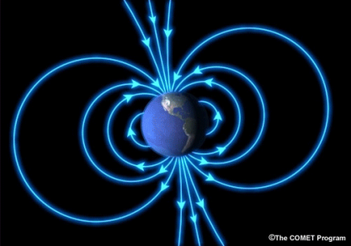
What we know:
The sea floor has bands of alternating north and south facing magnetite.
These bands are parallel to the mid-ocean ridges.
Video: Magnetic Reversals
Notes:
Magnetic Reversals: https://www.youtube.com/watch?v=BCzCmldiaWQ

Slide 28
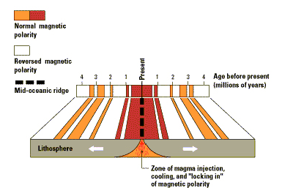

Slide 29
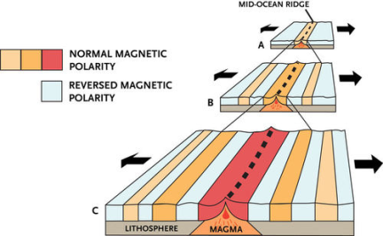
What we propose:
Is due to changes in the earth’s magnetic field over its history.
It is because earth’s magnetic field has changed every few million years.
The patterns on either side are symmetrical.
Meaning new seafloor is being added equally on each side of the ridge.
Student Activity: Sea Floor Model

Slide 30
Magnetic Striping near Iceland

Slide 31
Term to Know
Magnetic Striping– patterns of magnetism trapped in rocks on either side of plate boundaries.

Slide 32
Age of the Sea floor & Sediment Thickness

Slide 33
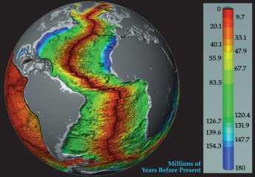
Age of sea floor
When rocks on the sea floor were dated, they found that the rocks further away from the mid-ridge are older than those close.
The oldest seafloor rocks were 200 million years old, some continental rocks were thousands of millions of years old
This means the sea floor is younger than the continents

Slide 34
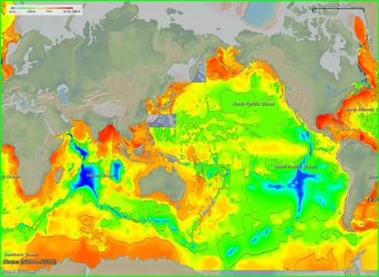
Sediment thickness
Sediment is thicker the further away you get from the ridges
This shows that sediment has been falling a longer time away from the ridges

Slide 35
Draw this Diagram

Slide 36
How Plates Move
Youtube Video: Drones Sacrificed for Spectacular Volcano Video
Notes:
Youtube video: https://www.youtube.com/watch?v=zFIWWM0Iv-U

Slide 37
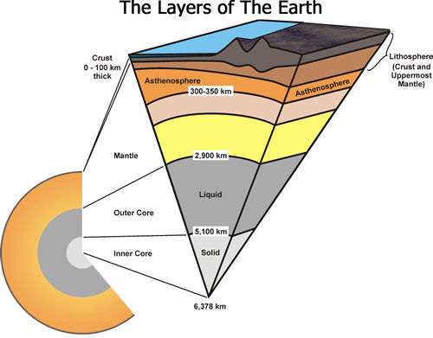
Earth’s layers
The earth consists of different layers:

Slide 38
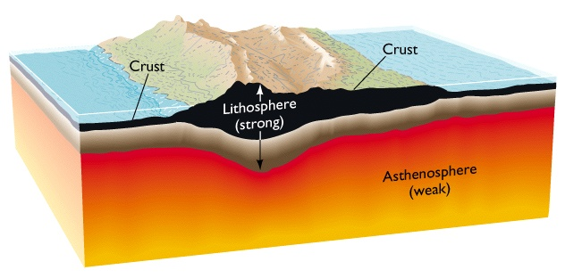
Earth’s layers
Crust - solid, made up of cracked plates that float.
Asthenosphere - semi-solid rock in the upper mantle, which flows very slowly
Question:
What makes it
so hot inside
the earth?

Slide 39
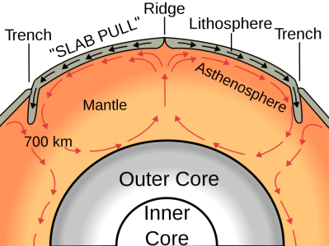
Two Theories
Convection Current Theory - The plates are dragged along as magma rises and flows along the plates, forming convection currents (YouTube Video: Plate Tectonics)
Gravity Theory - Gravity pulls the new crust away from the ridge as it cools and becomes more dense
Notes:
Plate Tectonics - https://www.youtube.com/watch?v=ryrXAGY1dmE

Slide 40
Draw this Diagram

Slide 41
Rifting
Rifting is when the crust cracks and subsides, allowing oceans in.
The continents then move along with the ocean floor as it spreads apart from the ridges

Slide 42
End

Slide 43
Is plate movement a problem for Christianity?
It is assumed that plate movement has always occurred slowly.
Mount D?? Though had a fissure forming was very quick which is contrary to the generalisation that plate movement always occurs slowly over a long period of time.
Google Image of Mount

