Slide 1
Coldex Investigation

Slide 2
Overview
You will be conducting the investigation in groups set by your teacher.
You will be required to follow the Scientific Method.
You will need to do some pre-reading to understand the background scientific concepts.
Your written assessment (Investigation Proforma) will be individual and sat in test-like conditions.

Slide 3
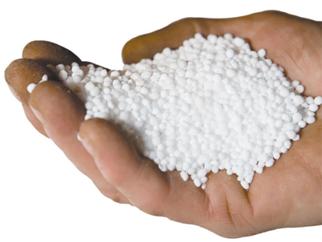
Background Story
Urea is a colourless, crystalline compound that undergoes an endothermic reaction when dissolved in water. This means that when it is mixed with water, it sucks in heat from the surrounding area, making it seem very cold.
A company wants to use this product and sell it under the name of COLDEX. In order to comply with the ACCC, the company needs you to test the compound’s reaction then record and present the data.

Slide 4
Your Task
You will need to design an investigation using the scientific method.
You will test the effects of different amounts of urea on the temperature of the reaction.
You will need to come up with all parts of the investigation.
Refer to the PowerPoint (Scientific Method) for help.

Slide 5
Your Materials
Beakers
Measuring Cylinder
Thermometers
Digital Scales
Urea (Coldex)
Spatula
If you believe you need any other unique materials outside of this list you must discuss this with your teacher immediately.

Slide 6
Background Reading

Slide 7
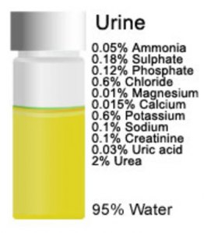
Urea
Endothermic Reactions
Temperature and Rate of Reaction
Concentration and Rate of Reaction

Slide 8
Student Task

Slide 9
Open your workbooks and title the top of the page as “Coldex Concentration Investigation”
Note down your group members.
Begin the task by completing the following:
Read information documents and summarise key information relative to the investigation.
Consider the task and write a hypothesis
Identify your variables
Begin detailing what methods and equipment you will use to test your hypothesis.
Draw up a blank table that correlates with the data you will collect.

