Slide 1
Chemistry: Chemical Change and Balancing Equations

Slide 2
What is the difference?
Demo: Physical and Chemical change in a piece of paper.

Slide 3
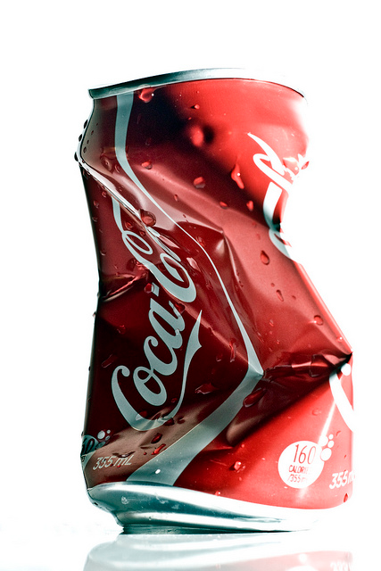
Physical change
Physical changes do not produce new substances
E.g. boiling, crushing a can

Slide 4
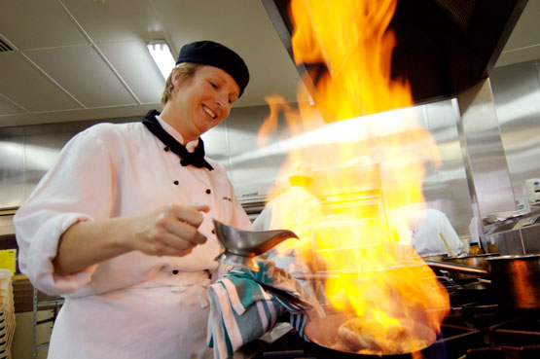
Chemical change
A chemical change produces a new substance
E.g. burning, cooking
You can often tell a chemical change by these:
Light
Heat
Colour change
Bubbles
New smell
Sound

Slide 5
Why do we balance?
It’s like a puzzle

Slide 6
Law of conservation of mass
Atoms cannot be created or destroyed
Therefore:
The mass of reactants = the mass of products

Slide 7
Hydrogen Gas Demo
Reactants → Products
H₂ + O₂ → H₂O
Notes:
Best to explain this via drawing, then using this as a second summary.

Slide 8
Summary: We balance equations because …
No matter is lost in a reaction.
So, there must be the same number of atoms on each side of the arrow
This is done by adding numbers in front of chemicals. We call them coefficients.
We add coefficients until they are balanced on both sides.

Slide 9
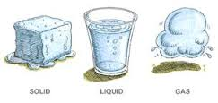
Ways of writing the equation.

Slide 10
Word equations are written with their chemical names.
Calcium Carbonate + Sulfuric acid → Calcium Sulfate + Carbon dioxide gas + water
Chemical equations are written with the chemical formula.
CaCO₃ + H₂SO₄ → CaSO₄ + CO₂ + H₂O
Chemical equations also should include their states.
CaCO₃(s) + H₂SO₄(aq) → CaSO₄(s) + CO₂(g) + H₂O(l)
(s) for solid, (l) for liquid, (g) for gas, (aq) for an aqueous solution (ie. dissolved in water)

Slide 11
Practice

Slide 12
__H₂ + __0₂ → __H₂O

Slide 13
Balancing Equation
___N₂ + ___H₂ → ___NH₃

Slide 14
Balancing Equation
CH₄ + O₂ → CO₂ + H₂O

Slide 15
Balancing Photosynthesis

Slide 16
This is the process by which plants convert energy from the sun into food.
WORD: Carbon Dioxide + Water → Glucose sugar + Oxygen + Water
CHEMICAL: CO₂ + H₂O → C₆H₁₂O₆ + O₂ + H₂O
CAN YOU BALANCE IT ?
BALANCED CHEMICAL: 6CO₂ + 12H₂O → C₆H₁₂O₆ + 6O₂ + 6H₂O

Slide 17
End

Slide 18
Recall: Naming ionic compounds and writing formula (one metal and one non-metal)
Metal goes first, with normal name
Negative ion goes second (usually with end of name changed to –ide)
Do swap and drop
Some common negative ions that don’t end in –ide are PO₄³⁻ (phosphate), CO₃²⁻ (carbonate), HCO₃⁻ (hydrogen carbonate) and SO₄²⁻ (sulfate)

Slide 19
Naming covalent compounds (no metals)
The element closer to the left side of the periodic table is named first, and keeps its normal name
The element to the right has the end of its name changed to –ide
Prefixes are used to indicate if there is more than 1 atom in the molecule:
Mono-1, di-2, tri-3, tetra-4 penta-5
e.g. N₂O₄ is called dinitrogen tetraoxide and CO₂ is carbon dioxide

