Slide 1
National Geographic Video
Boundaries and Plates

Slide 2
Types of Crust

Slide 3
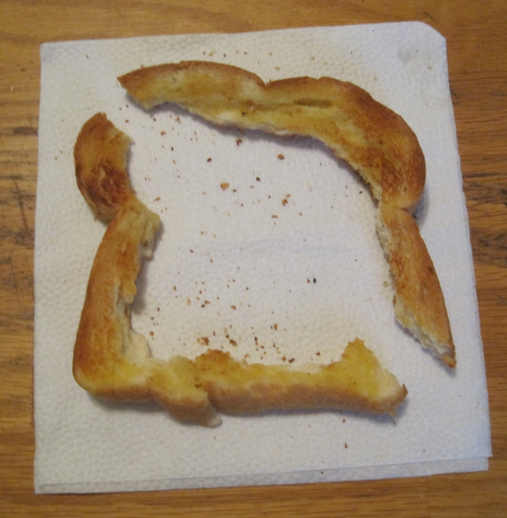
Oceanic Crust
Continental Crust
More dense
Contains more heavy elements like iron and magnesium
Darker in colour
Thinner
Less dense
Contains more light elements like silicon and aluminium
Lighter in colour
Thicker
The densities of the types of crust are important when the plates are moving near each other.

Slide 4
Plates

Slide 5
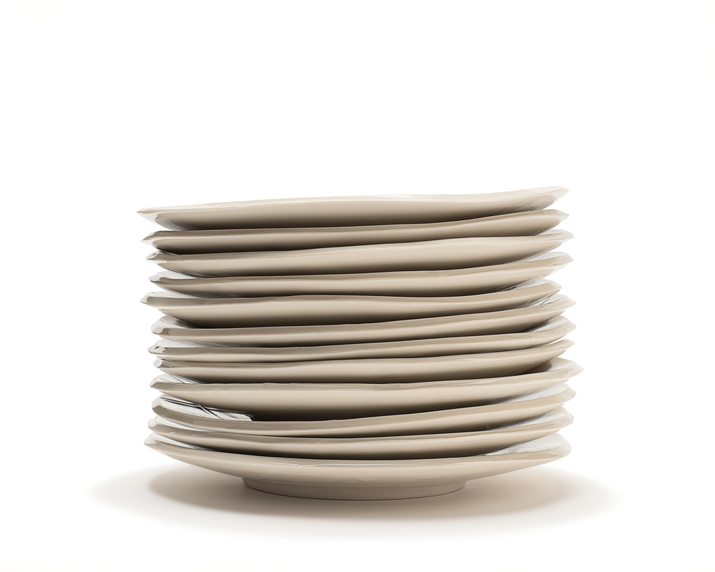
Where are the plates?
7 extremely large plates
10 medium sized plates
60 smaller sized plates
Name the 7 major plates
___________________
___________________
___________________
___________________
___________________
___________________
___________________

Slide 6
Major plates
Label Worksheet

Slide 7
Boundaries
Diverging
Converging
Oceanic Crust with Continental Crust
Continental Crust with Continental Crust
Oceanic Crust with Oceanic Crust
Transform

Slide 8
Diverging

Slide 10
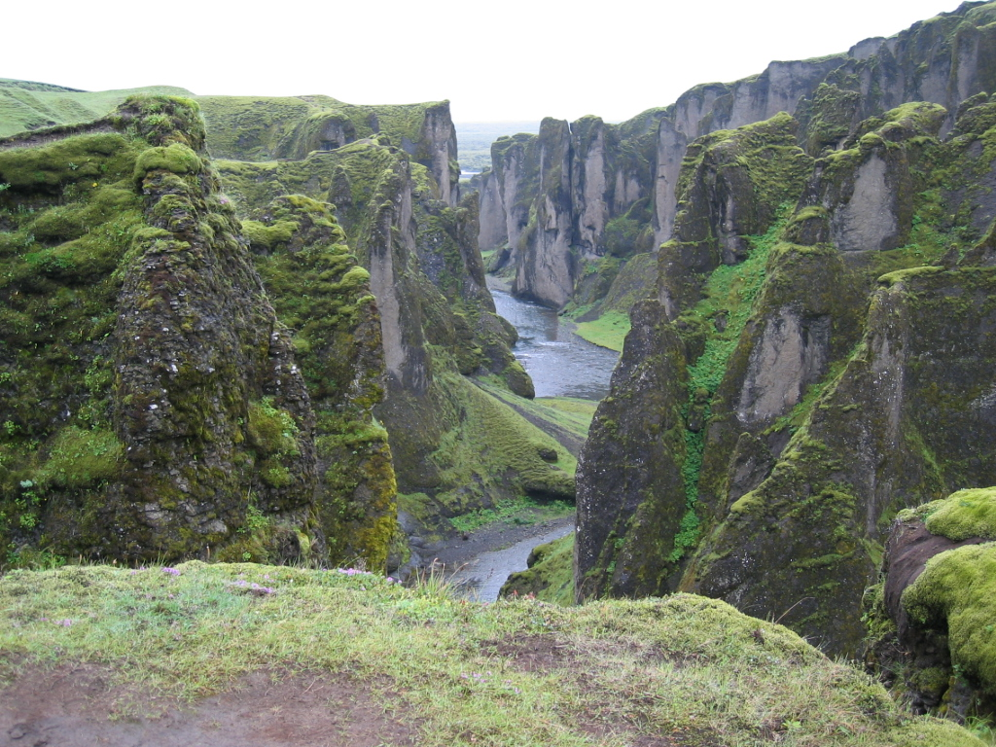
Key Facts:
When plates move away from each other.
Causes rifting to form which is filled with magma that cools and becomes new plate.
Called constructive boundaries.
Form non-violent volcanos
Ocean ridges are all diverging boundaries

Slide 11
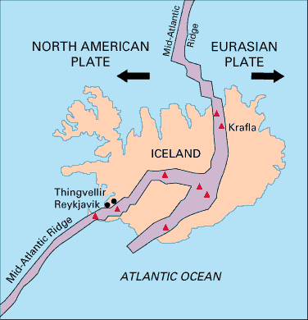
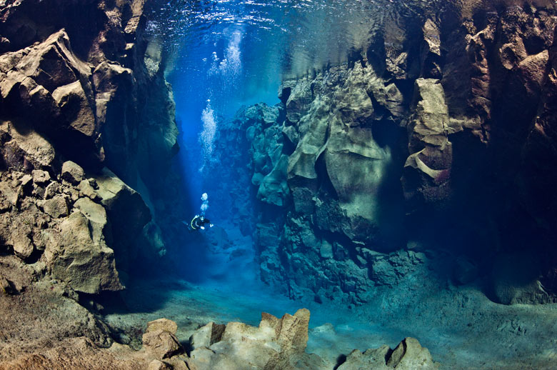
Interesting Diverging boundary
The Mid-Atlantic Ridge runs through Iceland.
So the Island is continuing to get wider and wider.
Notes:
Youtube: Mid Atlantic Ridge https://www.youtube.com/watch?v=sgDM6m0lUGY

Slide 12
Dating
Geologists try to estimate the age of geological features based on the distance between the rifts.
Currently Iceland is moving around 3 cm apart each year.
Iceland is 250 km wide.
$\frac{Width of geological feature in centimeters}{Average distance moved apart each year}$ = Age
What is a huge assumption that these geologists make?

Slide 13
Converging

Slide 15
Kinaesthetic Activity
Heavy Tectonic Plate
Foam Tectonic Plate
Gell (Mantle)
Use these to demonstrate interactions between plates.

Slide 16
Key Facts
When two plates collide with each other
Also known as destructive boundaries because it destroys rock.
3 Types of crust interactions
Oceanic Crust with Continental Crust
Continental Crust with Continental Crust
Oceanic Crust with Oceanic Crust
Notes:
Ring of Fire: https://youtu.be/CCAxQ6tyvFQ?t=5m

Slide 17
Summary Table
Name | Interaction | Forms | Example Location
Oceanic with Continental
Continental with Continental
Oceanic with Oceanic

Slide 18
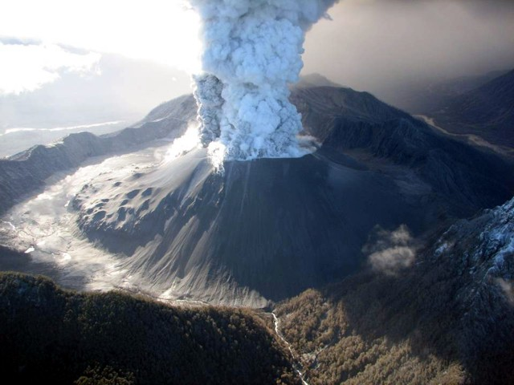
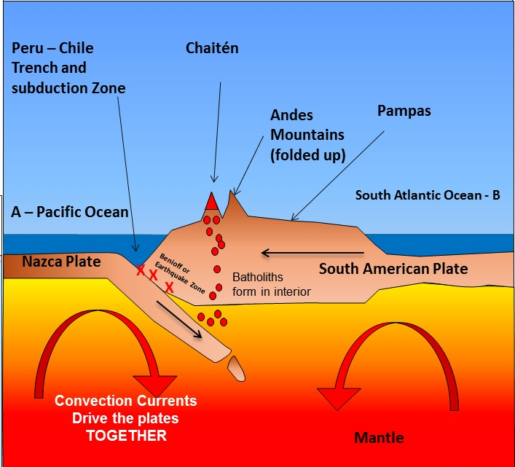
Oceanic Crust with Continental Crust
Interaction: The denser oceanic plate sinks under the lighter continental plate.
The continental plate subsequently becomes distorted forming:
Fold mountains
i.e. Andes mountains
Trenches
Violent volcanoes
Notes:
Ring of Fire: https://youtu.be/CCAxQ6tyvFQ?t=5m

Slide 19
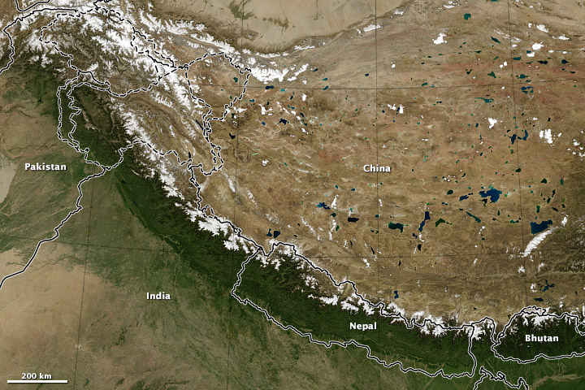
Continental with Continental
Interaction: Both are pushed upward
Form: very high mountain ranges
I.e. Indian and Eurasian plates = Himalayas
Eurasian Plate
Indian Plate
Notes:
Youtube: Flying from Mt.Everest Red Bull - https://www.youtube.com/watch?v=h_k8LsJDGlM
Ring of Fire: https://youtu.be/CCAxQ6tyvFQ?t=5m

Slide 20
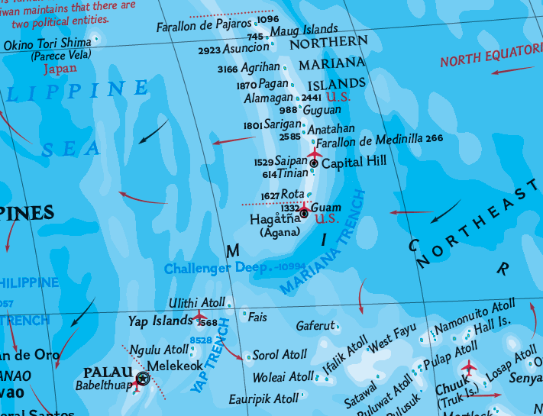
Oceanic with Oceanic
Interaction: The fastest moving plate subducts beneath the slower moving plate
Forming: A deep trench.
A chain of islands (island arc) forms from the magma
i.e. Mariana trench – Pacific plate and Mariana plate = Mariana Islands
Notes:
Ring of Fire: https://youtu.be/CCAxQ6tyvFQ?t=5m

Slide 21
Transform

Slide 23
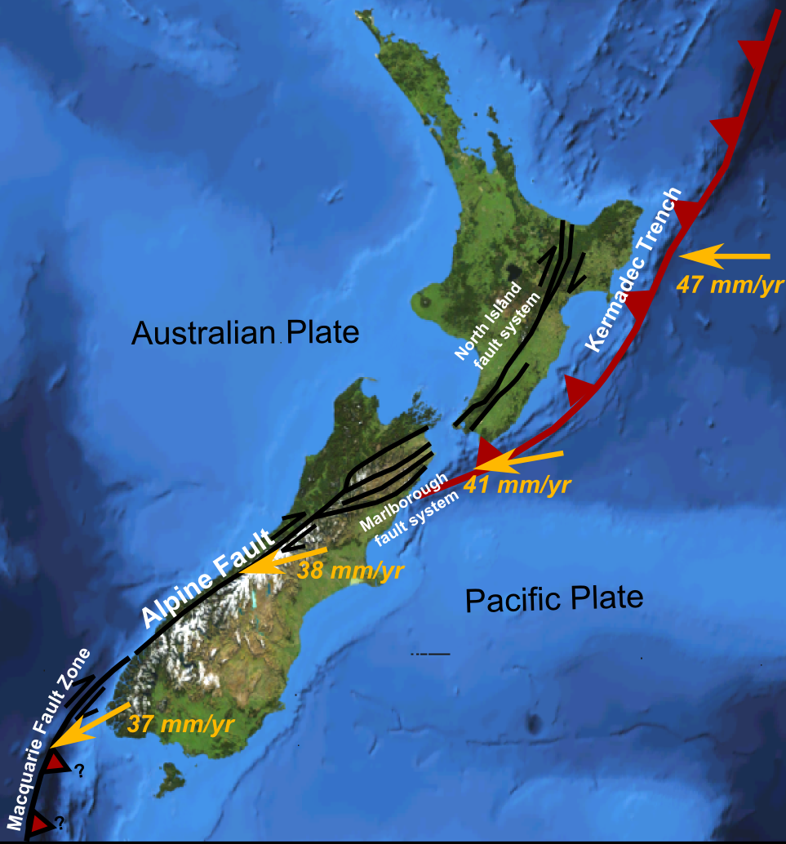
Where plates slide parallel to each other but in opposite directions.
Normally the plates move slowly, but a sudden slip will cause earthquakes.
Usually has
Fold mountains
Fault lines (cracks).

Slide 24
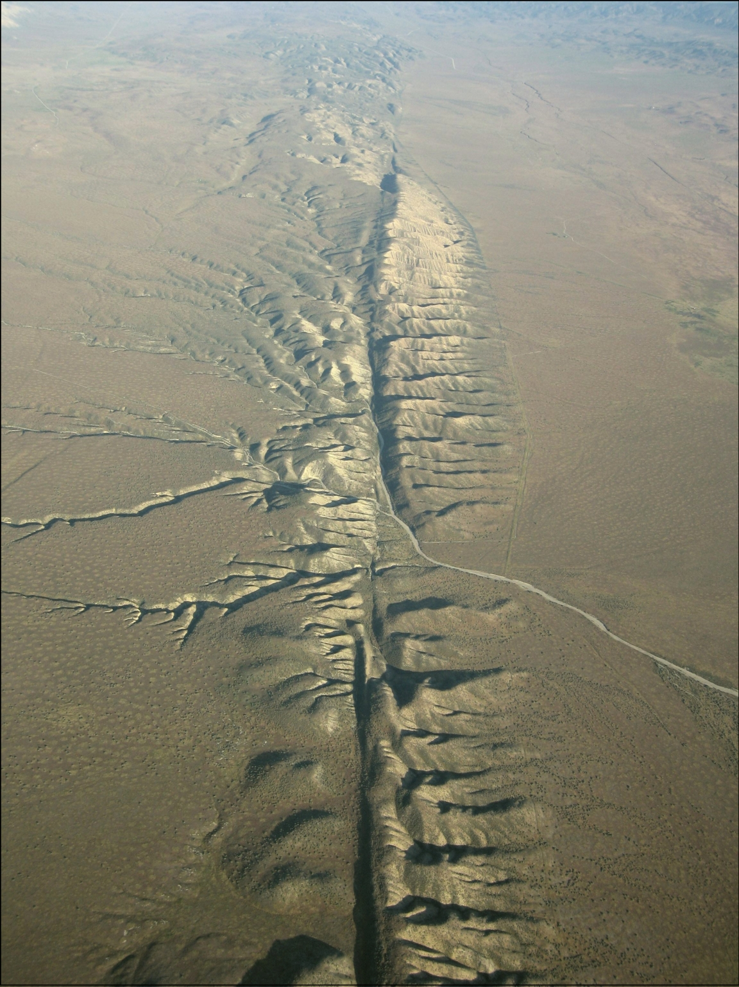
San Andreas Fault Line
Notes:
San Andreas Fault Discovery Channel: https://www.youtube.com/watch?v=ZxPTLmg0ZCw

Slide 25
Practical Activity

Slide 26
Practical Activity: Plasticine Boundaries
Students to create models of the three types of plate movement.
Use one colour for the asthenosphere and one for the crust.
Students take a photo using device and add labels and arrows using photo editor.

Slide 27
End

