Slide 1
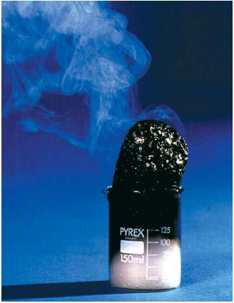
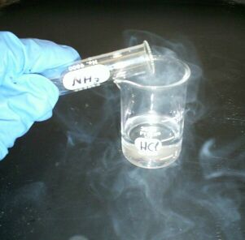
3 Acid reactions

Slide 2
Practice
Identify the acids, bases, metals and carbonates in the following examples:
HCl ____________________
Ca____________________
HF____________________
RbOH____________________
Fe₂(CO₃)₃____________________
Ca(OH)₂____________________
HNO₃____________________

Slide 3
Acid and Metals

Slide 4
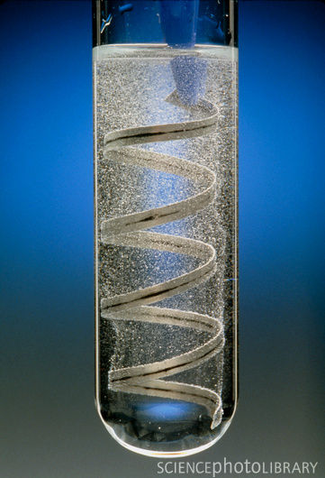
Acids and metals
Acids can corrode metals,
Usually breaking them down into a salt and hydrogen gas.
The general equation for the reaction between an acid and a metal is:
Acid + metal → a salt + hydrogen gas
Important Note:
Hydrogen Gas – H₂
Salt – Any compound formed by a metal taking the place of the hydrogen in an acid.
Practical: An example of this type of reaction is magnesium (metal) and hydrochloric acid

Slide 5
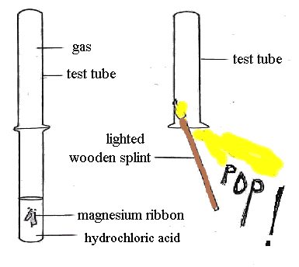
Acid reactions experiment
Reaction of an acid with a reactive metal

Slide 6
Word and Chemical Problems 1
1. Hydrochloric acid (HCl) + magnesium metal (Mg)
2. Sulfuric Acid (H₂SO₄) and Magnesium metal (Mg)

Slide 7
Word and Chemical Problems 2
Nitric Acid (HNO₃) and Zinc Metal (Zn)
Sulfuric Acid (H₂SO₄) and Sodium Metal (Na)

Slide 8
Your Turn
Acid Reactions Booklet
Complete Acid Reactions Worksheet 2 in your booklet

Slide 9
Acids And Carbonates

Slide 10
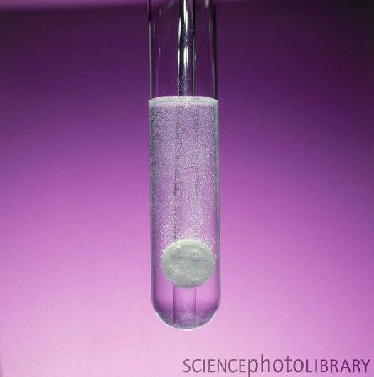
Acids and carbonates
Acids react with carbonates to produce carbon dioxide (CO₂) as well as salt and water.
The general formula is:
Acid + carbonate → a salt + water + carbon dioxide
Note:
A Carbonate is CO₃ ²⁻
An example of this type of reaction is calcium carbonate and hydrochloric acid:
Hydrochloric acid + calcium carbonate → calcium chloride + water + carbon dioxide

Slide 11
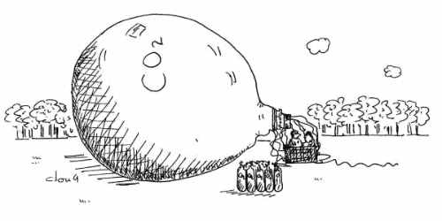
Acid reactions experiment
Vinegar (ethanoic acid) + Baking Soda (Sodium Hydrogen Carbonate) → Sodium Acetate + Water + Carbon Dioxide
CH₃COOH + NaHCO₃ → NaCH₃COO + H₂O + CO₂
2 heaping teaspoons of Baking Soda
60 mls of vinegar
600 ml coke bottle
Rubber stopper to fit lid

Slide 12
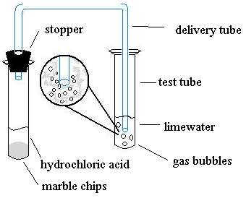
Acid reactions experiment
Reaction of an acid with a carbonate

Slide 13
Word and Chemical Problems 1
Sodium Hydrogencarbonate + Sulphuric Acid →
Sodium Carbonate + Sulphuric Acid →

Slide 14
Word and Chemical Problems 2
Iron (III) Carbonate + Carbonic Acid →
Calcium Carbonate + Nitric Acid →

Slide 15
Your Turn
Acid Reactions Booklet
Complete Worksheet 3 – Acid + Metal Carbonate Reaction
Note: Refer to the “Acids You Need to know…” at the back of your booklet.

Slide 16
Acid and bases
Neutralisation

Slide 17
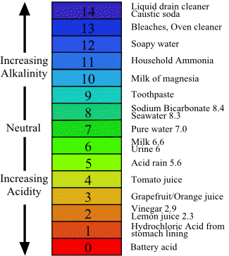
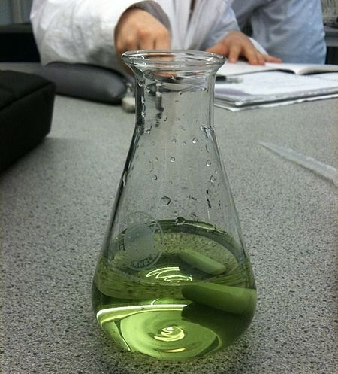
Acids and bases
Acids and bases neutralise each other when mixed.
They change each other into harmless substances such as water and a salt.
Neutralisation reactions take the form:
Acid + base → a salt + water
An example of this type of reaction is:
Sulfuric acid + sodium hydroxide → sodium sulfate + water

Slide 18
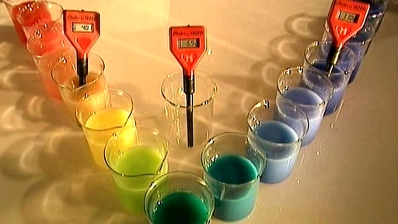
Acid reactions experiment
Reaction of an acid and a base

Slide 19
Heartburn
www.youtube.com/watch?v=3j2JbRUfpBo
Heartburn is caused by HCl from your stomach risiing into your esophagus.
Antacid tablets contain bases such as Mg(OH)₂ or Al(OH)₃ that neutralise the acid and bring relief.

Slide 20
Word and Chemical Problems 1
Aluminium Hydroxide + Hydrochloric Acid → Aluminium Chloride + Water
Potassium Oxide + Nitric Acid → Potassium Nitrate + Water

Slide 21
Word and Chemical Problems 2
Iron (III) Oxide + Sulphuric Acid →
Copper (II) Oxide + Phosphoric Acid →

Slide 22
Your Turn
Acid Reactions Booklet
Complete Worksheet 4 – Acid + Base Reactions (pg. 11-12)
Note: Refer to the “Acids You Need to know…” at the back of your booklet.

Slide 23
Acid Rain

Slide 24
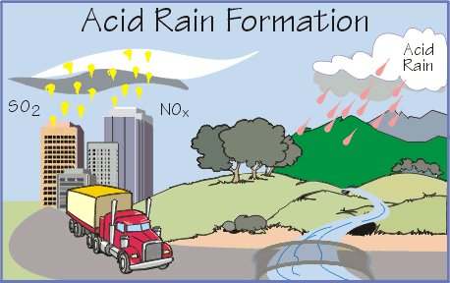
Identify – Clickview: http://online.clickview.com.au/mylibrary/videos/06ffd294-e412-41b6-a709-d791b99c2b96
Causes of Acid Rain
Effects of Acid Rain
Measures to control Acid Rain

