Slide 1
The Death of Paul

Slide 2
Races
Ping-pong ball and Spoon Race
Selected students try and use a spoon to carry a ping-pong ball around a course in the fastest time.

Slide 3
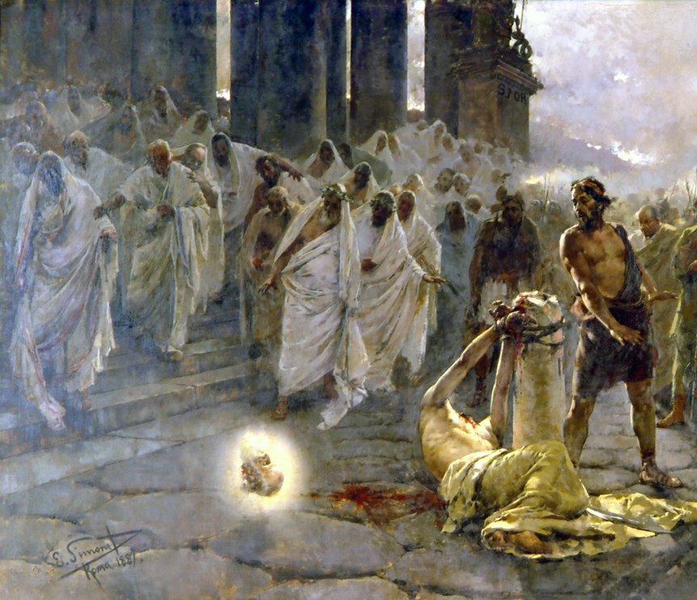
BEHEADING OF THE APOSTLE PAUl
On the 29th June 67 AD, Paul the Apostle, formerly known as Saul of Tarsus was taken about 3 kilometers outside of the city of Rome. There, a Roman soldier, during the reign of the Emperor Nero, beheaded the apostle Paul.
His friend and fellow apostle Peter was killed around the same time.
He was condemned to death for preaching the ‘Good News’ about Christ Jesus.
Paul played a huge role in founding the churches of the western Roman Empire. As a testament to his work, the churches he laboured to build endured for centuries.

Slide 4
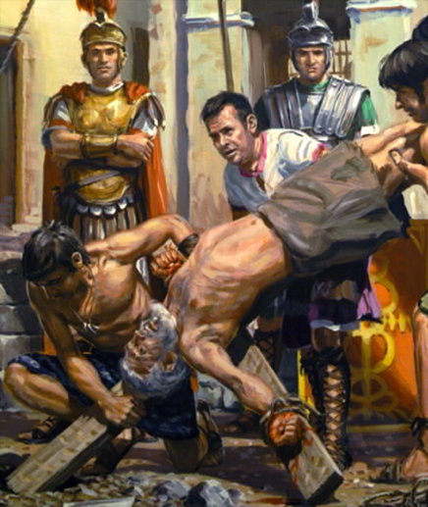
Paul was aware of his own influence but realised that it was only because of God’s mercy that he was able to do any of it. He said:
“For I am the least of all the apostles—I do not even deserve to be called an apostle, because I persecuted God's church. But by God's grace I am what I am, and the grace that he gave me was not without effect. On the contrary, I have worked harder than any of the other apostles, although it was not really my own doing, but God's grace working with me.
Paul was ideally equipped to be a great apostle in the west. Because he was a Roman citizen, he could move freely throughout the entire Roman world. Because he was educated in Greek literature, he understood the Greek mindset. Finally, because he was previously a Pharisee, he could freely enter into the Jewish synagogues and temple and reason with his fellow-countrymen.

Slide 5
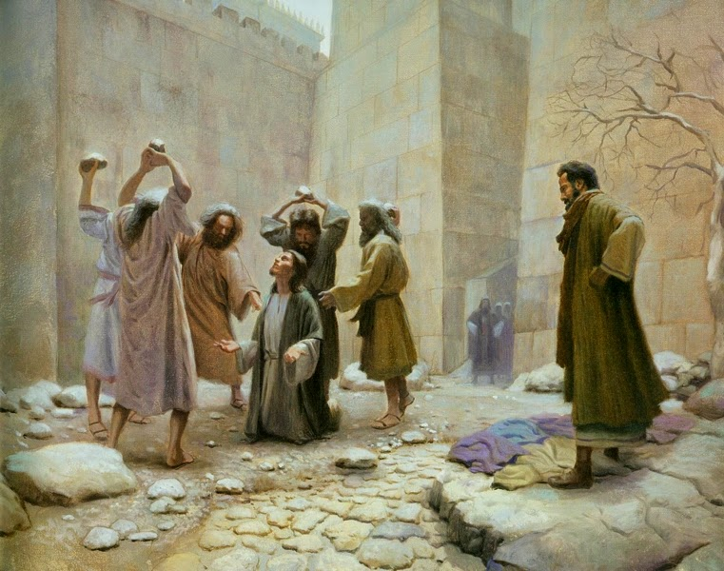
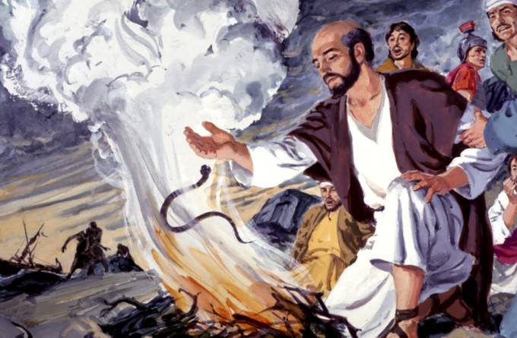
Saul the Persecutor
Paul the Persecuted
When we first read of Paul in the Bible, he was a zealous Jew, a persecutor of those who followed “the way,” as the early Christians called their movement. After Christ blinded him with a vision on the road to Damascus—where he was headed to arrest Christians—his life turned around. To a Christian believer named Ananias, Jesus foretold that Paul would suffer much. This promise was fulfilled. Writing a dozen years before his execution, Paul detailed a list of beatings, floggings, stonings, and shipwrecks. He had at least one more shipwreck and many years of prison ahead of him.

Slide 6
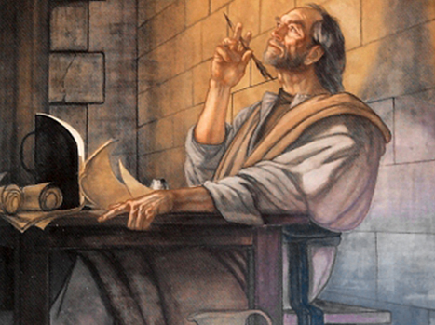
What Paul did while in Prison
Many of Paul’s letters were written while he was in prison. In fact, Paul and his close associates penned the bulk of the New Testament in prison.
In the end, he gave his life for the Saviour he had proclaimed. His beheading was the culmination of a life made as an “offering” to the Lord Jesus Christ.

Slide 7
Key Letter Moments
Letter to the Colossians – Explained how Jesus Christ was fully God, and the creator of the universe.
Letter to the Romans – A clear, evidence based explanation of Christianity.
Letter to the Corinthians - “I decided that while I was with you I would forget about everything except Jesus Christ and his death on the cross.”
Letter to the Galatians - “It is no longer I who live, but it is Christ who lives in me. This life that I live now, I live by faith in the Son of God, who loved me and gave his life for me.”
Letter to the Philippians - “God did this (sent Jesus) so that every person will bow down to honour the name of Jesus. Everyone in heaven, on earth, and under the earth will bow.”

Slide 8
Paul’s Final Goodbye
“My life is being given as an offering for God. The time has come for me to leave this life here. I have fought the good fight. I have finished the race. I have served the Lord faithfully. Now, a prize is waiting for me—the crown that will show I am right with God. The Lord, the judge who judges rightly, will give it to me on that Day. Yes, he will give it to me and to everyone else who is eagerly looking forward to his coming.”

Slide 9
Questions
In what month was Paul beheaded?
Who was the other apostle that also was killed in Rome?
Because Paul was a Roman citizen, how did that help him spread the ‘good news’?
To what did Paul attribute all of his life’s work?
Where did Paul write most of his letters?
In which letter did Paul give an evidence based defence of Christianity?
Recall what God told Ananias about what would happen to Saul/Paul.
What was ‘prize’ that Paul was given?
Do you think this prize was worth all the difficulties that he experienced? Why or why not?

Slide 10
The End

