Slide 1
Lesson 5: Paul gets wrecked
Acts 27:27 – 28:11

Slide 2
Introduction Activity
Goal: be the last man standing.
Three rounds of commands each with a specific action.
Eliminations can either be:
Doing the wrong action
Being the last person to complete certain commands.
Arguing with the Admiral

Slide 3
 | Command | Action
1 | Scrub the Decks | Act like you are scrubbing the floor
2 | Fire the Cannon | Light a cannon and make an explosion noise.
3 | Up on Deck | Jump up onto a chair (last one up is out)
4 | Man the Lifeboats | Get into groups of 3 and row
5 | Captain’s Coming | Salute and say ‘Aye Aye Captain’
6 | Hit the Deck | ‘Matrix style’ dodging a cannonball
7 | Captain’s Daughter | Everyone curtseys
8 | Monkey Onboard | Jump on chair like a monkey (last one up is out)
9 | To Port | Move to the left side of the ship
10 | To Starboard | Move to the right side of the ship
11 | Pieces of Eight | Flap like a parrot and squawk “Pieces of Eight”
12 | Last one to Dinner | Sit down on a chair backwards (last to sit is out)
13 | Climb the Rigging | Act like you are climbing the rigging
14 | Peg Leg Jim | Walk around with one leg stiff
15 | Mutiny | Find a partner and ‘sword fight’

Slide 4
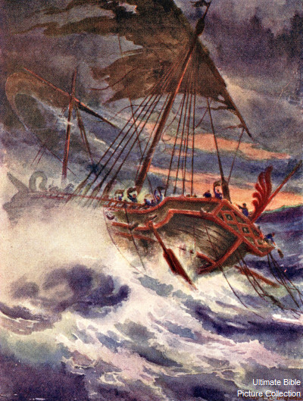
Paul gets shipwrecked
On the fourteenth night we were still being blown around in the Adriatic Sea. The sailors thought we were close to land. They threw a rope into the water with a weight on the end of it. They found that the water was 120 feet deep. They went a little farther and threw the rope in again. It was 90 feet deep. The sailors were afraid that we would hit the rocks, so they threw four anchors into the water. Then they prayed for daylight to come. Some of the sailors wanted to leave the ship, and they lowered the lifeboat to the water. They wanted the other men to think that they were throwing more anchors from the front of the ship. But Paul told the army officer and the other soldiers, “If these men do not stay in the ship, you will lose all hope of survival.” So the soldiers cut the ropes and let the lifeboat fall into the water.
Just before dawn Paul began persuading all the people to eat something. He said, “For the past two weeks you have been waiting and watching. You have not eaten for 14 days. Now I beg you to eat something. You need it to stay alive. None of you will lose even one hair off your heads.” After he said this, Paul took some bread and thanked God for it before all of them. He broke off a piece and began eating. All the men felt better and started eating too. (There were 276 people on the ship.) We ate all we wanted. Then we began making the ship lighter by throwing the grain into the sea.

Slide 5
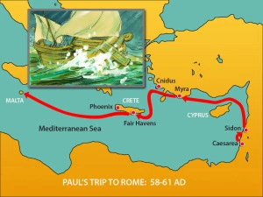
Davey Jones Locker
When daylight came, the sailors saw land, but they did not know what land it was. They saw a bay with a beach and wanted to sail the ship to the beach if they could. So they cut the ropes to the anchors and left the anchors in the sea. At the same time, they untied the ropes that were holding the rudders. Then they raised the front sail into the wind and sailed toward the beach. But the ship hit a sandbank. The front of the ship stuck there and could not move. Then the big waves began to break the back of the ship to pieces.
The soldiers decided to kill the prisoners so that none of the prisoners could swim away and escape. But Julius the army officer wanted to let Paul live. So he did not allow the soldiers to kill the prisoners. He told the people who could swim to jump into the water and swim to land. The others used wooden boards or pieces of the ship. And this is how all the people went safely to land.

Slide 6
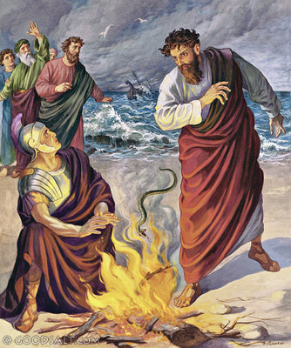
The snake was hungry
When we were safe on land, we learned that the island was called Malta. The people who lived there were very good to us. It was raining and very cold, so they built a fire and welcomed all of us. Paul gathered a pile of sticks for the fire. He was putting the sticks on the fire, and a poisonous snake came out because of the heat and bit him on the hand. When the people living on the island saw the snake hanging from his hand, they said, “This man must be a murderer! He did not die in the sea, but Justice does not want him to live.”
But Paul shook the snake off into the fire and was not hurt. The people thought he would swell up or fall down dead. They waited and watched him for a long time, but nothing bad happened to him. So they changed their opinion. They said, “He is a god!”
There were some fields around that same area. They were owned by a man named Publius, the most important Roman official on the island. He welcomed us into his home and was very good to us. We stayed in his house for three days. Publius’ father was very sick. He had a fever and dysentery, but Paul went to him and prayed for him. He laid his hands on the man and healed him. After this happened, all the other sick people on the island came to Paul, and he healed them too.

Slide 7
Questions
What was the sea that they were shipwrecked in?
What were the sailors specifically afraid of?
When the sailors were going to try and leave the ship in a rowboat, what did they act like they were doing?
Paul made a promise to the people on the boat. What was it?
Why did the soldiers want to kill the prisoners?
What was the name of the army officer that told them not to?
How many people died in the shipwreck.
What bit Paul when he was collecting firewood?
What did the people think he was after that happened.
When he didn’t die what did they think he was?
What was Paul doing on the island for the three months they were there?

Slide 8
The End

