Slide 1
Lesson 4: Paul and the Predictor
Acts 16:16-40

Slide 2
Introduction Activity: What Pic?
Students to sit in two separate rows.
The two students at the front of the row roll a die each.
Whoever gets the HIGHEST number gets to play (note: the number they roll is also the number of tiles they can remove).
After choosing which tiles to remove, they are allowed one guess at the image.
If they guess correctly they get 10 points and get to play the next round. The other person rotates to the back of the line.
If they guess incorrectly, they also move to the back of the line.
At the end of the game, points are totalled and the 5 highest totals win a Mentos.
Notes:
What Pic is an app for Apple products. It covers a picture with squares and by removing one square at a time you try and guess the image beneath.

Slide 3
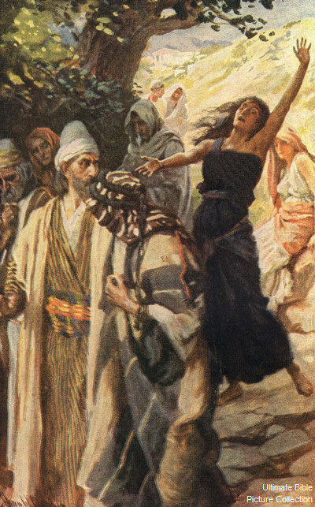
Paul starts ‘trouble’ and gets in trouble
One day we were going to the place for prayer, and a servant girl met us. She had a spirit in her that gave her the power to tell what would happen in the future. By doing this she earned a lot of money for the men who owned her. She started following Paul and the rest of us around. She kept shouting, “These men are servants of the Most High God! They are telling you how you can be saved!” She continued doing this for many days. This bothered Paul, so he turned and said to the spirit, “By the power of Jesus Christ, I command you to come out of her!” Immediately, the spirit came out.

Slide 4
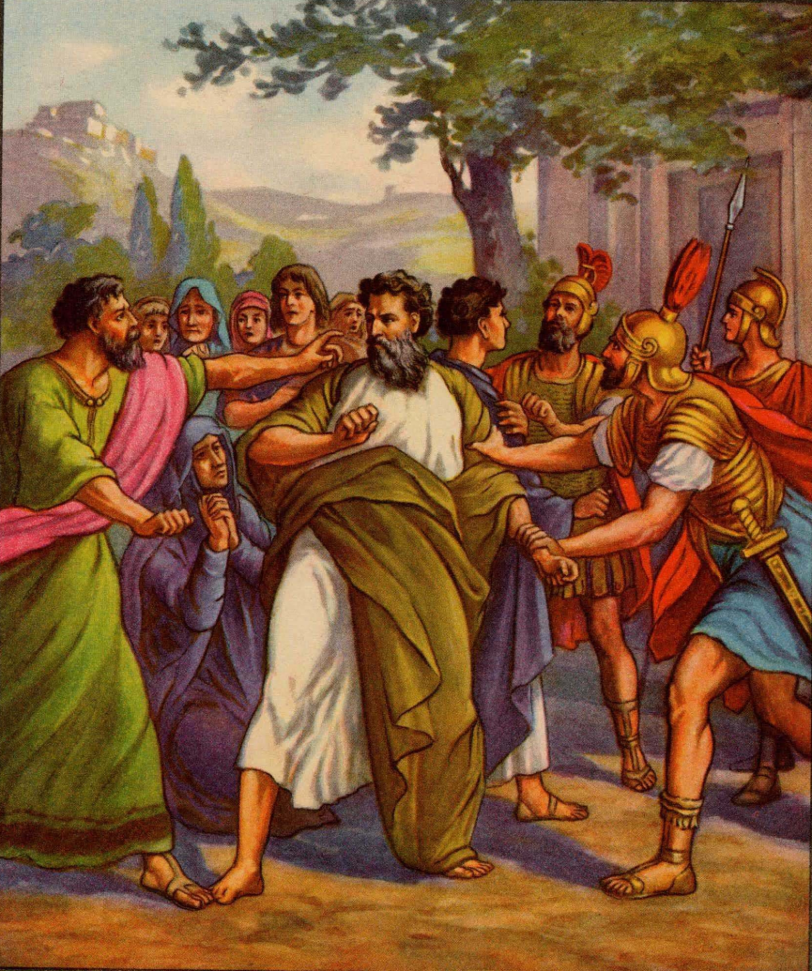
When the men who owned the servant girl saw this, they realized that they could no longer use her to make money. So they grabbed Paul and Silas and dragged them to the public square to meet with the authorities. They brought Paul and Silas before the Roman officials and said, “These men are Jews, and they are making trouble in our city. They are telling people to do things that are not right for us as Romans to do.”
The whole crowd turned against Paul and Silas. The officials tore the clothes off both men and ordered that they be beaten with rods. They were beaten severely and thrown into jail. The officials told the jailer, “Guard them very carefully!” When the jailer heard this special order, he put Paul and Silas far inside the jail and bound their feet between large blocks of wood.

Slide 5
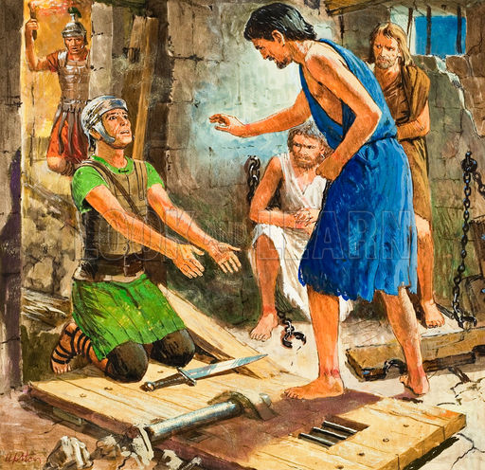
Who doesn’t like late night singing?
About midnight Paul and Silas were praying and singing songs to God. The other prisoners were listening to them. Suddenly there was an earthquake so strong that it shook the foundation of the jail. All the doors of the jail opened, and the chains on all the prisoners fell off. The jailer woke up and saw that the jail doors were open. He thought that the prisoners had already escaped, so he got his sword and was ready to kill himself. But Paul shouted, “Don’t hurt yourself! We are all here!”
The jailer told someone to bring a light. Then he ran inside and, shaking with fear, fell down in front of Paul and Silas. Then he brought them outside and said, “Men, what must I do to be saved?”

Slide 6
They said to him, “Believe in the Lord Jesus and you will be saved—you and all who live in your house.” So Paul and Silas told the message of the Lord to the jailer and all the people who lived in his house. It was late at night, but the jailer took Paul and Silas and washed their wounds. Then the jailer and all his people were baptized. After this the jailer took Paul and Silas home and gave them some food. All the people were very happy because they now believed in God.

Slide 7
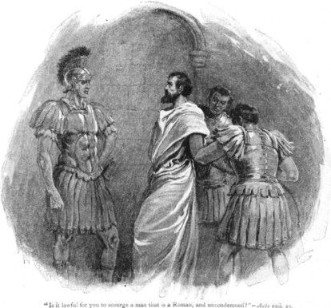
Paul the Roman Citizen
The next morning the Roman officials sent some soldiers to tell the jailer, “Let these men go free.”
The jailer said to Paul, “The officials have sent these soldiers to let you go free. You can leave now. Go in peace.”
But Paul said to the soldiers, “Those officials did not prove that we did anything wrong, but they beat us in public and put us in jail. And we are Roman citizens. Now they want us to go away quietly. No, they must come here themselves and lead us out!”
The soldiers told the officials what Paul said. When they heard that Paul and Silas were Roman citizens, they were afraid. So they came and told them they were sorry. They led them out of the jail and asked them to leave the city. But when Paul and Silas came out of the jail, they went to Lydia’s house. They saw some of the believers there and encouraged them. Then they left.

Slide 8
Questions
Do you think there are people who can actually tell the future?
Why did the people who owned the girl get upset with Paul when he healed her?
What were Paul and Silas doing when the earthquake hit?
Why did the jailer want to kill himself when he thought the prisoners had escaped?
What do you think led the jailer say “What must I do to be saved?”
What again was the message that Paul was preaching?

Slide 9
The End

