Slide 1
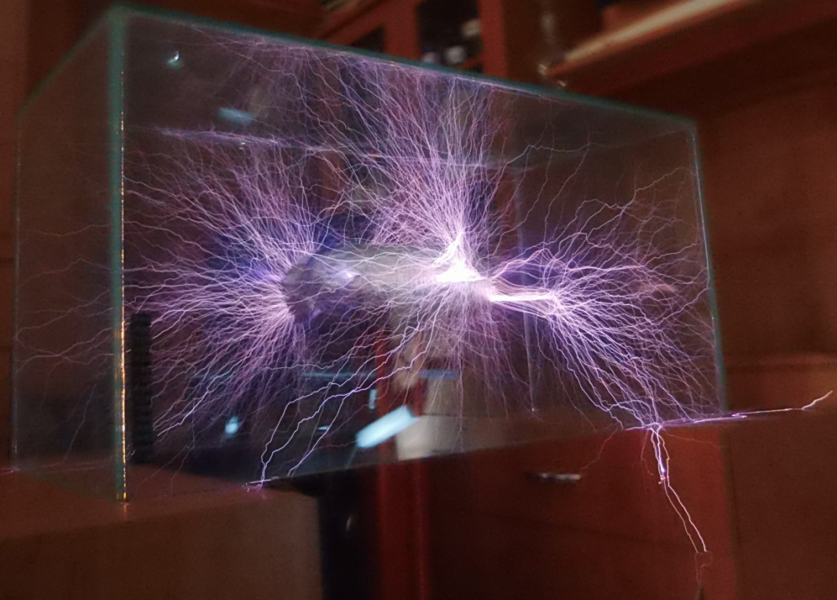
Current, Voltage and Resistance Calculations

Slide 2

When electrons flow through a circuit, a few things are happening with them:
Electrons carry energy, and they can have different amounts of it
Different amounts of electrons can move past a point in a circuit (if they are going faster, more can travel past a point)
Obstacles can slow electrons down

Slide 3
Current

Slide 4
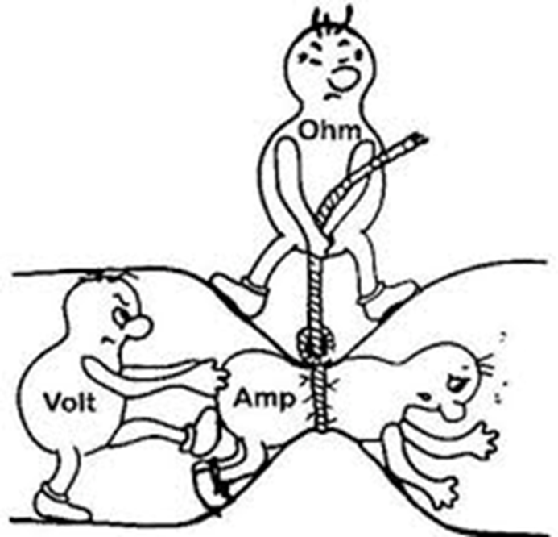
Current

Slide 5
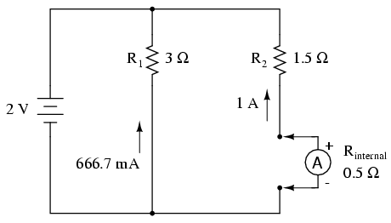
Current
Amperes or amps (A) is a measure of current
It is a measure of the amount of charge that flows past a point in a circuit in one second
It is measured by a device called an ammeter
An ammeter needs to be in line with the rest of the circuit

Slide 6
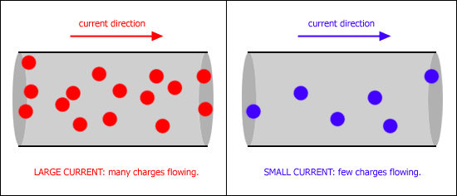
Current
Current is high if a lot of charge flows past a point in one second

Slide 7
Voltage

Slide 8
Voltage

Slide 9
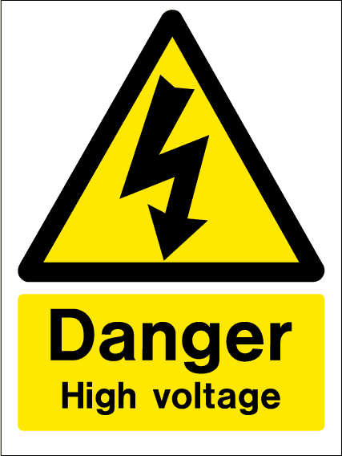
Voltage
Is a measure of the amount of energy supplied to the electron source (the supply voltage)
Also a measure of the amount of energy used by the charges as they pass through a component such as a light globe

Slide 10
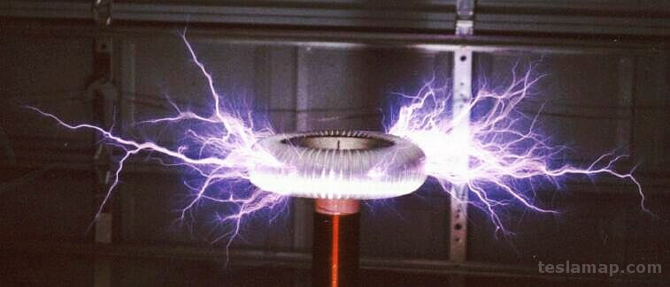
Voltage
Measured using a voltmeter (units are volts, or V)
The voltage is high if
  the electrons are losing a lot of energy or
  are supplied with a lot of energy by a power source

Slide 11
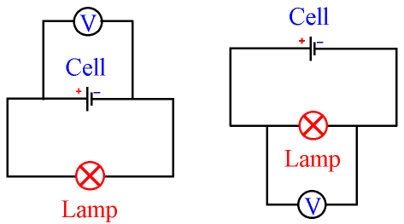
Voltmeters
Voltmeters are connected to either side of a component, not in line with the circuit

Slide 12
Your Turn
Complete Question 6

Slide 13
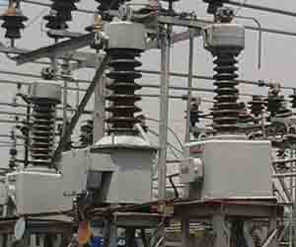
Supply voltage
Electrons are supplied with energy from a power source which has its own voltage.
Higher supply voltages give electrons a bigger push to get around the circuit.
Sometimes a transformer is used to reduce the voltage from 240V in Australia to a lower voltage (like 19V for laptops)

Slide 14

Voltage drop
Because components use energy (e.g. a light), there is a drop in voltage, as some of the electrons energy is used

Slide 15
Resistance

Slide 16

Resistance

Slide 17

Resistance
Electrons moving around a circuit are slowed down by atoms that make up the wires
Resistance measures how difficult it is for an electric current to flow through wires
A high resistance means that electrons find it hard to pass through the material
Resistance is measured using
the unit ohm (Ω)

Slide 18
Resistance and Voltage Rely on Each Other

Slide 19
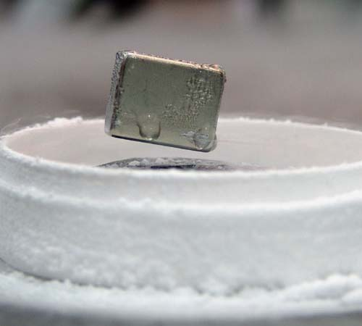
Resistance and voltage
Electrons don’t bump into much if they pass through materials with low resistance, so there is little drop in energy (or voltage)
In high resistance materials, a lot of energy is lost when the electrons bump into things, so there is a large drop in voltage

Slide 20
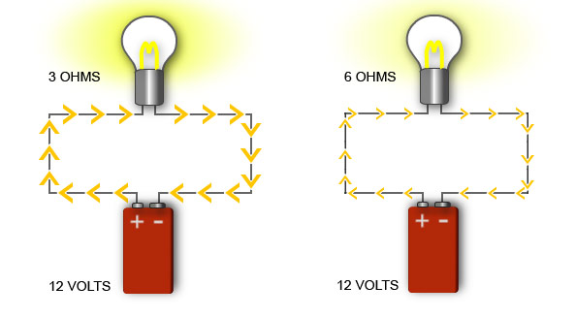
Resistance and current
As the resistance of a component increases, fewer electrons can get through it every second, which reduces the current

Slide 21
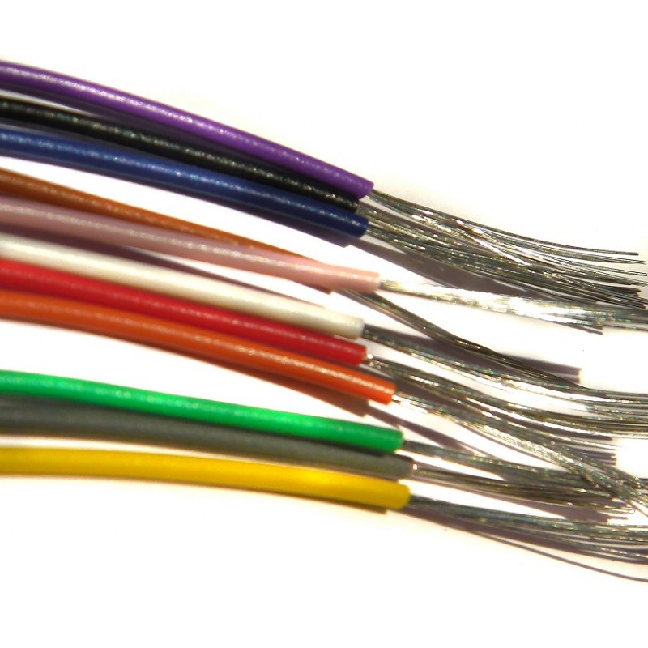
Resistance depends on:
The type of material (e.g. metals are low, rubber is high)
Length of the wire (longer wire means more obstacles, which means more resistance)
Thickness of wire (electrons can pass more easily through thick wires)

Slide 22
Practical uses of Resistance

Slide 23
Twig movie: Resistance
https://www.twig-world.com/film/resistance-1556/

Slide 24
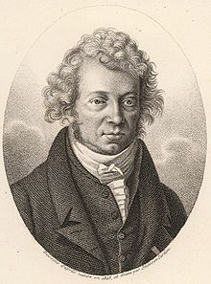
Andre Ampere
The reason we use the symbol ‘I’ instead of a ‘C’ for current in the equation is because it stands for “intensite du courant” in French (intensity of flow).
This originated from the writings of Andre Ampere the French mathematician and physicist.

Slide 25
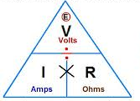
voltage-current-resistance
voltage= current x resistance
          V=I x R

Slide 26
Your turn…
Complete the Voltage equation practice problems on your worksheet.

