Slide 1
Organising elements in the Periodic Table

Slide 2
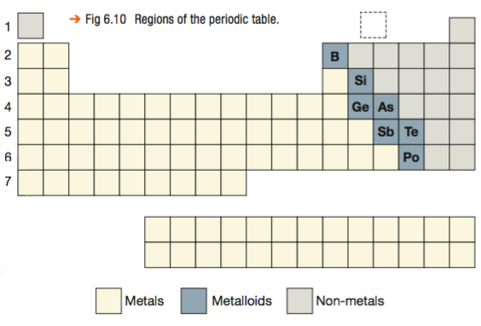
Grouping elements
Two main groups: Metals, Non-metals
Metals – nearly ¾ of all elements
In-between: Metalloids

Slide 3
Metals
Metals have many properties in common. Pure metals are:
lustrous (shiny)
ductile (able to be drawn into a wire)
malleable (able to be beaten into a new shape)
able to conduct heat and electricity

Slide 4
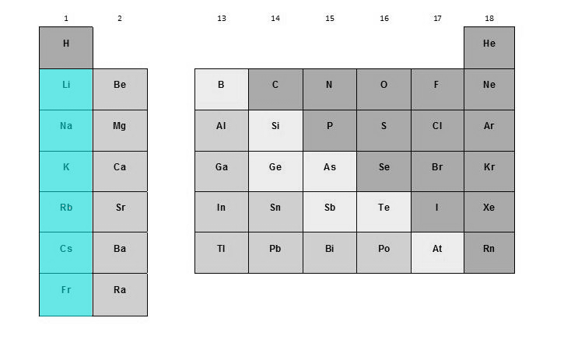
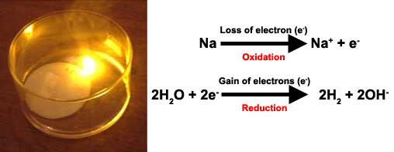
Group 1 metals: Alkalis
All have 1 valence (outer shell) electron
Low melting points
Soft –freshly cut: shiny surface
Highly reactive (more violent ↓)
⇧
Alkaline

Slide 5
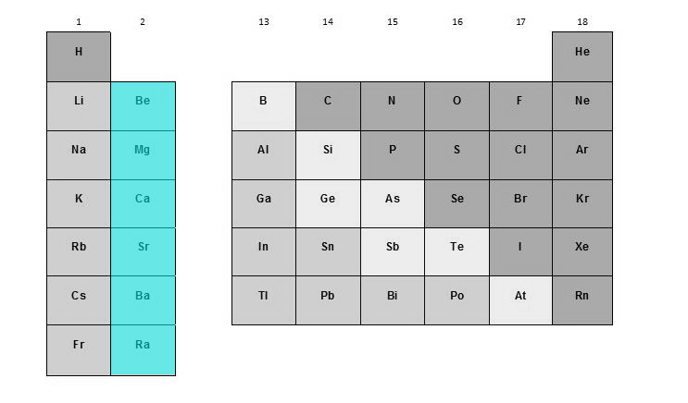
Group 2 metals: Alkaline earths
All have 2 valence electrons
Relatively low melting points
Relatively soft
Very reactive (less than Group 1)
More violent reactions ↓

Slide 6
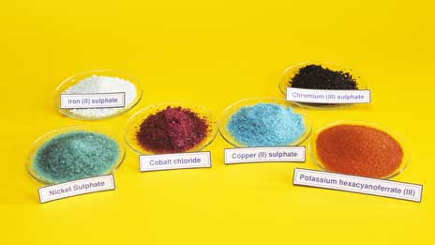
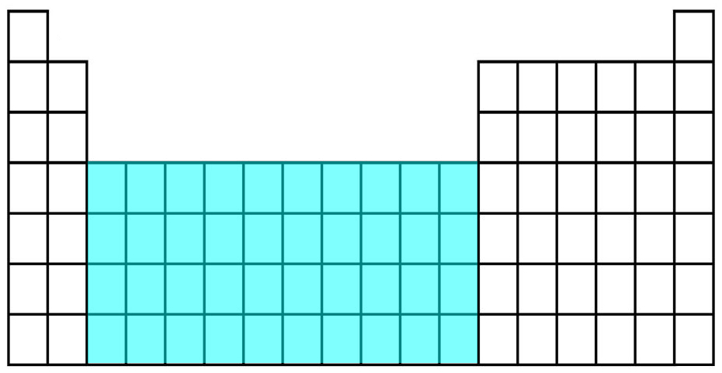
Groups 3-12: Transition metals
Large block of 10 groups
Some are magnetic (e.g. Fe, Co, Ni)
Only gold (Au) and copper (Cu) not silvery
Many form coloured compounds
Many form >1 compound with reactive non-metals, e.g. FeCl₂ and FeCl₃

Slide 7
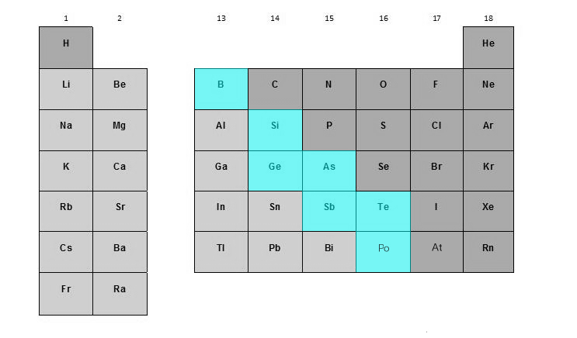
Metalloids
“staircase” boundary elements
Most properties un-metallic, but:
Conduct electricity
3 Semiconductors:
silicon, germanium, (gallium)
Used in electrical devices

Slide 8
Non-metals
Don’t have metallic properties
Not lustrous; not ductile
Some brittle; some coloured
Large range of melting & boiling points
Many are gases
Bulk of Earth’s crust and living tissues

Slide 9
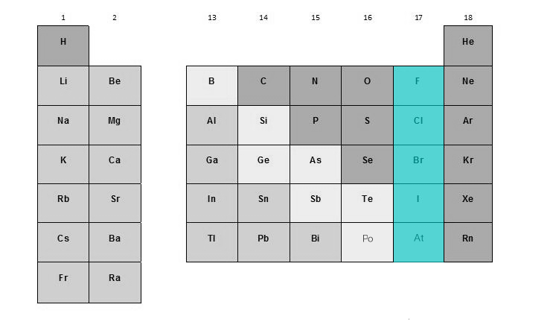
Group 17: Halogens
All have 7 valence electrons
React with metals → salts
‘halogen’ = ‘salt-forming’
Some have bleaching properties

Slide 10
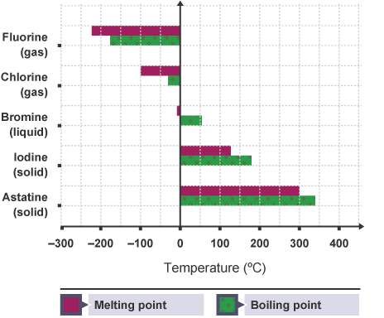
Group 17: Halogens
Graph shows how melting and boiling points increase ↓
F, Cl : gas
Br : liquid
I, At : solid (At unstable)
Less reactive ↓

Slide 11
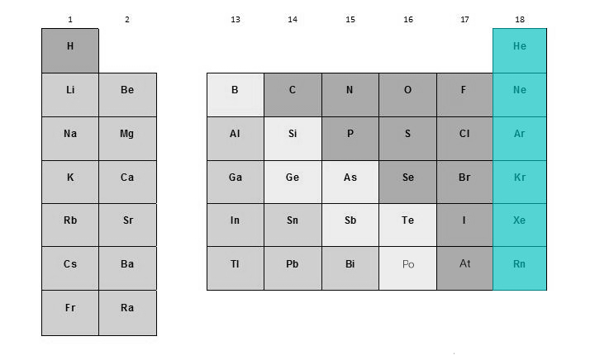
Group 18: Noble gases
Full outer shell:
He has 2 valence electrons
All others 8 valence electrons
Unreactive, inert
Xe and Kr can react with F
Rn : radioactive gas

Slide 12
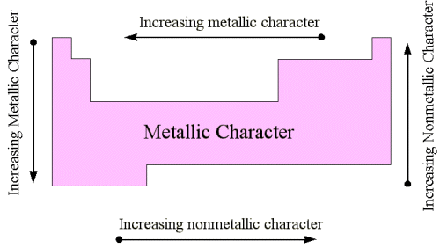
Metallic trends
More metallic: down, left
Less metallic: up, right

Slide 13
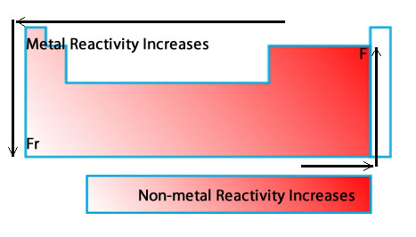
Reactivity trends
The most metallic and the most non-metallic elements are most reactive
More reactive going:
for metals : down, left
for non-metals : up, right
Trends for metals and non-metals are opposite
Francium : most reactive metal
Fluorine : most reactive non-metal

Slide 14
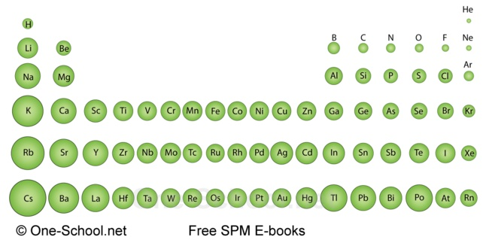
Size trends (atomic radius)
Radius of atoms becomes smaller from left to right across a period; and
atoms become larger from top to bottom down a group:
Largest: bottom left
Smallest: top right
Going right, more protons means electrons are attracted more strongly, making the atom’s radius smaller.
Going down, periods have more shells, making radius bigger.

