Slide 1
Covalent Bonding

Slide 2
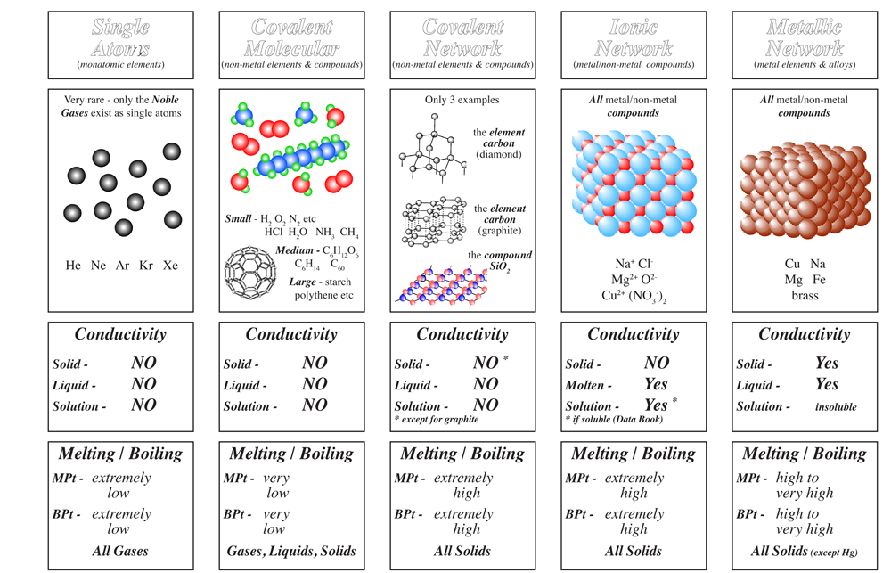

Slide 4
Watch: Fuse School video
Interactive: Covalent Bonds Tutorial
Examine some of the ball-and-stick models of molecules.

Slide 5
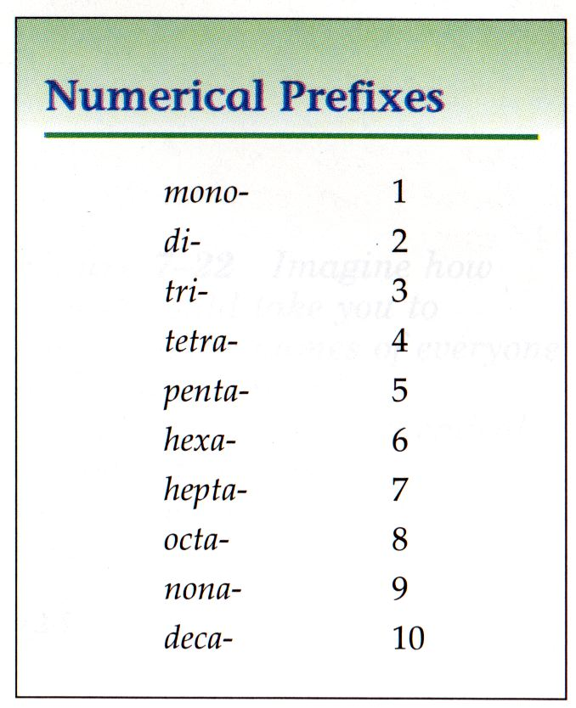
Rules for naming covalent molecules
Replace the ending of the second element with "ide“ (just like in ionic compounds).
Write a prefix for the number of atoms of each element (see table).
If there is only one atom of first element, drop the prefix. E.g., CO is carbon monoxide, not monocarbon monoxide.
If there are two vowels in a row that sound the same once the prefix is added (they "conflict"), remove the extra vowel. E.g. monoxide becomes monoxide. The extra o is dropped.

Slide 6
Examples of named covalent molecules:
SO₂ is called sulfur dioxide
SiI₄ is called silicon tetraiodide
SF₆ is called sulfur hexafluoride
CS₂ is called carbon disulphide
Do this worksheet:
Names and Formulas of Covalent Compounds

Slide 7
Lewis Dot Structures (Electron Dot Diagrams)
Lewis Dot Structures show how valence electrons pair up to form covalent bonds in molecules.
To master this skill, do these worksheets with your teacher:
Covalent Bonds and Lewis Dot Structures
(Optional) Lewis Structures (Electron Dot Diagrams) for Covalent Bonding
Use this as a reference sheet!
Try this on your own:
Lewis Dot Structures Practice
Do this worksheet to review:
Starter for 10… Covalent dot and cross

Slide 8
Ionic vs. Covalent

Slide 9
Do covalent substances conduct electricity?
Covalent substances do not have any mobile charge carriers in any state, so they cannot conduct electricity.

Slide 10
What about melting and boiling points?
Covalent bonds are strong between the atoms inside the molecules;
But forces of attraction between molecules are quite weak:
Little energy is required to separate the molecules from each other –
Low mp and bp

Slide 11
Summary: Ionic vs. Covalent

Slide 12
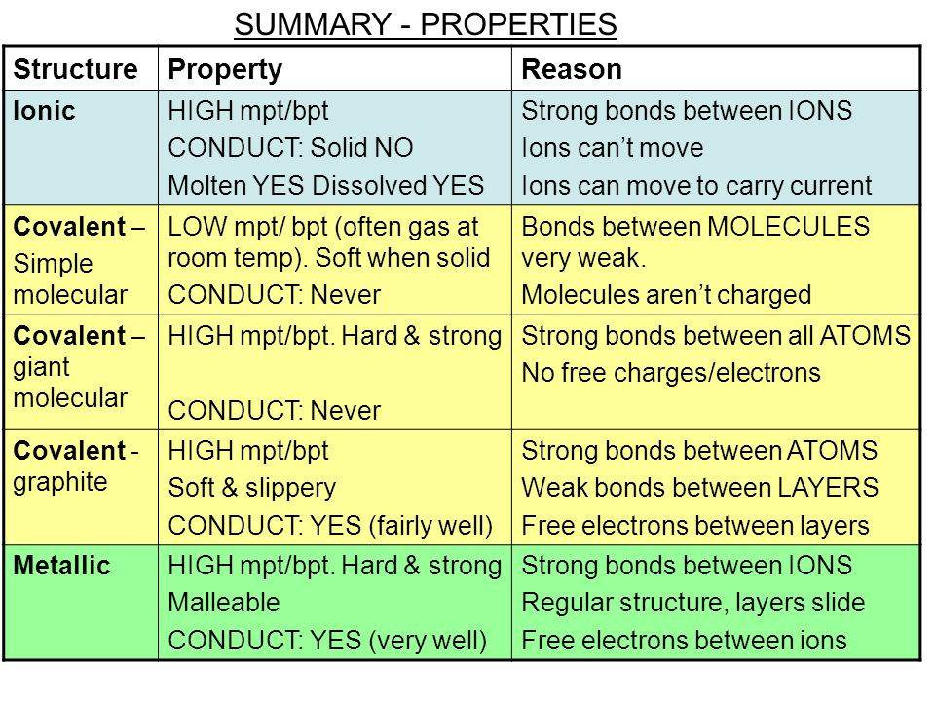

Slide 13
Comparing the 3 types of bonding
gg

