Slide 1
Ionic, Covalent and Metallic Bonding
Supplement

Slide 2
Atoms form bonds
Atoms are rarely found on their own in nature (unbonded)
Q: Why do atoms form bonds?
To complete their outer shell, giving them the same, stable configuration as the noble gases.

Slide 3
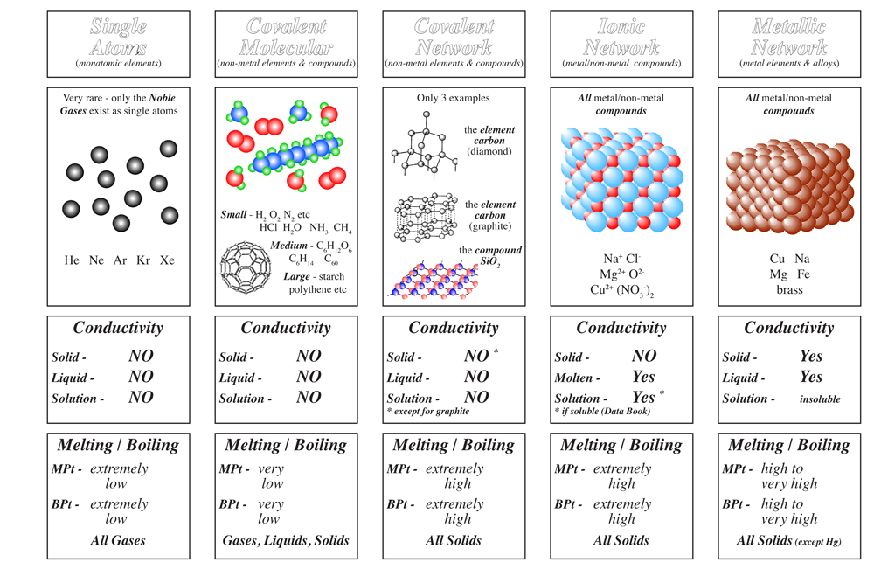

Slide 4
Ions align in regular patterns

Slide 5
Watch: What are ions?
Pause to draw the ions in your workbook
Watch: Ionic compounds

Slide 7
High melting points
A lot of energy is required to break the strong ionic bonds.

Slide 8
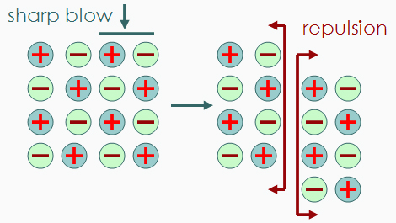
Brittle
When struck, layers shift and ions of the same charge line up and repel, forcing the network crystal structure to break.

Slide 9
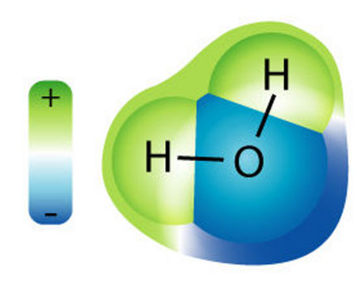
Most are soluble in water
Water has a positive and negative end, so ions are attracted and dissolve.

Slide 10
Conductivity
Summary

Slide 11
Conductivity
To conduct, there must be free charge carriers, electrons or ions.
In both liquids and solutions, ions are free to carry charge.

Slide 13
Review
Interactive: Ionic Bonding Tutorial
Worksheet: Ionic bonding – True or False?
Worksheet: Ionic Bonding Review and Ionic Compounds Properties

