Slide 1
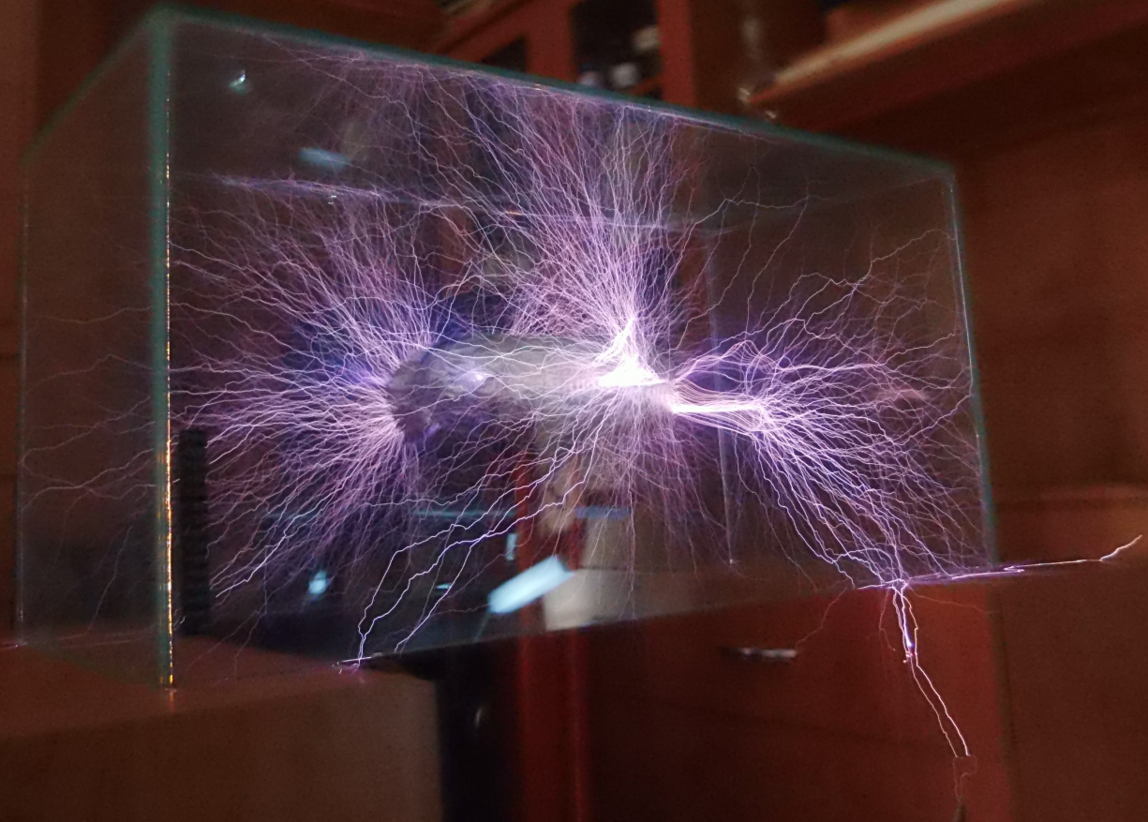
Components and Series vs. Parallel Circuits

Slide 2
Components

Slide 3
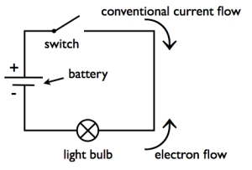
Circuits
Electrons need a path to travel around so they can deliver their energy
The path is called an electric circuit
Any break in the circuit stops the flow of electrons (e.g. a switch)

Slide 4
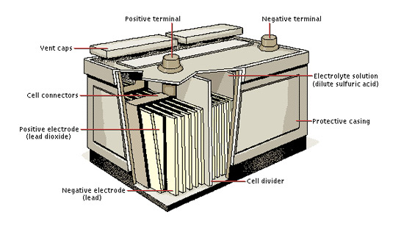
Circuits must have:
An energy source (e.g. battery/generator) which supplies the electrons with energy
An energy user (e.g. light globe/motor) which uses the energy
Wires to connect everything, completing the circuit

Slide 5
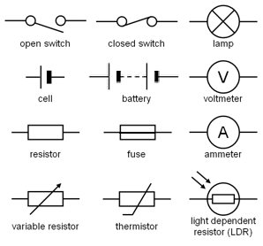
Components
Different parts of a circuit are known as components and has different symbols:

Slide 6
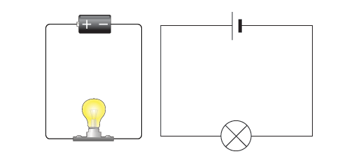
Circuit diagram
Shows how circuits are connected:

Slide 7
Circuit Diagrams (for a torch)
Another symbol for lamp

Slide 8
Your turn…
Make flash cards for all of the different symbols used in circuits.
Use the pictures on your worksheet AND pg. 107 of your 9 Oxford book to help you.

Slide 9
Series Circuits

Slide 10
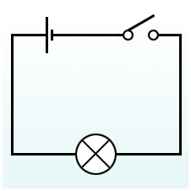
Series circuits
All components are connected up one after another to form a single loop

Slide 11
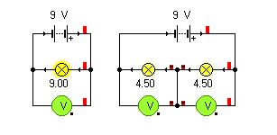
Series circuits
When the charges leave the battery, they have a full load of energy
This charge is shared among the components because the current must pass through all components

Slide 12
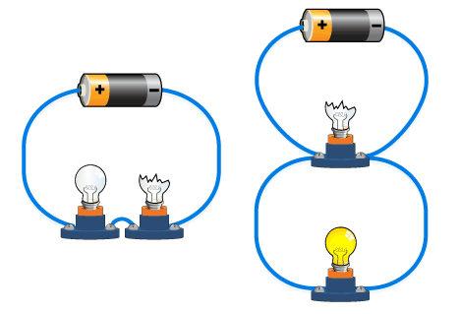
Problems with series circuits:
Globes cannot be controlled individually
Current stops flowing if any of them break (and it is then hard to find the faulty one)
Adding more globes makes the current dimmer

Slide 13
Your turn
Complete question 10 in your workbook.

Slide 14
Parallel Circuits

Slide 15
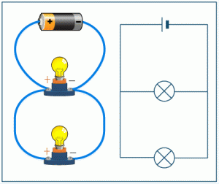
Parallel circuits
Has a number of branches, and each branch has it’s own component
The current leaving the battery splits, with equal amounts going down each branch. Each globe receives the full amount of energy

Slide 16
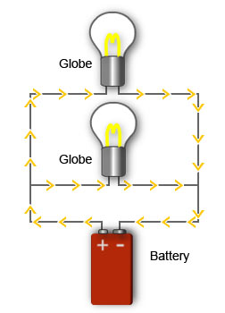
Benefits of parallel circuits
Each branch can have it’s own switch
Only one branch is affected if a globe blows (this makes it easy to find the broken one)
Adding extra globes does not affect their brightness

Slide 17
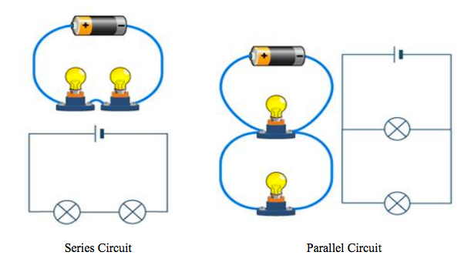
Summary
Components in a series circuit have the same current, but split the voltage between them
Components in a parallel circuit have the same voltage across them but split the current

Slide 18
Movie: Series and Parallel Circuits
See weebly

