Slide 1
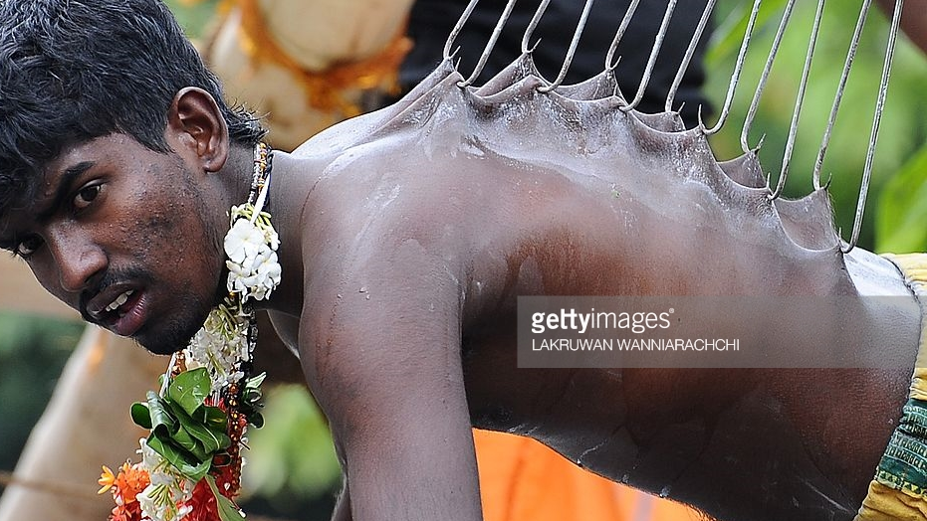
Hinduism
'the way of release'
Based on the book:
“A spectator’s guide to world religions” By: John Dickson

Slide 2
Koh Koh – Historical Game
Rules
Equipment
Two poles that can be pushed into the ground.
Cones to mark a rectangular area ~ 30 x 15 meters
9 players per team

Slide 3
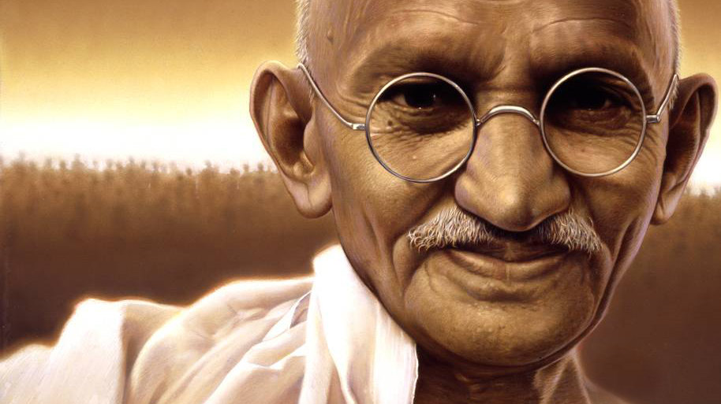
History
The majority of Hindu’s have never heard of something called Hinduism.
The term was coined by British writers to describe the cacophony of beliefs, practices, rituals and exercises.
The word Hindu comes from the ‘Indus Valley’
It is debatably the oldest of the 5 religions (~1500BC) and is very complex.
Famous adherents are:
Gandhi
Sachin Tendulkar

Slide 4
The writings of the ‘eternal religion’
Vedas
1500BC – 500BC
Upanishads
1000BC – 300BC
Smriti
500BC – AD300

Slide 5
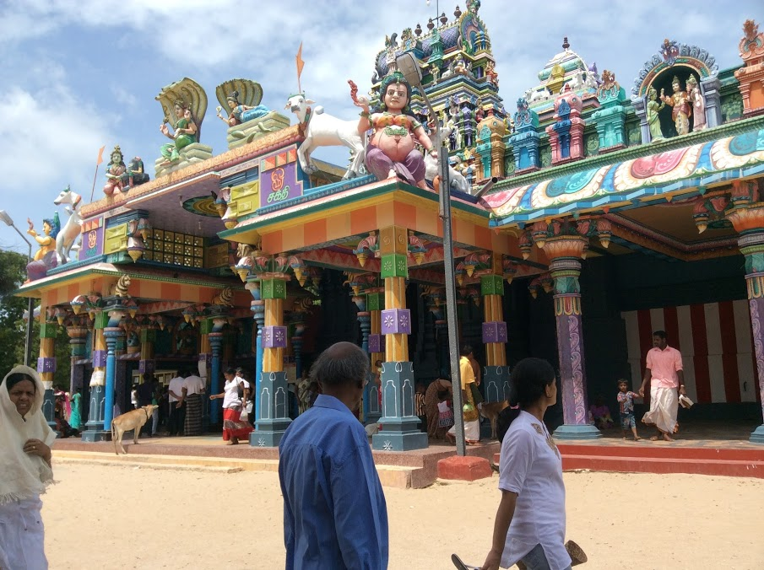
Vedas
Wisdom

Slide 6
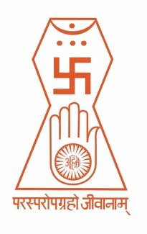
Vedas Overview
There are 4 sections that make up the Vedas.
The Rig-veda
The Yajur-veda
The Sama-veda
The Atharva-veda.
Notes:
Attached to the four vedas are much later writings that discuss, explain and amplify the original collection. (ie. The Brahamanas, the Aranyakas and the Upanishads)

Slide 7
Wisdom of Verses
Collection of 1000 hymns that are sung in connection with ancient rituals (Animal sacrifices, fire offerings, drinking hallucinogenic juice)
Wisdom of the Sacrificial Formulas
The words that were to be said by the priests when the rituals above took place. Often involved praising the gods.
Wisdom of the Chants
Contains verses from the first book, but with explanations of how they were to be chanted.
Wisdom of the Atharvan Priests
A collection of hymns, prayers and curses of a ‘magical nature’. Probably written a little while after the first three.

Slide 8
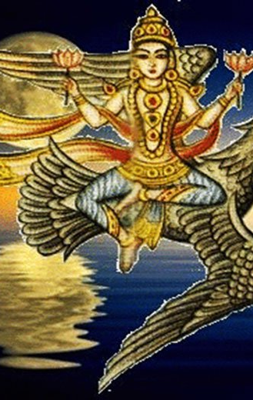
2 Key Veda Teachings
Polytheism:
They present a polytheistic collection of ‘devas’ (powerful, unpredictable beings)
About 1000 are mentioned in the Vedas and range from good to evil.

Slide 9
2 Key Veda Teachings
Rituals:
Soma Ritual – A priest took the juice of a certain plant and poured it over the alter. He then drank the hallucinogenic which they believed gave him divine insights and powers.
Fire Ritual – A priest places and animal on an alter and sets it on fire. The fire is believed to be a manifestation of Agni who accepts it by consuming (burning) the animal.
Other rituals: Wedding ceremony, ceremonial cremation, temple worship

Slide 10
Student Task
Look up the following 5 Hindu gods that are found in the Vedas and complete the following.
Look up the god on Google and observe one of the images.
Based on the picture, try to determine what each god’s power/purpose is.
Finally, research the god’s actual purpose and note it down.
Indra
Agni
Soma
Vishnu
Siva

Slide 11
Upanishads
Sitting Near

Slide 12
The writings of the ‘eternal religion’
Vedas
1500BC – 500BC
Upanishads
1000BC – 300BC
Smriti
500BC – AD300

Slide 13
Upanishads Overview
Claims to provide ultimate insight into life and the universe using…
Parables and Anecdotes
Philosophical Arguments
Dialogue, Poems and Proverbs
Constructed by Indian gurus who reflected on the content of their religion and sought to make sense of the world in light of it.
Considered by many as the real sacred writings of Hinduism.

Slide 14
Most Important Beliefs
Brahman
Karma
Atman
Samsara
Student Task: Expert Groups
In groups of four, you will be assigned one of the teachings seen on the right.
You must become an ‘expert’ in that field and be able to explain that teaching.
Write down your findings and key points on your triangle.
Notes:
Teacher needs to provide copies of the reading on these sections from ‘A spectator’s guide to world religions’ By John Dickson

Slide 15
Summary
Notes:
Start Khan Academy Video at 2:10

Slide 16
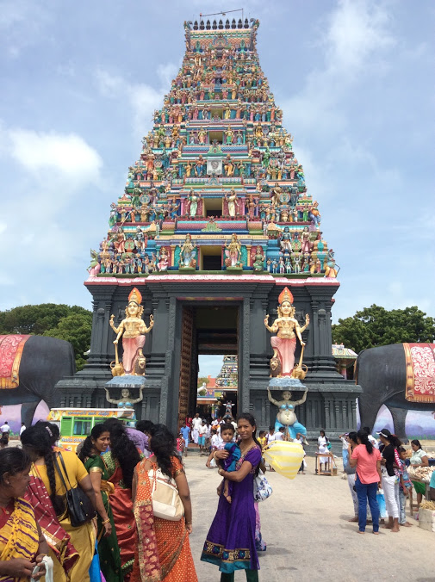
Smriti

Slide 17
The writings of the ‘eternal religion’
Vedas
1500BC – 500BC
Upanishads
1000BC – 300BC
Smriti
500BC – AD300
Notes:
Interesting note: Hindus believe that the universe appears and disappears every 24 million years (12 million existing and 12 million not existing). They also believe that the Vedas along with the Upanishads are revealed to human teachers at the beginning of each new cosmic cycle.

Slide 18
‘Remembered’ writings
Smriti
Romance of Rama
Other Sacred Texts
Great Epic of Bharata Dynasty
Song of the Lord
The smriti (remembered writings) are considered less authoritative than the Vedas, but are just as popular.
Two very important poems found in these writings are:
Romance of Rama (Ramayana) – it is a love story with daring rescues, infidelity and kidnapping.
Great Epic of Bharata Dynasty (Mahabharata) – it is a massive mythological epic that contains a poetic account of a battle between cousins which almost destroys the entire race.
This poetic account is known as the Song of the Lord (Bhagavad-gita) and is regarded by many as the most treasured of all Hindu scriptures.

Slide 19
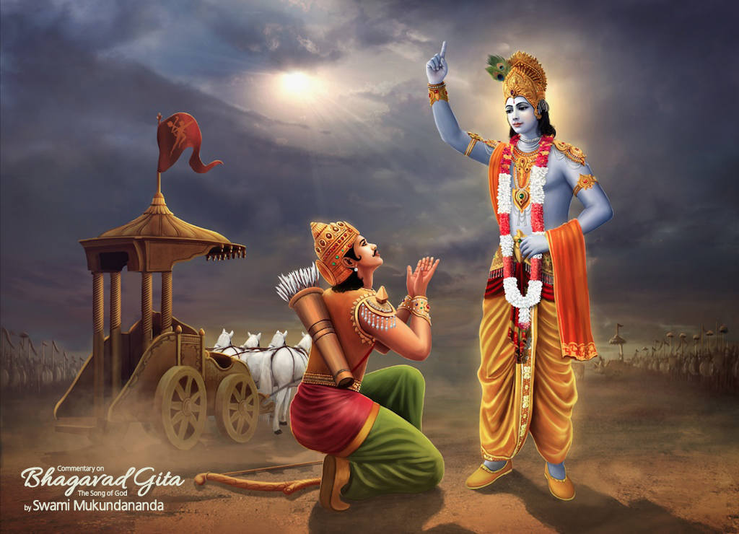
Song of the Lord
Two Important Characters
Prince Arjuna, and his advisor Krishna, who turns out to be an incarnation of the god Vishnu
Story Plot
Prince Arjuna is getting ready to slay the opposing armies, he wonders whether he should lay down his weapons to avoid shedding blood.
Krishna enters saying - ‘he needs to fulfil his duty as a warrior prince’. Prince Arjuna listens to this advice and launches into battle finally emerging the winner.
This introduces the ‘Four Castes’ of people in Hinduism.

Slide 20
The four castes
Brahmans
Ksatriya
Vaisyas
Sudras
The Laws of Manu
The most famous of the books that specifically outlines how each caste should perform their duties.
Notes:
The castes were important because by rejecting ones caste, you prevented your release ‘moksha.

Slide 21
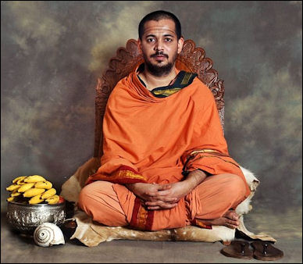
Caste 1 – Priests (Brahmans)
Upper Class
The most ‘near’ to the ultimate life-principle of the universe. Hence the name ‘Brahmans’
Notes:
Regarded as the descendants of the original Vedic priests (15ooBC). They form the top layer in Indian society

Slide 22
Caste 2 – Warrior Kings (Ksatriya)
UPPER – MIDDLE CLASS
This is the cast of Prince Arjuna who was told to ‘do his duty’ by Vishnu.

Slide 23
Caste 3 – Common people (Vaisyas).
Middle Class
Make up the majority of Hindu society.
Regarded as descendants of the Aryan people. They are the ‘workers’ of society

Slide 24
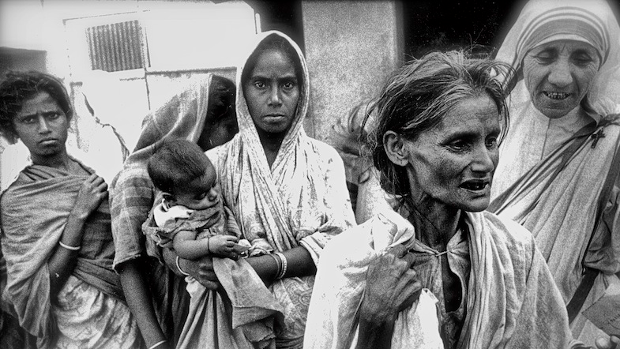
Caste 4 – Servants (Sudras)
Lower class
The role of the Sudras is simply to serve the rest of society.
Cannot achieve moksha until their karma puts them in one of the upper three castes.
Notes:
Hinduism regards the Sudras as sharing nothing of the Vedic Heritage. Their role is simply to serve the rest of society

Slide 25
Student Task - Research
Mother Theresa
Mahatma Ghandi
Siddarthu Guatama
Research the three individuals on the right
Describe what they thought of the caste system.
Explain what they did about it.

Slide 26
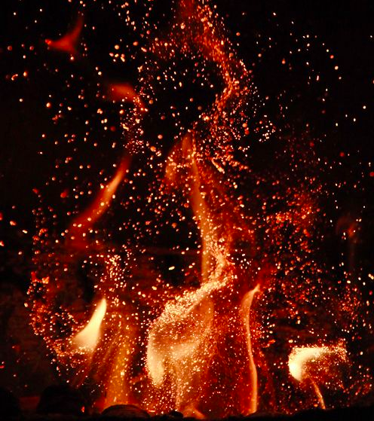
Putting it all together
The ultimate end of Hinduism is realising our unity with Brahman. Understanding that in the depths of our soul (Atman) we are all one, like a single, under–sea continent.
Even though an island appears on the surface, to be separate, it is in fact a part of something bigger. That is what we really all are; Brahman - infinite and absolute perfection.
Notes:
in some Hindu traditions, like bhakti yoga and the baghavad gita, Brahman is a person, to be loved and trusted. In the other Hindu traditions, Brahman is not a person, but simply the one and only reality, of which we are all manifestations

Slide 27
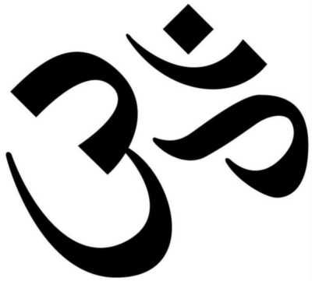
The expression of this unity of Atman to Brahman is the formula
– ‘Thou art that’ –
‘Atman is Brahman’.
When this full realisation happens, Moksha occurs
‘the spark returns to it’s flame’
Om symbol
A sacred sound and spiritual icon.
It describes the relationship between Atman and Brahman.

Slide 28
The 3 Yogas

Slide 29
The 3 Paths
The 3 Yogas
Karma Yoga
Jnana Yoga
Bhachti Yoga
‘Yogas’ – work/yoking to a task
By succeeding in one of these paths one can escape birth and re-birth and obtain Moksha

Slide 30
Yoga #1 – Path of duties: Karma-Yoga
A path to Brahman through ordinary, daily work.
Only actions that were in accordance with your caste led to release.
One’s actions must also be performed with detachment.
Notes:
Discussion – Why is it okay for some Hindu’s to fight wars and not okay for others? (hint – think back to the four ‘castes’)

Slide 31
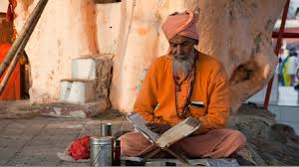
Yoga #2 – Path of knowledge: Janani-Yoga
A mental, intellectual path to Brahman – in which you learn to understand yourself differently – you learn to detach your thoughts from your body – your ego and its desires.
You learn to identify yourself with the universal observing mind of Brahman.
This is the most difficult path to achieve.

Slide 32
Yoga #3 – Path of Devotion: Bhachti-Yoga
An alternative path to Brahman achieved by devoting yourself to one of the Hindu gods (preferably Krishna).
How to show devotion?
Deep personal affection.
Ritual worship at a temple.
Setting up a shrine at home.
This is the most dominant form of Hinduism today
Bhagavad Ghita 12:1-7:
Arjuna asked Krishna – “what's considered to be more perfect, those who are properly engaged in your devotional service, or those who worship the impersonal Brahman?
Krishna said – “he whose mind is fixed on my personal form, always engaged with worshiping me with great and supernatural faith is considered by me to be most perfect…for I am the swift deliverer from the ocean of birth and death”

Slide 33
Two most popular gods to devote to.

Slide 34
Vishnu
(Vaishnavism) – Worshipers typically take a blend of their favourite stories and incarnations of Vishnu. Most commonly Mahabharata.
Vishnu is thought to have had 10 incarnations, or Avatars. The two most popular are Rava and Krishna (mentioned earlier).
Vishnu is thought to embody the preserving qualities of ‘Brahman’ - Turns Brahman into a person.

Slide 35
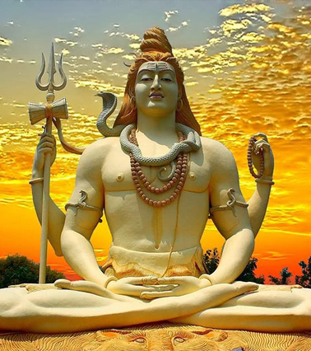
Siva
(Saivism) – features in the great epics of the ‘remembered writings’ (Smriti).
Also thought to embody characteristics of Brahman. Whereas Vishnu is the friend and preserver of humanity, Siva is the multi-faceted master over nature and human beings.
Side-note – teachers from a branch of Saivism during the 1200s AD developed a particular form of yoga (hatha-yoga) involving difficult breathing and body exercises. This was thought to bring ‘oneness’ with the divine. Sound familiar?

Slide 36
The End

