Slide 1
Buddhism
‘the way of enlightenment’
Based on:
“A spectator’s guide to world religions” By: John Dickson

Slide 2
Student Activity: Brainstorm
What do you know about Buddhism?
?
?
?
?
Buddhist flag
created in 1885

Slide 3
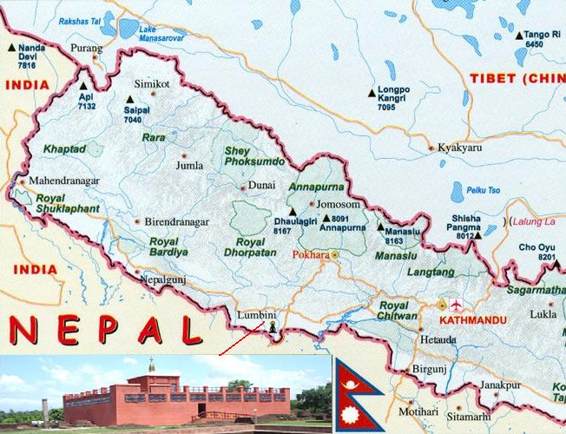
History
Buddhism is probably the most intellectually sophisticated of the faiths.
It also requires the highest level of discipline
Birthplace of the Buddha was in Lumbini, Nepal
Famous Adherents:
Dalai Lama
Richard Gere

Slide 4
Common Misconception
Budai – Chinese monk
Buddha
Notes:
Picture: Ploylada Sirachadapong - http://www.glittersnipe.com/2012/06/25/five-clues-that-your-thai-restaurant-is-fake/

Slide 5
Read/Watch: The Enlightenment of Buddha
First name was Siddhartha Gautama
Born into an upper caste and enjoyed a luxurious lifestyle.
Observed 4 different men in 4 different states.
Sought understanding for this suffering and undertook suffering himself.
Neither extreme led to insight so he proposed a ‘middle path’ that were explained by 4 beliefs and 8 habits.

Slide 6
Buddhas critique of Hinduism

Slide 7
Rejections of Hinduism
Caste system
Role of Brahmans
God, soul, self
Believed even the lowest caste could achieve enlightenment.
Rituals and philosophy were ignorant and like the blind leading the blind.
Considered them all to be guesswork and irrelevant.
Paths of Hinduism
Considered them paths of ignorance.
Believed there was no actual YOU.
You do not exist.

Slide 8
5 Aggregates of Attachment
Self
Matter
(rupa)
Sensation
(vedana)
Perception
(samjna)
Mental Formations
(samskara)
Consciousness (vijnana)
You don’t exist.
The thing that you call ‘you’ is really just a combination of 5 ever-changing physical and mental activities going on in the same space.
The goal of Buddhism is to help you realise that you don’t ultimately exist.
Those who are ignorant of this are actually one of the main causes for suffering because they crave for existence.

Slide 9
Extension
Matter
The MATERIAL world such as matter, odour etc.
Sensation
Eg – an odour up my nose might result in the SENSATION of smell.
Perception
Eg – I RECOGNISE that a smell to be that of my body odour.
Mental Formations
Eg – I DECIDE to go and take a bath
Consiousness
Eg – I am AWARE of a smell that is unpleasant

Slide 10
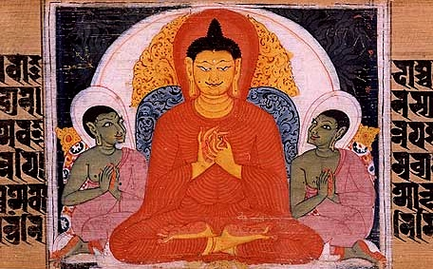
The 4 Noble Truths

Slide 11
1. Suffering exists
2. Origin of suffering
3. The end of suffering
From birth to death everything is dukkha (suffering).
The root of suffering is because we crave for things.
The realisation that the end of suffering comes when we eliminate all human cravings.
4. The path to end suffering
The eight-fold path leads to full realisation of Nirvana.
It involves Karma

Slide 12
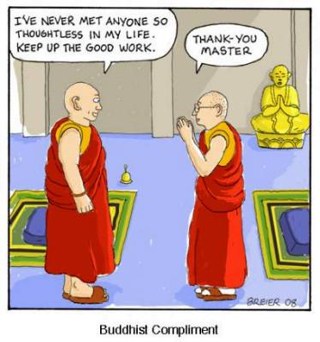
Karma and Nirvana
Nirvana
Karma
Buddhist karma usually refers to a wilful action that grows out of your cravings.
Because cravings lead to suffering, even though you have done something good, suffering will always follow.
Even worse, the effects of your wilful action (karma) will not end at death, but will lead to rebirth and thus further dukkha (suffering)
Solution: The perfect Buddhist will live without any craving whatsoever, even a craving to do good. No craving = no karma = no rebirth = problem solved.
Nirvana is the extinguishing of all desire, fully realising that ‘self’ does not exist.
Nirvana is neither positive nor negative. It is just the truth, said Buddha

Slide 13
Student Activity: Understanding Nirvana
Task 2: Research the 4 levels of Nirvana. Name them and explain what each level is.
Task 1: Identify how those who have reached Nirvana will react to the following situations and explain why.
Poverty - ________________________________________
Personal insults - ________________________________________

Slide 14
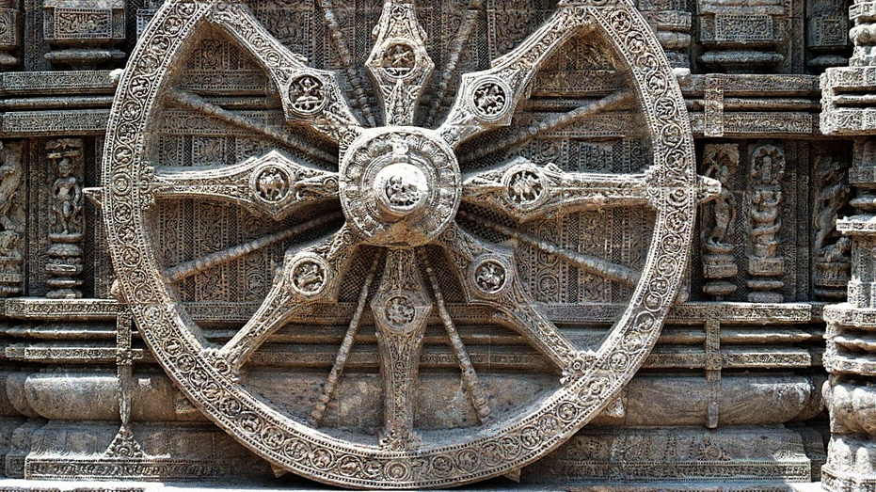
The Eightfold Path

Slide 15
1. Right Understanding
2. Right Aim
3. Right Speech
4. Right Action
5. Right Livelihood
6. Right Effort
7. Right Mindfulness
8. Right Concentration

Slide 16
What it looks like: These actions are to ensure consistency with the removal of desire and eradication of ‘self’
Studying the sacred texts
Aspire to Buddhist ideals
Refrain from lying, slander
No dishonesty, no alcohol, no illegitimate sexual activities
Choose a profession that does no harm
Energetic diligence to daily remove unwholesome states of mind
Strive to be aware of everything going on around. Every breath, sensation, emotion
Meditation to enhance the powers of concentration. Meditation should be done in every daily activity, from walking to using the toilet.

Slide 17
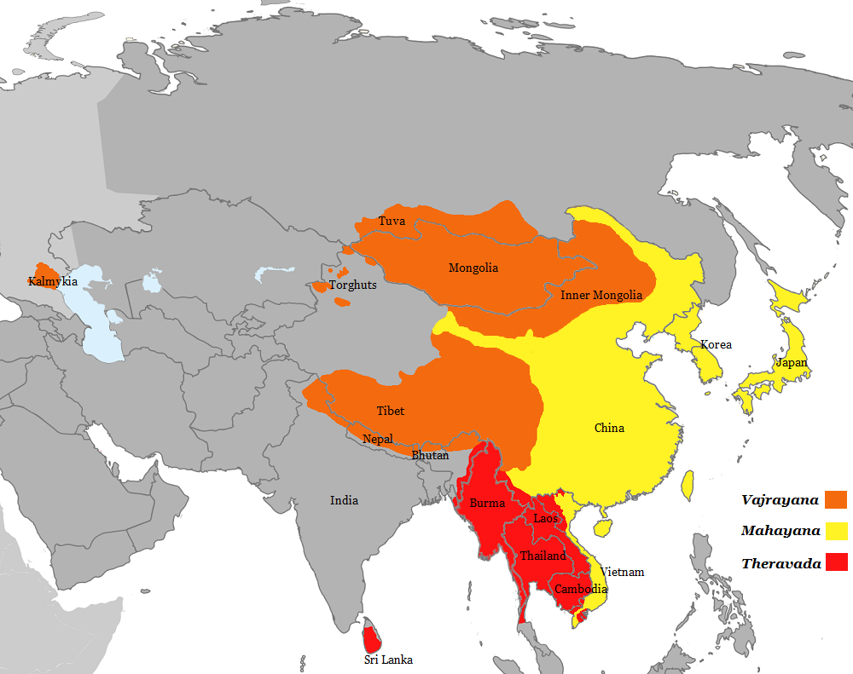
Two main schools of Buddhism

Slide 18
Theravada Buddhism
The Three Baskets is written in the Pali language
Overview
‘School of Elders’
Make up 38% of Buddhists
Emphasis the historical man Gautama and shuns the mystical.
Distinguishing
Small collection of Scriptures
Everything is within you
No gods or worship
Monks and laymen
there is a distinction between them.
no divine beings. Tends to be atheistic
Nirvana is experienced through individual human effort
Holy book is the ‘Three Baskets”. It contains rules for living in a monastery, sayings of Buddha, and philosophical reflections

Slide 19
Mahayana Buddhism
Overview
“The Great Vehicle”
Make up 56% of Buddhists
Buddha is a saviour figure
Distinguishing
Large selection of Scriptures
A celestial Buddha
Delaying Nirvana: The Bodhisattva-path
Emphasise postponing Nirvana to save others
Includes the writings of monks who through meditation received revelations from the Buddha revealing truths.
Gautama was an incarnation of a celestial, heavenly Buddha who exists throughout time.
Those who could attain Nirvana choose to continue the cycle of rebirth in order to teach the world of the Buddha.

Slide 20
End

