Slide 1
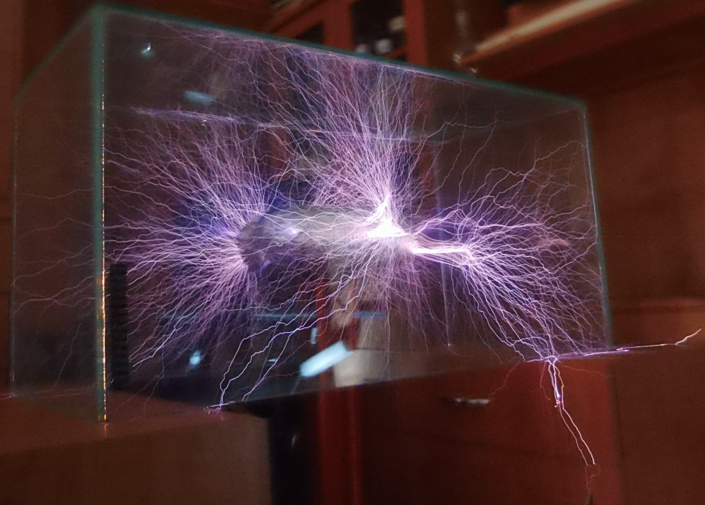
Static and Current Electricity

Slide 2
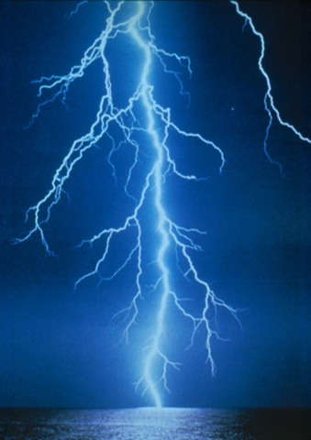
Quiz:
A bolt of lightning:
Is 5cm wide
True
Is less than 20,000 degrees Celsius
False: 30,000 degrees
Is the main source of plasma on earth
True
Could power a 25 watt light globe for 6 months
False: Could power it for a year!

Slide 3
Quiz:
Lightning kills 24,000 people per year
True
Can reach 5km in length
False: Can reach 8km in length
Contains 100 million volts
True
Can happen in volcanoes, forest fires and snowstorms
True

Slide 4
General Information

Slide 5
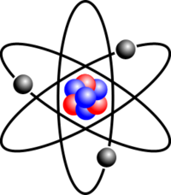
What is electricity?
A form of energy caused by the movement of electrons
Atoms made of protons (+), neutrons and electrons (-)
Electrons can be knocked off one atom and transferred to the next

Slide 6
Your turn…
Complete question 1 & 2 on your worksheet.

Slide 7
Movie…
Twig- Static Electricity
https://www.twig-world.com/film/static-electricity-1543/

Slide 8
Static Electricity

Slide 9
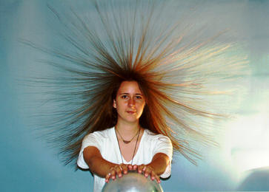
Static electricity
What is it?
It is the build up of electrical charge on a surface
Usually due to one surface rubbing against another, rubbing the electrons off one (making it positive) onto the other (making it negative)

Slide 10
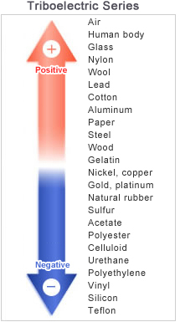
Triboelectric Series
Those at the top tend to become more positively charged.
Those at the bottom tend to be come more negatively charged.

Slide 11
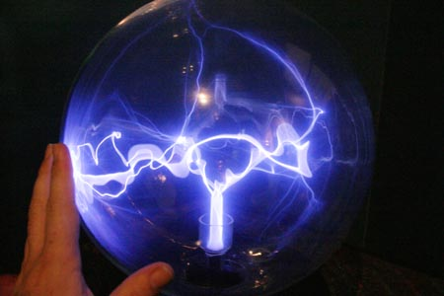
The charge usually leaks away after some time into the surroundings.
If the build up continues, the electrons may jump across a gap from the negative to the positive surface.
This converts the energy into heat, light, sound and motion (basically a mini lightning bolt)

Slide 12
Movie
Twig- Lightning
https://www.twig-world.com/film/glossary/lightning-593/

Slide 13
Your turn…
Complete question 3 on your worksheet
In groups of 3-4:
Get a balloon and rub it on your blazer
Now look at the effects the charged balloon has on
a. your hair
b. a thin stream of tap water
c. some small bits of cut up paper
Demo: Van der Graaf Generator
Twig Video: Van der Graf Explanation.

Slide 14
Your turn…
Go to the following link to see how static electricity works:
https://phet.colorado.edu/sims/html/balloons-and-static-electricity/latest/balloons-and-static-electricity_en.html
Go to the following link and use your new knowledge of static electricity to complete the game:
https://phet.colorado.edu/en/simulation/electric-hockey

Slide 15
Current Electricity

Slide 16
Movie:
Twig- Electric Current:
https://www.twig-world.com/film/glossary/electric-current-660/

Slide 17
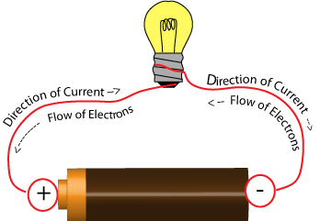
Current electricity
The electricity you get from a battery or electrical point is not static electricity
It is electrons moving along a wire. This is called a current
These moving electrons have energy that is transferred into other forms as they go through components (e.g. light globes)
Shout-out to Benjamin Franklin for the confusion by labelling the direction of current ‘incorrectly’.

Slide 18
Your turn…
Answer question 4 and 5 on your worksheets.

