Slide 1
Introduction to Christianity

Slide 2
Introduction

Slide 3
Introduction Activity
Equipment:
Instructions:
Telephone Pictionary Handout
Pencil/Pen
This game is similar to Chinese whispers, but it includes a writing down and a drawing stage.

Slide 4
Is the Bible Reliable

Slide 5
Historical Verifiability supports the validity of the New Testament

Slide 6
The New Testament is constantly under attack, and its reliability and accuracy are often contested by critics. If the critics want to disregard the New Testament, then they must also disregard other ancient writings by Plato, Aristotle, and Homer. This is because the New Testament documents are better-preserved and more numerous than any other ancient writings. Because they are so numerous, they can be cross checked for accuracy . . . and they are very consistent.
There are presently 5,686 Greek manuscripts in existence today for the New Testament. If we were to compare the number of New Testament manuscripts to other ancient writings, we find that the New Testament manuscripts far outweigh the others in quantity.

Slide 7
Historical Verifiability
Author | Date Written | Earliest Copy | Approximate Time Span between original & copy | Number of Copies | Accuracy of Copies
Lucretius | died 55 or 53 B.C. |  | 1,100 yrs. | 2 | ----
Pliny | A.D. 61-113. | A.D. 850. | 750 yrs. | 7 | ----
Plato | 427-347 B.C. | A.D. 900. | 1,200 yrs. | 7 | ----
Demosthenes | 4th Cent. B.C. | A.D. 1100. | 800 yrs. | 8 | ----
Herodotus | 480-425 B.C. | A.D. 900. | 1,300 yrs. | 8 | ----
Suetonius | A.D. 75-160. | A.D. 950. | 800 yrs. | 8 | ----
Thucydides | 460-400 B.C. | A.D. 900. | 1,300 yrs. | 8 | ----
Euripides | 480-406 B.C. | A.D. 1100. | 1,300 yrs. | 9 | ----
Aristophanes | 450-385 B.C. | A.D. 900. | 1,200 yrs. | 10 | ----
Caesar | 100-44 B.C. | A.D. 900. | 1,000 yrs. | 10 | ----
Livy | 59 BC-A.D. 17 | ---- | ??? | 20 | ----
Tacitus | circa A.D. 100. | A.D. 1100. | 1,000 yrs. | 20 | ----
Aristotle | 384-322 B.C. | A.D. 1100. | 1,400 yrs. | 49 | ----
Sophocles | 496-406 B.C. | A.D. 1000. | 1,400 yrs. | 193 | ----
Homer (Iliad) | 900 B.C. | 400 B.C. | 500 yrs. | 643 | 95%
New Testament | 1st Cent. A.D. (A.D. 50-100) | 2nd Cent. A.D. (c. A.D. 130 f.) | less than 100 years | 5600 | 99.5%

Slide 8
As you can see, there are thousands more New Testament Greek manuscripts than any other ancient writing. The internal consistency of the New Testament documents is about 99.5% textually pure. That is an amazing accuracy. In addition, there are over 19,000 copies in the Syriac, Latin, Coptic, and Aramaic languages. The total supporting New Testament manuscript base is over 24,000.
Almost all biblical scholars agree that the New Testament documents were all written before the close of the First Century. If Jesus was crucified in A.D. 30., then that means the entire New Testament was completed within 70 years. This is important because it means there were plenty of people around when the New Testament documents were penned--people who could have contested the writings. In other words, those who wrote the documents knew that if they were inaccurate, plenty of people would have pointed it out.

Slide 9
Historians support the existence of Jesus Christ
“I am an historian, I am not a believer, but I must confess as an historian that this penniless preacher from Nazareth is irrevocably the very center of history. Jesus Christ is easily the most dominant figure in all history.”
- H. G. Wells

Slide 10
From the writings of Senator Tacticus on the History of the Roman Empire
Roman Historian Tacitus:
“Nero fastened the guilt ... on a class hated for their abominations, called Christians by the populace. Christus, from whom the name had its origin, suffered the extreme penalty during the reign of Tiberius at the hands of ... Pontius Pilatus, and a most mischievous superstition, thus checked for the moment, again broke out not only in Judaea, the first source of the evil, but even in Rome....”
Notes:
Alexander the Great – Has no primary sources of reference to his existence/works.

Slide 11
Archaeological Finds Support the accuracy Bible

Slide 12
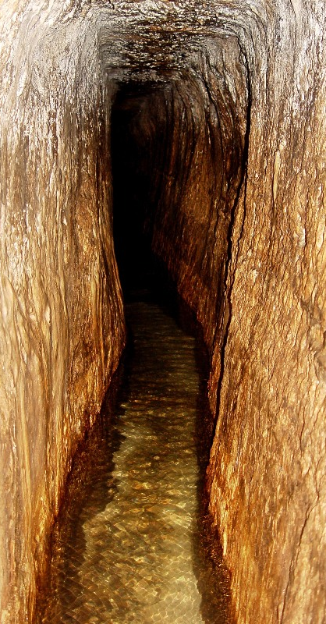
Some of many examples
Hezekiah’s Siloam tunnel – A 580 meter tunnel described in 2 Kings 20 and 2 Chronicles 32 as being dug to prevent the Assyrians from cutting off the water supply can be found today. The inscription describes the process of how the tunnel was dug from both sides.
Existence of Hittites (Genesis 23 and 2 Samuel) – 1906 the ruins of Hattusas, the Hittite capital, were uncovered which included extensive Hittite historical records.
The cities of Jericho, Haran, Hazor, Magiddo, have been excavated, many based on the geographical markers found in the Bible.
In 2005 the Pool of Siloam was discovered when installing new sewerage tunnels…

Slide 13
Eye Witness Accounts

Slide 14
Eye Witness Accounts
Matthew, Mark, Luke, John, and Peter write about what they saw.
They detailed the places they were at.
They also detail many people who lived during that time who saw it as well.

Slide 15
Scientific Reliability of the Bible It’s not a Science book, but great scientists have studied it and consider it dependable.
“This most beautiful system of the sun, planets and comets, could only proceed from the counsel and dominion of an intelligent and powerful Being.”
― Isaac Newton, The Principia: Mathematical Principles of Natural Philosophy

Slide 16
Prophesies – Accumulated Evidence supports authenticity of Jesus.
Notes:
While some prophesies are powerful in and of themselves. The prophesies are strongest as a whole since the Bible claims to be the word of God himself.

Slide 17
Old Testament vs New Testament
Notes:
While some prophesies are powerful in and of themselves. The prophesies are strongest as a whole since the Bible claims to be the word of God himself.

Slide 18
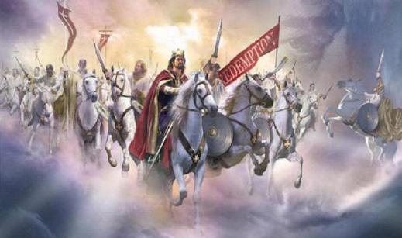
What the Jews thought . . .
Notes:
While some prophesies are powerful in and of themselves. The prophesies are strongest as a whole since the Bible claims to be the word of God himself.

Slide 19
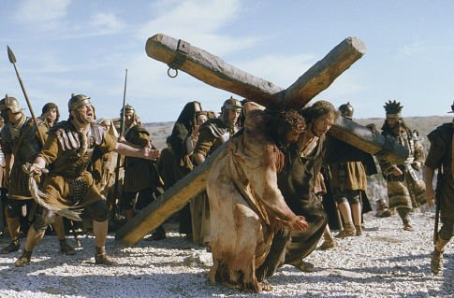
What God meant
Notes:
While some prophesies are powerful in and of themselves. The prophesies are strongest as a whole since the Bible claims to be the word of God himself.

Slide 20
Notes:
While some prophesies are powerful in and of themselves. The prophesies are strongest as a whole since the Bible claims to be the word of God himself.

Slide 21
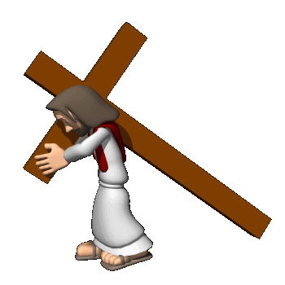
What did Jesus Claim?
25 BC
0
25 AD
Important Names Jesus Claimed:
Messiah = Promised saviour
LORD = God
Christ = Chosen by God

Slide 22
Christianity in 2 minutes
Overview
Notes:
Youtube Video: What is Christianity - https://www.youtube.com/watch?v=Ut-UOhY0s8E

Slide 23
Questions to Discuss
How do you think the game we played helps support the first point under the historical reliability of the Bible.
Why are multiple eyewitness accounts useful?
What is the purpose of the Old Testament?
What did Jesus claim?
Why did the Jewish leaders not like Jesus?

Slide 24
Introduction to the Book of Acts
Written sometime between 60 AD – 100 AD
Authored by Luke who was a well educated Gentile and a physician by profession.
Purpose:
Present a historical account
Give a defence of Christianity
Triumph Christianity in the face of persecution.

Slide 25
The End

